Slide 1

5G NR Advanced Training

Slide 2
Contents
Module 1: 4G-5G RAN System Description
• 1.1 Overview of 4G LTE and 5G NR
o Evolution from 4G to 5G technologies
o System architecture and components of 4G-5G RAN
• Interworking of 4G and 5G RAN
o Coexistence and interoperation strategies
o Dual-connectivity solutions

Slide 3

Overview of 4G LTE and 5G NR

Slide 4
Key Technical Differences: 4G (LTE-Advanced) vs. 5G (NR)
4G LTE-Advanced
5G New Radio (NR)
Designed for People & Mobile Broadband
Designed for Everything (People, Machines, Industry)
Monolithic Architecture
Flexible Service-Based Architecture
Enhanced Mobile Broadband
eMBB
URLLC
mMTC
Enhanced Mobile
Ultra-Reliable
Massive Machine
Single Service Category
Broadband
Low-Latency
Type Communications
• High-speed mobile internet
4K/8K Video, AR/VR
Autonomous, Surgery
IoT, Smart Cities
• Smartphones & tablets focus
• Up to 1 Gbps peak speeds
Network Slicing Architecture
eMBB Slice
URLLC Slice
mMTC Slice
Primary Use Cases
Diverse Use Cases
Auto Car
Industry
VR/AR
IoT
Smart City
Phone
Tablet
Video
Advanced Technical Specifications
Technical Specifications
• Latency: <1ms (URLLC)
• Device Density: 1M/km²
• Latency: 10-50ms
• Device Density: 100,000/km²
• Peak Speed: 20 Gbps
• Energy Efficiency: 100x better
• Peak Speed: 1 Gbps
• Energy Efficiency: Baseline
• Frequency: Sub-6 GHz + mmWave
• Network Slicing: Full support
• Frequency: Sub-6 GHz
• Network Slicing: Limited
• Beamforming: Advanced MIMO
• Edge Computing: Native
Paradigm Shift
Fundamental Transformation
From single-purpose mobile broadband
to multi-service connectivity platform
enabling Society 5.0 and Industry 4.0

Slide 5
Core Network Architecture: 4G EPC vs 5G Core
4G EPC (Evolved Packet Core)
5G Core (5GC)
Hardware-Based • Rigid Architecture • Dedicated Appliances
Cloud-Native • Service-Based Architecture • Network Slicing
Physical Hardware Infrastructure
Cloud-Native Infrastructure (VNFs/CNFs)
Service-Based Architecture (SBA)
MME
S-GW
P-GW
HSS
AMF
SMF
UPF
UDM
Mobility Management
Serving Gateway
PDN Gateway
Home Subscriber
Entity
Server
Access & Mobility
Session Management
User Plane
Unified Data Mgmt
Dedicated Hardware
Dedicated Hardware
Dedicated Hardware
Dedicated Hardware
Software VNF
Software VNF
Software VNF
Software VNF
PCRF
OCS
PCF
AUSF
NRF
Policy Control &
Online Charging
Policy Control
Authentication
NF Repository
Charging Rules
System
Software VNF
Software VNF
Software VNF
Dedicated Hardware
Dedicated Hardware
API-Based Communication
Network Slicing - Multiple Virtual Networks
EPC Limitations
eMBB Slice
High Bandwidth | Medium Latency
Isolated Virtual Network
• Fixed hardware-based network functions
• Monolithic architecture
URLLC Slice
Ultra-Low Latency | High Reliability
Isolated Virtual Network
• Limited scalability and flexibility
• Vendor lock-in issues
• Single service type optimization
• Difficult to upgrade/modify
mMTC Slice
Low Power | Massive Connectivity
Isolated Virtual Network
• No network slicing capability
• High CAPEX/OPEX costs
5GC Advantages
• Cloud-native virtualized functions (VNFs/CNFs)
• Vendor-agnostic and interoperable
• Service-based architecture with APIs
• Reduced CAPEX/OPEX costs
• Dynamic scaling and programmability
• Edge computing integration
• Multiple service support via network slicing
• Rapid innovation and deployment

Slide 6
Latency Revolution: 4G vs 5G Technical Architecture
Latency Performance Comparison
Three Key Technical Innovations
4G: 30-50ms
50x Improvement
Flexible Numerology
Edge Computing
Streamlined Protocol
4G
Mini-slots & Dynamic TTI
MEC Integration
Optimized Stack
Ultra-fast transmission
Reduced round-trip time
Reduced processing
5G
<1ms
Impact: Enables real-time control, autonomous vehicles, remote surgery, industrial automation
Innovation 1: Flexible Numerology
Innovation 2: Edge Computing Integration (MEC)
Innovation 3: Streamlined Protocol Stack
4G LTE: Fixed 1ms TTI
4G: Centralized Cloud Processing
4G LTE Stack
5G NR Stack
1ms slots (fixed)
UE
Long Round-trip: 30-50ms
Cloud
Application
Application
5G NR: Variable TTI + Mini-slots
IP
IP
Optimized processing
5G: Multi-access Edge Computing (MEC)
PDCP
Multiple processing steps
PDCP/RLC
Reduced overhead
Mini-slots (0.125-0.5ms)
Standard slots
RLC
Complex header handling
MAC
Streamlined headers
UE
<1ms
MEC
Optional
Cloud
MAC
Legacy overhead
Hardware acceleration
URLLC: Ultra-fast mini-slots enable <1ms latency
PHY
PHY
Real-World Impact: Applications Enabled by Ultra-Low Latency
Autonomous Vehicles
Remote Surgery
Industrial Robots
AR/VR
Smart Grid
Cloud Gaming
Split-second decisions
Haptic feedback
Real-time control
Immersive experience
Instant response
Zero lag experience
5G's sub-millisecond latency transforms networks from human-centric to machine-centric infrastructure
Enabling real-time applications that were impossible with previous generations

Slide 7
Spectrum Revolution: 4G vs 5G Frequency Usage & Bandwidth
5G FR1 (Sub-6 GHz)
Electromagnetic Spectrum Utilization
5G FR2 (mmWave)
4G Range
600 MHz
2.6 GHz
6 GHz
24 GHz
52 GHz
4G LTE Spectrum (Sub-6 GHz Only)
5G NR Spectrum (Multi-band Approach)
Frequency Range: 600 MHz - 2.6 GHz
FR1 (Sub-6 GHz): 450 MHz - 6 GHz
FR2 (mmWave): 24 GHz - 71 GHz
Band 12
Band 2
Band 7
Band 41
n71: 600MHz
n41: 2.5GHz
n78: 3.5GHz
n257: 28GHz
n260: 39GHz
n261: 28GHz
700 MHz
1900 MHz
2600 MHz
2500 MHz
Bandwidth Limitations:
Coverage: Wide area | Speed: 100 Mbps - 4 Gbps
Coverage: Short range | Speed: 1-20 Gbps
Bandwidth: Up to 100 MHz per carrier
Bandwidth: 100-400 MHz per carrier
Maximum: 20 MHz per carrier
Carrier Aggregation: Up to 5 carriers = 100 MHz total
5G Peak Theoretical Speeds
Peak Theoretical Speed: ~1 Gbps (with carrier aggregation)
FR1: Up to 4 Gbps
FR2: Up to 20 Gbps
Typical Real-world: 50-150 Mbps
Combined theoretical maximum: 20+ Gbps (100x faster than 4G)
Coverage vs Speed Trade-off Analysis
Range: 5-30 km | Speed: 50-150 Mbps
Range: 1-10 km | Speed: 100 Mbps - 4 Gbps
Range: 200-500m | Speed: 1-20 Gbps
4G Coverage
5G FR1 Coverage
5G FR2 Coverage
Blocked
Tree
Wall
Optimal Use Cases by Frequency Band
4G Sub-6 GHz
5G FR1 Sub-6 GHz
5G FR2 mmWave
5G Hybrid Deployment
• Wide area mobile broadband
• Enhanced mobile broadband
• Ultra-high-speed hotspots
• Seamless handover
• Voice calls and messaging
• 4K/8K video streaming
• Stadium/venue connectivity
• Coverage + Capacity
• Video streaming (HD)
• IoT and smart cities
• Industrial automation
• Future-ready networks
Spectrum Evolution: From Limited Sub-6 GHz to Comprehensive Multi-band Architecture

Slide 8
Radio Access & Antenna Technology Evolution: 4G MIMO vs 5G Massive MIMO
4G LTE Radio Access & MIMO Technology
5G NR Radio Access & Massive MIMO Technology
Fixed OFDMA • Limited Antennas • Omnidirectional Coverage
Flexible OFDMA • Massive Arrays • Precision Beamforming
4G Radio Access: Fixed OFDMA
5G Radio Access: Flexible OFDMA with Multiple Numerologies
Subcarrier Spacing: Fixed 15 kHz
Limitations:
Variable Subcarrier Spacing: 15 kHz - 120 kHz
Advantages:
• Single numerology (15 kHz only)
• Service-specific optimization
• Not optimized for diverse services
• Dynamic adaptation
• Limited flexibility
15 kHz (Coverage)
30 kHz (Balanced)
120 kHz (URLLC)
• Ultra-low latency support
15 kHz spacing (rigid structure)
• Higher latency for URLLC
• Improved spectral efficiency
4G MIMO: 2x2, 4x4, or 8x8 Antenna Configuration
5G Massive MIMO: 32, 64, 128+ Antenna Arrays with Beamforming
8 Antennas (Maximum)
Signal Characteristics:
128+ Antenna Array
Beamforming Benefits:
• Broadcasting in all directions
Beam 3
• Focused signal energy
• Signal interference between users
Beam 1
• Reduced interference
Base Station
User 3
• Limited spatial multiplexing
Base Station
User 3
• Higher signal quality
User 1
• Energy waste in unused directions
User 1
• Increased capacity
• Reduced spectral efficiency
• Energy efficiency
Beam 2
• Spatial multiplexing
Omnidirectional Coverage
User 2
User 2
Technical Comparison: MIMO vs Massive MIMO
Aspect
4G MIMO
5G Massive MIMO
Improvement Factor
Antenna Count
2-8 antennas
32-128+ antennas
16x-64x more
Signal Precision
Omnidirectional
Precision beamforming
10x better targeting
Spectral Efficiency
30 bps/Hz
100+ bps/Hz
3-5x improvement
Energy Efficiency
Baseline
100x better per bit
100x improvement
Concurrent Users
Tens per cell
Hundreds per cell
10x more users
Key Enabling Technologies
Advanced DSP
AI/ML Optimization
Hardware Innovation
Network Intelligence
Cloud RAN
• Real-time beamforming
• Predictive beamforming
• Miniaturized antennas
• Self-organizing networks
• Centralized processing
• Channel estimation
• Dynamic optimization
• Low-power RF chains
• Adaptive algorithms
• Flexible deployment
• Interference cancellation
• User behavior prediction
• Massive arrays
• Resource optimization
• Cost optimization
The Antenna Revolution: From Broadcasting to Precision Targeting
Massive MIMO transforms wireless from "spray and pray" to surgical precision, enabling unprecedented capacity and efficiency

Slide 9
System architecture and components of 4G-5G RAN

Slide 10
5G Core Network: Key Design Principles & Paradigm Shifts
1. Service-Based Architecture (SBA)
4G EPC (Legacy)
5G Core - Service-Based Architecture
MME
S1
SGW
S11
PGW
Evolution
Network Functions (NFs):
Key Benefits:
💡 Analogy: Web Services
AMF
SMF
UDM
PCF
• Microservices Architecture
NFs communicate like web services - they don't need to
Point-to-Point Interfaces
• Standardized APIs (HTTP/2 + JSON)
know each other's internal workings, just how to call
Rigid • Protocol-Specific
Service Bus (HTTP/2 + REST APIs)
• Modular & Scalable
the right API for the service they need.
Hard to Add New Services
• Easy to Add New Services
2. Control & User Plane Separation (CUPS)
Control Plane (CP)
User Plane (UP)
🎯 CUPS Benefits
"THE BRAIN"
SEPARATED
"THE WORKHORSE"
✓ Reduced Latency:
UPF can be placed at network edge (factories, city centers)
AMF
SMF
PCF
UPF
✓ Flexible Scaling:
Scale CP and UP independently based on traffic demands
Signaling • Management
User Data Traffic
✓ Cost Optimization:
Deploy UP functions only where needed
Decision Making • Authentication
Video • Web • Streaming
✓ Service Innovation:
Enable edge computing and ultra-low latency services
Centralized Location
Distributed • Edge Deployment
🏭 Use Case:
Factory automation, AR/VR, autonomous vehicles
3. Cloud-Native Design
Virtualized/Containerized
Stateless Design
🚀 Cloud-Native Benefits & Capabilities
Docker
K8s
VM
NF
state
UDR
🔄 High Resilience:
💰 Cost Efficiency:
Instance
Central Store
• NF instance fails → Another takes over instantly
• Pay-as-you-use cloud resources
• Run on Cloud Infrastructure
• No session data lost (stored in UDR)
• Resource sharing across multiple services
• Private/Public/Hybrid Cloud
NF
state
📈 Dynamic Scaling:
🔧 DevOps Integration:
• Kubernetes Orchestration
Instance
• Auto-scale based on traffic demand
• CI/CD pipelines for rapid deployment
• Dynamic Scaling
Session state stored centrally
• Spin up/down NF instances as needed
• Infrastructure as Code (IaC)
• Resource Optimization
Any instance can handle any request
⚡ Result: Dramatic improvement in resilience, scalability, and operational efficiency

Slide 11
5G NSA Core Network Architecture
Non-Standalone Architecture with Separated Control/User Planes
UE
User Equipment
Dual Connectivity
Control Plane
EPC (Evolved Packet Core)
EN-DC
MME
HSS
PCRF
S6a
Home
Policy and
LTE
Mobility
Charging
S1-MME
Management
Subscriber Server
S11
S5/S8-C
Gx
QoS Control
LTE eNodeB
5G gNodeB
SGW-C
PGW-C
eNB
X2 Interface
gNB
Serving Gateway
PDN Gateway
IMS
Master Node (MN)
Secondary Node (SN)
Control Plane
Control Plane
Core
Sxa
Sxb
VoLTE
RRC
PDCP
PDCP
RLC/MAC
Support
SGW-U
S5/S8-U
PGW-U
S1-U
Serving Gateway
PDN Gateway
User Plane
User Plane
SGi
Radio Access Network (RAN)
User Plane
Internet
5G NSA Key Characteristics
Dual Connectivity (EN-DC): UE connects to both LTE eNB (master) and 5G gNB (secondary)
Control/User Plane Separation (CUPS): SGW-C/SGW-U and PGW-C/PGW-U interfaces
X2 Interface: Signaling and user-plane coordination between eNB and gNB
VoLTE for Voice: Voice services use VoLTE through IMS core (not VoNR)

Slide 12
5G Core Service-Based Architecture (SBA)
(3GPP TS 23.501, TS 23.502)
UE
N1
gNB
Reference Point Architecture
Network Slicing Support
(5G NR)
Outside the bus: N1, N2, N3, N4, N6
• NSSF manages slice selection
Inside the bus: Namf, Nsmf, Npcf, etc. service-based
• Multiple instances of NFs can be deployed
N2
AMF
SMF
PCF
NEF
NRF
N3
Session Management
Policy Control
Network Exposure
Network Repository
N4
Access and Mobility
Function
Function
Function
Function
Management Function
Service-Based Interface (SBI) Bus
HTTP/2 - REST - JSON
AF
User Plane Function
UPF
Application Function
UDM
AUSF
UDR
NSSF
SMSF
N6
Unified Data
Authentication
Unified Data
Network Slice
SMS
Management
Server Function
Repository
Selection Function
Function
DN
External
(Data Network)
Application
Items in red indicate key components and interfaces in 5G Service-Based Architecture
3GPP References:
Service-Based Interface (SBI) Naming:
• TS 23.501: System Architecture for 5G System
• Each NF exposes services with its name prefix (e.g., Namf, Nsmf)
• TS 23.502: Procedures for 5G System
• RESTful APIs with HTTP/2 as transport protocol
• TS 29.500: Technical Realization of SBI
• JSON is used for information encoding
• TS 29.501: Principles and Guidelines for SBI
• OpenAPI 3.0.0 specifications available in TS 29.5xx series

Slide 13
5G CORE NETWORK ARCHITECTURE
Service-Based Architecture (SBA) | ETSI TS 123 501 Standard
Control and User Plane Separation (CUPS) • Stateless Network Functions • Microservices Architecture
UE
5G CORE NETWORK (5GC) - SERVICE-BASED ARCHITECTURE
User Equipment
• Mobile Devices
NAS Signalling
CONTROL PLANE (CP) - STATELESS NETWORK FUNCTIONS
• IoT Devices
• Connected Vehicles
N8
N10
N1
Microservices Architecture • RESTful APIs over HTTP/2 • Cloud-Native Design
(R)AN
AMF
SMF
PCF
NEF
UDM
UDR
Access & Mobility
N11
Session Management
Policy Control
Network Exposure
Unified Data
Unified Data
Radio Access Network
N2
Management Function
Function
Function
Function
Management
Repository
• 5G gNB (3GPP)
CP Signalling
• UE Registration
• PDU Session Mgmt
• Policy Rules
• API Gateway
• Subscriber Data
• Database Backend
• WiFi AP (Non-3GPP)
• Mobility Control
• UE IP Allocation
• QoS Control
• External Access
• Authentication Data
• Stateful Storage
• Fixed Access
• N1/N2 Termination
• UPF Selection
• Charging Control
• 3rd Party Services
• Subscription Info
• Persistent Data
N12
AUSF
N22
NSSF
NRF
REFERENCE POINTS
Authentication
Network Slice Selection
Network Repository
DN
Control Plane
Server Function
Function
Function
Data Network
• UE Authentication
• Slice Selection
• Service Discovery
• Internet
User Plane
• Security Context
• NSSAI Management
• NF Registry
• Enterprise Networks
Support Functions
• Credential Verification
• Network Slicing
• Service Directory
• IMS Services
Service Registration
N3
N4
SBA
• Local Services
Key Interfaces:
User Plane Traffic
CUPS Critical
Service Bus
N1: UE ↔ AMF
N2: RAN ↔ AMF
N6
N3: RAN ↔ UPF
N4: SMF ↔ UPF
Data Network Exit
N6: UPF ↔ DN
USER PLANE (UP) - STATEFUL FUNCTIONS
High-Performance Packet Processing • Real-Time Data Forwarding
UPF - User Plane Function (Stateful Data Anchor)
Packet Routing • QoS Enforcement • Traffic Steering • Data Network Interconnection

Slide 14
AMF (Access and Mobility Management Function) - Network Interactions
Key AMF Functions:
• Registration & Connection Management • Security Anchor (SEAF)
• Mobility Control • NAS Termination • SM Proxy
NSSF
PCF
Network Slice Selection
Policy Control
UE
• Slice Selection
• AM Policy
SMF
User Equipment
• AMF Selection
• UE Policy
Session Management
• NAS Protocol
• PDU Sessions
• Registration Req
NS Selection
AM Policy
• UPF Selection
NAS Protocol
N15
Communication
N1
N22
N11
AMF
Access & Mobility
Management Function
• Registration Management
• Connection Management
• Security Anchor (SEAF)
• Mobility Control
N2
N12
gNodeB
NGAP Protocol
Authentication
AUSF
UECM/SDM
5G Base Station
N8
Authentication Server
• RAN Functions
• UE Authentication
• UE Context Mgmt
• Security Keys
UDM
Unified Data Mgmt
• Subscription Data
• UE Registration

Slide 15
SMF (Session Management Function) Overview
Core Control Plane Function for PDU Session Management
Session Management
UE IP Management
UPF Selection and Control
Policy and QoS
✓ PDU Session Establishment
✓ IPv4/IPv6 Allocation
✓ UPF Selection Logic
✓ PCC Rules Translation
✓ Session Modification
✓ Static IP Management
✓ N4 Rules Installation
✓ QoS Enforcement
✓ Session Release
✓ DHCP/DN-AAA Integration
✓ Dynamic UPF Re-selection
✓ Traffic Steering
AMF
PCF
Access and Mobility
Policy Control
Management
N11
SMF
N7
Function
Session Management Function
• PDU Session Lifecycle Management
UPF
• Policy Enforcement Point
N4
• UPF Control via N4 Interface
N40
CHF
User Plane
• IP Address Management
Charging
Function
Function
As per Section 6.2.2
Core SMF Functionalities Specification
Downlink Data Management
Charging Support
SSC Management
✓ Data Notification Trigger
✓ CHF Integration
✓ SSC Mode 1, 2, 3
✓ UE Paging Coordination
✓ Usage Data Collection
✓ Session Continuity
✓ Idle Mode Handling
✓ Billing Information
✓ PDU Session Anchor

Slide 16
UPF (User Plane Function) Overview
The "Workhorse" of 5G Networks - User Plane Data Processing Engine
PDU Session Anchor
Packet Routing
Packet Inspection
Policy Enforcement
QoS Handling
✓ Gateway to Data Network
✓ RAN ↔ Data Network
✓ Deep Packet Inspection
✓ Gating and Blocking
✓ Rate Enforcement
✓ Mobility Anchor Point
✓ Advanced Forwarding
✓ Application Detection
✓ Traffic Redirection
✓ Packet Marking (QFI)
✓ IP Address Preservation
✓ UL CL / Branching Point
✓ Traffic Classification
✓ Traffic Steering
✓ Session-AMBR/MBR
Key UPF Rules
SMF
Other UPFs
📋 PDR (Packet Detection)
Control Interface
I-UPF / PSA
🔄 FAR (Forwarding Action)
Master-Slave
UPF Chaining
⚡ QER (QoS Enforcement)
N4
N9
📊 URR (Usage Reporting)
UPF
All rules provisioned
by SMF via N4
User Plane Function
Master-Slave relationship
🔧 Data Processing Workhorse
RAN
📊 Packet Routing and Forwarding
gNodeB
N3
🛡️ Policy Enforcement Engine
N6
Data Network
GTP-U Tunnel
⚡ QoS and Traffic Management
Internet / IMS
Corporate Network
Usage Reporting
Downlink Buffering
N4 Transport
CUPS Architecture
✓ Data Volume Collection
✓ CM-IDLE State Handling
✓ SMF-UPF Signaling
🧠 Control Plane: AMF/SMF (Brains)
✓ Time-based Statistics
✓ Data Notification
✓ I-SMF Scenarios
💪 User Plane: UPF (Muscle)
✓ Charging and Billing
✓ Paging Trigger
✓ Tunnel Transport
⚡ Flexible Edge Deployment
Control and User Plane Separation (CUPS) Architecture | Section 6.2.3

Slide 17
5G Radio Access Network (RAN) Architecture: The NG-RAN
5G NG-RAN Architecture: The RAN Split
Radio Unit (RU)
Cell Site / Near Cell Site
Edge Cloud / Data Center
• RF Processing
Distributed Unit (DU)
Centralized Unit (CU)
• Low-PHY Functions
Fronthaul
• Antenna Interface
• High-PHY Processing
• RRC (Radio Resource Control)
• Digital Beamforming
eCPRI/Ethernet
• MAC (Medium Access Control)
Midhaul
• PDCP (Packet Data Convergence)
Backhaul
5G Core
• RLC (Radio Link Control)
F1 Interface
• Non-real-time Processing
NG Interface
Network
• Real-time Processing
• Higher-layer Protocols
• Low-latency Functions
• Centralized Intelligence
Key Benefits of RAN Split Architecture
Flexibility & Scalability
Cost Optimization
Performance Enhancement
• Independent scaling of components
• Reduced CAPEX through centralization
• Ultra-low latency applications
• Vendor-agnostic deployments
• Lower OPEX with automation
• Enhanced mobile broadband
• Cloud-native architectures
• Shared infrastructure resources
• Massive IoT connectivity
• Network slicing support
• Energy efficiency improvements
• Advanced interference management
Technical Notes:
• Fronthaul: High-bandwidth, low-latency connection using eCPRI over Ethernet or fiber
• Midhaul: F1 interface enabling flexible placement of CU functions
• This architecture enables Open RAN implementations and multi-vendor ecosystems

Slide 18
CU-DU Split in 5G Architecture
Key Benefits for Network Deployment and Performance
To 5G Core Network
Edge Data Center / Regional Hub
Cell Site
Centralized Unit (CU)
Distributed Unit (DU)
RRC, PDCP
F1 Interface
RLC, MAC, High-PHY
Control Plane Functions
Real-time Processing
Scheduling, HARQ
CU-CP
CU-UP
Radio Unit (RU)
Low-PHY, RF
To UE
Benefits of CU-DU Split
Flexibility
Scalability
Edge Computing
Deploy functions where they
CU and DU resources can be
Place DU and UPF close to users
make the most sense
scaled independently based
Significantly reduces latency
(centralized CU, distributed DU)
on specific requirements
for URLLC applications
Resource Pooling
Virtualization (vRAN/Open RAN)
Centralized CU allows efficient
Standardized F1 interface enables multi-vendor environments
coordination across multiple
CUs and DUs from different suppliers can potentially interoperate
DUs/cells
Facilitates vRAN and O-RAN deployments

Slide 19

What is Dual Connectivity?
SeNB
SCG PSCell [Carrier 3]
SCG Secondary
Cell
Group
SCG Scell [Carrier 4]
MeNB
MCG Master
Cell
Group
MCG SCell [Carrier 2]
MCG PCell [Carrier 1]
Notes:
Dual Connectivity includes:
Bearer Split - in dual connectivity, this term refers to the ability to split a bearer over multiple RAN Nodes.
Split bearer: in MR-DC, a radio bearer with RLC bearers both in MCG and SCG.
Dual Connectivity - is the operation where a device consumes radio resources provided by at least two different network points (Master and Secondary) connected while in the RRC (Radio Resource Control) Connected state.
MCG (Master Cell Group) - in MR-DC, a group of serving cells associated with the Master Node, comprising of the SpCell (PCell) and optionally one or more SCells
Master RAN Node - in dual connectivity mode, this is the gNB/ng- eNB/eNB which terminates the core network connectivity and therefore acts as the mobility anchor towards the core network.
SCG (Secondary Cell Group) - is the group of serving cells associated with the Secondary RAN Node.
Secondary RAN Node - in MR-DC, the radio access node, with no control plane connection to the core network, providing additional resources to the UE. It may be an en-gNB (in EN-DC), a Secondary ng-eNB (in NE-DC) or a Secondary gNB (in NR-DC and NGEN-DC)

Slide 20










5G Core Deployment Options
Option 1 (Legacy Networks)
Option 5
Option 2
EPC
5GC
5GC
N2 | N3
NR
f₂
LTE
f₁
eLTE
f₁
Option 7
Option 4
Option 3
5GC
5GC
EPC
S1-U
S1-MME
NR
f₂
X2
NR
f
2
NR
f
2
LTE
f₁
eLTE
f₁
LTE
f₁
Deployed options depend on Use Cases/Spectrum

Slide 21
5G Network Architecture: NSA and SA
(3GPP TS 38.300, TS 37.340, TS 23.501)
Non-Standalone (NSA)
Standalone (SA)
(Option 3/3a/3x - TS 37.340)
(TS 38.300)
(PDCP/RLC/MAC)
NR-Uu
gNB (NSA)
gNB (SA)
UE
F1
UE
NR-Uu
gNB-CU-CP
gNB-CU-UP
Dual connectivity
gNB-CU
gNB-DU
SA capable
(RRC/PDCP/RLC)
E1
(Control Plane)
(User Plane)
SA Only:
RRC/PDCP-C
SDAP/PDCP-U
RRC/PDCP
RLC/MAC/PHY
• SDAP protocol
F1-C
F1-U
LTE-Uu
X2
• CU-CP/CU-UP split
(X2-C, X2-U)
• PDCP-C/PDCP-U split
gNB-DU
eNB
RLC/MAC/PHY
(4G LTE)
Master Node
NG-C
NG-U
S1
(NGAP)
(GTP-U)
(S1-MME, S1-U)
5GC (5G Core)
EPC (4G Core)
AMF
MME
SMF
PCF
S-GW
UDM
AUSF
P-GW
UPF
NRF
Network Exposure (NEF)
3GPP References:
Protocol Stack Abbreviations:
• TS 38.300: NR and NG-RAN Overall Description
• RRC: Radio Resource Control • PDCP: Packet Data Convergence Protocol
• TS 37.340: Multi-RAT Dual Connectivity (EN-DC)
• RLC: Radio Link Control • MAC: Medium Access Control
• TS 23.501: System Architecture for 5G System
• SDAP: Service Data Adaptation Protocol (SA only) • GTP-U: GPRS Tunneling Protocol

Slide 22
5G NR Standalone (SA) Architecture (Option 2)
Next Generation NodeB
User Equipment
NG-RAN
5G Core (5GC)
UE
N1
Service-Based Architecture (SBA)
Xn
gNB
N2
AMF
Access and Mobility
SBI
Other Network Functions
gNB-CU
Management Function
DN
Centralized Unit
UDM, AUSF, PCF, NRF, NSSF, NEF
UPF
Data Network
NR Uu
N3
User Plane
N6
Internet, IMS, etc.
F1
Function
SBI
gNB-DU
SMF
N4
Control Plane
Distributed Unit
Session Management
Function
User Plane
Full 5G Core + 5G RAN Implementation

Slide 23
5G Non-Standalone Architecture 3x
The Dual Connectivity and the split bearer work together in the 5G-LTE interworking.
The Control Plane will always go over the LTE layer.
The data bearers to the DC-enabled UE can go over LTE or over 5G.
PDCP layer splitting point
SgNB
SgNB
DC UE
S1-U
X2
S1-U
S1-C
MeNB
EPC
Split bearer – Control Plane
Split bearer – User Plane

Slide 24
LTE - 5G Non-Standalone (NSA) Architecture Option 3x interworking
EPC
P-GW
The Non-Standalone Architecture uses (reuses) the concept of split bearer.
The split bearer is a data bearer that is set up between two nodes (here: between LTE S-GW and 5G SgNB), but at the PDCP level the actual data can be split and sent over two different channels (here: 5G radio and LTE radio via X2 relay).
The PDCP layer at the UE will take care of reordering the received packets.
MCG Bearer
SCG Bearer Split
S5
MME
S11
S-GW
NR PDCP
NR PDCP
NR PDCP
RLC
RLC
NR RLC
NR RLC
S1-C
S1-U
S1-U
MAC
NR MAC
NR MAC
X2-C
MeNB
SgNB
MeNB
SgNB
X2-U
Uu
The data bearer that goes over 5G radio can be split and sent partially over 5G radio and partially over LTE radio (with data packets relayed over X2 connection).
UE

Slide 25
Option 3 EN-DC
Option 3
Option 3A
Option 3X
Bearer split at master Node
Independent bearer at second Node
Bearer split at Secondary Node
EPC
EPC
EPC
S1-C
S1-U
S1-C
S1-U
S1-U
S1-C
S1-U
S1-U
X2-C
X2-C
X2-C
PDCP
PDCP
PDCP
NR PDCP
PDCP
NR PDCP
NR PDCP
X2-U
X2-U
RLC
RLC
RLC
RLC
NR RLC
RLC
RLC
NR RLC
NR RLC
MAC
MAC
MAC
NR MAC
MAC
NR MAC
LTE eNB
gNB
LTE eNB
gNB
LTE eNB
gNB
Core Network is EPC, LTE act as a MN, gNB act as SN.
Notes:
In MR-DC, the UE has a single RRC state, based on the MN RRC and a single C-plane connection towards the Core
Each radio node has its own RRC entity (E-UTRA version if the node is an eNB or NR version if the node is a gNB) which can generate RRC PDUs to be sent to the UE.
RRC PDUs generated by the SN can be transported via the MN to the UE.
The MN always sends the initial SN RRC configuration via MCG SRB (SRB1), but subsequent reconfigurations may be transported via MN or SN.
When transporting RRC PDU from the SN, the MN does not modify the UE configuration provided by the SN.
Option 3X
In E-UTRA connected to EPC, at initial connection establishment SRB1 uses E-UTRA PDCP. If the UE supports ENDC, regardless whether EN-DC is configured or not, after initial connection establishment, MCG SRBs (SRB1 and SRB2) can be configured by the network to use either E-UTRA PDCP or NR PDCP (either SRB1 and SRB2 are both configured with E-UTRA PDCP, or they are both configured with NR PDCP)
Change from E-UTRA PDCP to NR PDCP (or vice-versa) is supported via a handover procedure (reconfiguration with mobility) or, for the initial change of SRB1 from E-UTRA PDCP to NR PDCP, with a reconfiguration without mobility before the initial security activation
If the SN is a gNB (i.e. for EN-DC, NGEN-DC and NR-DC), the UE can be configured to establish a SRB with the SN (SRB3) to enable RRC PDUs for the SN to be sent directly between the UE and the SN. RRC PDUs for the SN can only be transported directly to the UE for SN RRC reconfiguration not requiring any coordination with the MN. Measurement reporting for mobility within the SN can be done directly from the UE to the SN if SRB3 is configured.
In EN-DC, the SCG configuration is kept in the UE during suspension. The UE releases the SCG configuration (but not the radio bearer configuration) during resumption initiation.
In MR-DC with 5GC, the UE stores the PDCP/SDAP configuration when moving to RRC Inactive but it releases the SCG configuration.

Slide 26





X2 Setup
SGW
MME
The feature introduces the S1-U, X2-U, X2-C interfaces over IPv4/IPv6 for the 5G gNB
The S1-U interface is used for the user data transport between the S-GW and the 5G Node B. It is based on GTP-U over UDP/IP (see TS 36.414). The GTPv1-U is supported (see TS 29.281).
The X2-U interface is used for the user data transport between the eNode B and at the 5G Node B. It is based on GTP-U over UDP/IP (see TS 36.414). The GTPv1-U is supported (see TS 29.281).
The X2-C interface is used for the control plane message transfer between the eNode B and the 5G Node B. The X2-C is based on the SCTP (Stream Control Transmission Protocol, see 3GPP TS 36.422).
S1U
(legacy)
S1C
(legacy)
S1U
LTE NodeB
X2-C X2-U
5G RAC
F1
5G RAU
RAC: Radio Access Cloud; CU
RAU: Radio Access Unit ; DU
RU: Radio Unit
5G RU

Slide 27
EN-DC (LTE-NR Dual Connectivity) Network Parameters & KPIs
eNodeB (MN)
MME/Core Network
UE Device
gNodeB (SN)
• endcSupportSwitch: ENABLED
S1
• DCNR Support: ENABLED
RRC
• EN-DC Capable
NR
• SSB Configuration
• featureStateEndc: ENABLED
• UE 5G NSA Subscription
• NR Band Support
• PCI, ARFCN, SCS
• X2/Xn Interface Config
• HandoverRestrictionList
• PDCP SN 12/18 bits
• RACH Parameters
• sctpPortX2/Xn
• UE Capabilities Check
• Measurement Reports
• p0-NominalPUSCH: -70 to -90 dBm
• LTE RSRP > -105 dBm
X2/Xn Interface
• p0-NominalPUCCH
• lteQualityThresholdForNrMeas
• PDCP SN Size Support
• scgInactivityTimer: 10-30s
• pdsch-HARQ-ACK-Codebook
• Release Threshold: -120 to -128 dBm
• pucch-Config/pusch-Config
• Hysteresis: 5-10 dB
• UL Power Control
NR Measurement Configuration (B1 Event)
SCG Addition Configuration
Bearer Configuration
MeasObjectNR-r15:
nr-SecondaryCellGroupConfig-r15:
Split Bearers (PDCP at MN):
• carrierFreq-r15 (ARFCN): NR frequency
• cellGroupId-r15: 1-maxSCG
• moreThanOneRLC-r15: true
• rs-ConfigSSB-r15: SSB config
• rlc-BearerToAddModListSCG-r15
• primaryPath-r15: eUTRA/nR/both
• ssb-ToMeasure: bitmap mask
• pdcp-SN-Size: len12bits/len18bits
• ul-DataSplitThreshold-r15
• ss-RSSI-Measurement: boolean
DRX Configuration:
• t-Reordering-r15: 40-150 ms
ReportConfigInterRAT (B1-NR):
• onDurationTimerSCG: 10-20 ms
SCG Bearers (PDCP at SN):
• b1-ThresholdNR RSRP: -110 to -120 dBm
• drx-InactivityTimerSCG: 100-200 ms
• High data rate non-GBR QCIs
• b1-ThresholdNR RSRQ: -16 to -20 dB
• longDRX-CycleSCG: 320-640 ms
• GBR QCIs (if NR reliable)
• hysteresis-r15: 1-3 dB (2x in IE)
RLF Timers:
MCG Bearers (LTE only):
• timeToTrigger-r15: 320-640 ms
• t310-r15: 500-1000 ms
• QCI 9 (Internet) initially
• maxReportCells-r15: 1-4
• n310-r15: n4-n6, n311-r15: n1
• Standard LTE DRB config
Key Performance Indicators (KPIs) for Monitoring
SCG Failure Analysis & Release Triggers
Setup & Connection KPIs:
Performance & Failure KPIs:
UE Initiated Failures (SCGFailureInformationNR):
• scgInactivityTimer: 10-30s
• EN-DC Setup Success Rate (target: >95%)
• SCG Drop Rate (<2% target)
• t310-Expiry: RLF timer expiration
• Poor NR Quality (<-125 dBm)
• SCG Addition Success Rate
• User Throughput (with/without EN-DC)
• randomAccessProblemSCG: RACH failure
• LTE quality degradation
• X2/Xn Interface Availability
• Session Time on NR
• rlc-MaxNumRetxSCG: RLC max retx
• Load balancing decisions
• Time to SCG Setup (<200ms target)
• SCG Failure Types Analysis
• synchReconfigFailureSCG: Reconfig fail
• Handover preparations
• RLF (t310-Expiry, RACH problems)
eNB Initiated Release Triggers:
• Inactivity Timer Expiry Rate
Optimization Guidelines & Best Practices
Coverage Optimization:
Reliability & Stability:
• B1 threshold tuning: Lower (-120 dBm) for limited NR coverage, Higher (-110 dBm) for good coverage
• RLF timers: t310 500-1000ms, n310 n4-n6, n311 n1 for balanced detection
• Hysteresis: 1-3 dB to prevent ping-pong, Time-to-trigger: 320-640ms for stability
• Release hysteresis: 5-10 dB between addition and release thresholds
Performance Tuning:
• PDCP reordering: 40-150ms for split bearers based on path delay difference
• DRX timers: Balance battery life vs latency (onDuration: 10-20ms, inactivity: 100-200ms)
• Monitor KPIs continuously: Setup success >95%, SCG drop <2%, failure type analysis
• Bearer mapping: QCI 9 start MCG→Split, High data QCIs to Split/SCG, GBR to SCG if reliable
• Vendor-specific: Consult RAN vendor documentation for exact parameter paths and ranges
• Environment-dependent: Tune based on urban/rural, indoor/outdoor, UE capabilities, traffic models

Slide 28
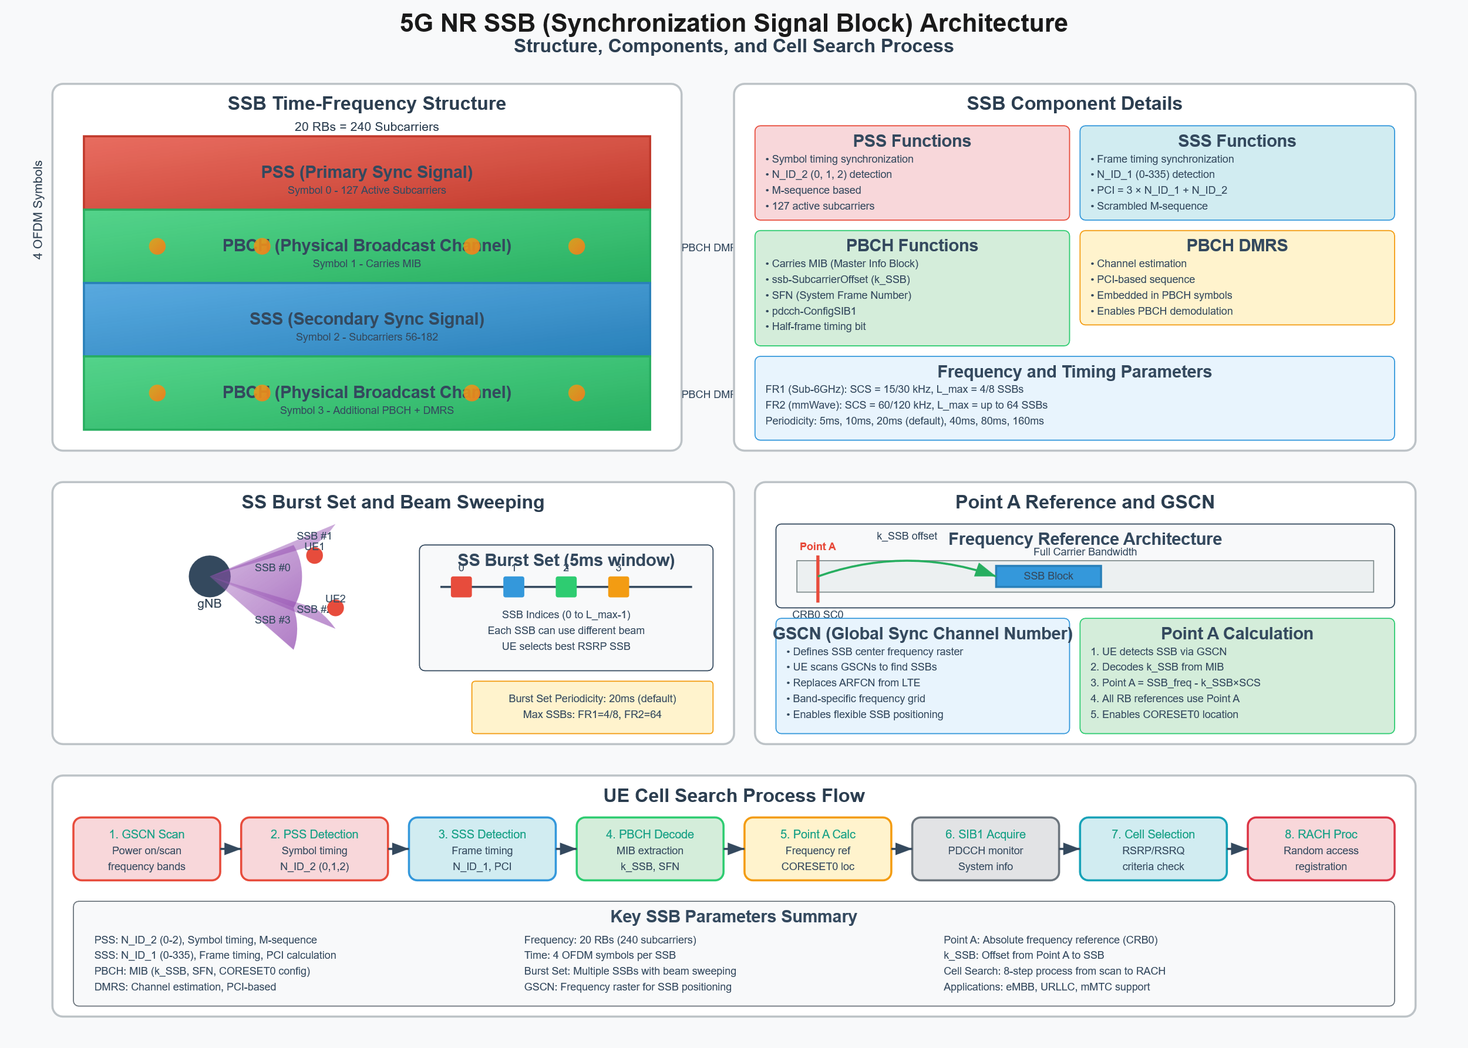

Slide 29
EN-DC Enablement and UE Capability
eNodeB Side (Master Node - MN):
Vendor-specific feature license/switch: E.g., endcSupportSwitch, featureStateEndc.
Check: Must be enabled per eNB or per cell.
Default: Often DISABLED initially.
Recommended: ENABLED on LTE cells intended as EN-DC anchors.
X2/Xn Interface Configuration:
Parameter (Conceptual): x2IpAddressListToGnb, xnIpAddressListToGnb, sctpPortX2, sctpPortXn.
3GPP IE (for X2AP/XnAP messages): Not directly a UE RRC param, but essential. ServedCellsToAdd, ServedCellsToModify in ENB CONFIGURATION UPDATE / GNODEB CONFIGURATION UPDATE.
Check: Correct IP addresses, SCTP ports, and link status to neighboring gNBs.
Default: Empty, requires manual configuration.
Recommended: All potential neighbor gNBs correctly configured and X2/Xn links operational.
MME Side (Core Network):
UE Subscription & MME Support: MME must indicate "DCNR (Dual Connectivity with NR) supported" to eNB for the UE (part of HandoverRestrictionList or UE capabilities).
Check: MME configured to allow DCNR, UE subscription includes 5G NSA service.
Default: Operator/vendor dependent.
Recommended: Enabled for 5G subscribers.

Slide 30
NR Measurement Configuration by eNB (for SCG Addition)
The eNB configures the UE to perform measurements on NR frequencies. This is typically done via an RRCConnectionReconfiguration message.
MeasConfig IE (within RRCConnectionReconfiguration):
measObjectToAddModList -> MeasObjectNR-r15: Defines what to measure.
carrierFreq-r15 (ARFCN): The NR Absolute Radio Frequency Channel Number.
Check: Correct ARFCNs of deployed NR carriers.
Default: None. Must be configured.
Recommended: List all deployed neighbor NR ARFCNs.
rs-ConfigSSB-r15 or ssb-ConfigMobilityNR-r15: SSB configuration.
ssb-ToMeasure: Bitmask indicating which SSBs to measure (can be shortBitmap, mediumBitmap, longBitmap).
ss-RSSI-Measurement: Boolean, enable/disable SSB RSSI measurement.
Check: Aligned with gNB's SSB transmission pattern (periodicity, subcarrier spacing if different from LTE).
Default: Vendor specific, often a conservative set.
Recommended: Match actual gNB SSB configuration. Use ssb-ToMeasure if specific SSBs are known to be strong/weak.
blackCellsToAddModList-r15 / whiteCellsToAddModList-r15: PCI lists for blacklisting/whitelisting specific NR cells.
Check: Useful for specific optimization or barring problematic cells.
Default: Empty.
Recommended: Use sparingly, only when necessary.
reportConfigToAddModList -> ReportConfigInterRAT: Defines how and when to report.
triggerType -> event:
eventId -> eventB1-NR-r15: Inter-RAT neighbor becomes better than a threshold.
b1-ThresholdNR-r15: Choice of nr-RSRP-r15 or nr-RSRQ-r15.
Value: Integer (-156 to -31 for RSRP, -43 to 20 for RSRQ in 3GPP units). Vendor OSS shows dBm/dB.
Check: Is the threshold appropriate for NR coverage?
Default Example (Vendor OSS): RSRP: -115 dBm; RSRQ: -18 dB.
Recommended:
RSRP: -110 to -120 dBm. Lower (e.g., -120 dBm) for more aggressive SCG addition if NR coverage is limited. Higher (e.g., -110 dBm) if NR coverage is good, to ensure a quality NR leg.
RSRQ: -16 to -20 dB.
reportOnLeave-r15: Boolean. If true, report when condition is no longer met.
hysteresis-r15: (0..30 in 0.5 dB steps).
Check: Prevents ping-pong reporting.
Default Example (Vendor OSS): 2 dB (which is hysteresis = 4 in 3GPP IE).
Recommended: 1-3 dB.
timeToTrigger-r15: (0, 40, 64, 80, 100, 128, 160, 256, 320, 480, 512, 640, 1024, 1280, 2560, 5120 ms).
Check: Balances responsiveness and stability.
Default Example (Vendor OSS): 320ms or 640ms.
Recommended: 320ms - 640ms. Shorter for faster SCG addition.
maxReportCells-r15: Max NR cells to include in one measurement report.
Default: 1 or 2.
Recommended: 1 to 4, depending on how many strong NR cells are typically found.
measIdToAddModList: Links a measObjectId with a reportConfigId.

Slide 31
NR Measurement Configuration by eNB (for SCG Addition)
The eNB configures the UE to perform measurements on NR frequencies. This is typically done via an RRCConnectionReconfiguration message.
LTE Serving Cell Condition (eNB internal logic, can be influenced by A-event thresholds):
Often, B1 measurements for NR are only triggered if the serving LTE cell quality is above a certain threshold (e.g., using Event A3/A5 logic: a3-Offset, a5-Threshold1/2). This ensures the LTE leg is stable enough to support EN-DC.
Parameter (Vendor conceptual): lteQualityThresholdForNrMeas, lteRsrpMinForEnDcAttempt.
Check: Ensure LTE conditions are reasonable and don't unnecessarily prevent NR measurements.
Recommended: LTE RSRP > -105 dBm or -100 dBm before attempting SCG addition.

Slide 32
SCG Addition Configuration (in RRCConnectionReconfiguration)
When the eNB decides to add an NR SCG based on measurement reports:
secondaryCellGroup -> nr-SecondaryCellGroupConfig-r15 IE: This is the main container.
cellGroupId-r15: (1..maxSCG-r15). Identifies the SCG.
rlc-BearerToAddModListSCG-r15 / rlc-BearerToReleaseListSCG-r15: For configuring RLC bearers on SCG (SN-terminated bearers).
For each bearer: logicalChannelIdentitySCG-r15, servedRadioBearer, rlc-ConfigSCG-r15 (AM/UM, timers), pdcp-ConfigSCG-r15.
pdcp-ConfigSCG-r15 -> pdcp-SN-SizeUL-r15 / pdcp-SN-SizeDL-r15: (len12bits or len18bits).
Check: UE and gNB support for 18-bit SN.
Default: Often len12bits.
Recommended: len18bits for high throughput bearers to avoid SN wrap-around, if supported.
mac-CellGroupConfigSCG-r15:
drx-ConfigSCG-r15: Configures DRX for the SCG.
onDurationTimerSCG: (1..60, 80, 100, 200, 300, 400, 500, 600, 800, 1000, 1200, 1600 psf) in subframes/slots.
drx-InactivityTimerSCG: (0, 1..60, 80, 100, 200, 300, 400, 500, 600, 800, 1000, 1200, 1600, 1920, 2560 ms).
drx-RetransmissionTimerDL-SCG / drx-RetransmissionTimerUL-SCG.
longDRX-CycleSCG-r15: (sf80, sf128, sf160, sf256 ... sf2560).
Check: DRX enabled and timers appropriate for battery saving vs. latency.
Default: May be vendor profile, or OFF.
Recommended: Enable DRX. Example: onDurationTimerSCG 10-20ms, drx-InactivityTimerSCG 100-200ms, longDRX-CycleSCG 320-640ms. Tune based on traffic patterns.
tag-ToReleaseListSCG-r15 / tag-ToAddModListSCG-r15: For Timing Advance Group configuration.
spCellConfigSCG-r15: Configuration for the PSCell (Primary SCell) in the NR SCG.
servCellIndex-r15: PCI and frequency of the target NR PSCell.
reconfigurationWithSyncSCG-r15: Includes RACH configuration for initial access to NR SCG.
rlf-TimersAndConstantsSCG-r15:
t310-r15: SCG Radio Link Failure detection timer. (ms0, ms50, ms100, ms200, ms500, ms1000, ms2000).
n310-r15: Max "out-of-sync" indications from PHY for SCG. (n1, n2, n3, n4, n6, n8, n10, n20).
n311-r15: Max "in-sync" indications to declare SCG RLF recovery. (n1, n2, n3, n4, n5, n6, n8, n10).
Check: Timers are not too aggressive (premature drops) or too relaxed (hanging on bad link).
Default Example (Vendor OSS): t310 200-1000ms, n310 n4-n6, n311 n1.
Recommended: t310 500-1000ms, n310 n4-n6, n311 n1. Values depend on expected radio conditions.

Slide 33
SCG Addition Configuration (in RRCConnectionReconfiguration)
When the eNB decides to add an NR SCG based on measurement reports:
Bearer Type Configuration (within RadioBearerConfig in RRCConnectionReconfiguration):
For Split Bearers (PDCP at MN-eNB):
pdcp-Config -> moreThanOneRLC-r15: (ENUMERATED {true}) Indicates split bearer for this DRB.
pdcp-Config -> primaryPath-r15: (ENUMERATED {eUTRA, nR, eUTRA-AndNR}) Suggests initial path for UL data. Not always strictly followed by UE.
pdcp-Config -> ul-DataSplitThreshold-r15: (b0, b100, b200 ... infinity) Threshold for UL data split.
pdcp-Config -> t-Reordering-r15: (ms0, ms20, ms40 ... ms1000, ...) Reordering timer at PDCP.
Check: Essential for split bearers to handle differential delay.
Default: ms40 - ms100.
Recommended: ms40 to ms150. Longer if significant LTE-NR path delay difference is expected.
For SCG Bearers (PDCP at SN-gNB):
The DRB is configured with rlc-BearerToAddModListSCG-r15 (as above) and cellGroupId pointing to SCG.
For MCG Bearers (PDCP at MN-eNB, LTE only):
Standard LTE DRB configuration without moreThanOneRLC or SCG mapping.
Operator Policy for Bearer Mapping:
Check: How are QCI bearers mapped (default bearer QCI 9, GBR bearers, IMS QCI 1/5)?
Default: QCI 9 often starts as MCG, then potentially moved to SCG/Split. High throughput bearers to Split or SCG.
Recommended:
QCI 9 (Internet): Start as MCG, or Split with ul-DataSplitThreshold = infinity (effectively MCG UL initially) or a high value.
High data rate non-GBR QCIs: Split bearer or SCG bearer (if NR link is robust).
GBR QCIs: Often SCG bearer if reliable NR, or MCG if NR reliability is a concern.

Slide 34
SCG Release
UE Initiated (SCG Failure): UE sends SCGFailureInformationNR-r15 to eNB.
failureType-r15: e.g., t310-Expiry, randomAccessProblemSCG, rlc-MaxNumRetxSCG, synchReconfigFailureSCG.
Check (via KPIs): Monitor frequency and types of SCG failures.
eNB Initiated: eNB sends RRCConnectionReconfiguration releasing the nr-SecondaryCellGroupConfig-r15.
Triggers (Vendor Specific Timers/Logic):
scgInactivityTimer: If no data on SCG bearers for X seconds.
Default (Vendor): 5-20 seconds.
Recommended: 10-30 seconds. Balance battery vs. re-setup latency.
Poor NR Quality: B1 event with reportOnLeave set to true, or a separate "NR bad quality" threshold (e.g., NR RSRP < -125 dBm).
Recommended Release Threshold: NR RSRP -120 to -128 dBm. Ensure sufficient hysteresis (e.g., 5-10 dB) from addition threshold.
LTE quality drops below a certain level where EN-DC is no longer beneficial.

Slide 35
gNB Side Parameters (Secondary Node - SN)
Xn/X2 Interface Configuration: (As above, but from gNB perspective).
Cell Configuration:
SSB: PCI, ARFCN, Subcarrier Spacing, Periodicity.
RACH parameters for SCG initial access.
PhysicalCellGroupConfig (part of what gNB would send in SA, but relevant for its capabilities):
pdsch-HARQ-ACK-Codebook: (dynamic, semi-static).
pucch-Config / pusch-Config (for SCG bearers).
UL Power Control: p0-NominalPUSCH, alpha, p0-NominalPUCCH.
Check: Aligned with link budget and interference goals.
Default: Generic values for the band.
Recommended: Tuned based on drive tests and performance monitoring. E.g., p0-NominalPUSCH might be around -70 to -90 dBm depending on band and cell range.
Supported PDCP SN Sizes: Must support what eNB requests.

Slide 36
Basic LTE-NR Dual connectivity
Dual Connectivity NSA mode 3x operation – call flow (1/2)
UE
MeNB
SgNB
MME
S-GW
P-GW
X2 connection existing
LTE Cell detection (PSS and SSS) and
LTE System Information decoding
HSS
Random Access over LTE
RRC Connection Establishment
S1AP:Initial UE Message
Update Location
GTP:Create Session Request
GTP:Create Session Request (DL S5 TEID)
GTP:Create Session Response (UL S1 TEID)
GTP:Create Session Response (UL S5 TEID)
S1AP:Initial Context Setup Request (UL S1 TEID)
AS Security Setup
UE Capability Transfer
RRC Connection Reconfiguration
S1AP:Initial Context Setup Response (DL S1 TEID)
GTP:Modify Bearer Request (DL S1 TEID)
GTP:Modify Bearer Request
GTP:Modify Bearer Response
GTP:Modify Bearer Response
UL S1 TEID / DL S1 TEID
UL S5 TEID / DL S5 TEID

Slide 37
Basic LTE-NR Dual connectivity
Dual Connectivity NSA mode 3x operation – call flow (2/2)
UE
MeNB
SgNB
MME
S-GW
P-GW
X2AP:SgNB Addition Request
RRC Connection Reconfiguration
X2AP:SgNB Addition Request Acknowledge
RRC Connection Reconfiguration Complete
X2AP:SgNB Reconfiguration Complete
UL data only
X2AP:SN Status Transfer
DL data Forwarding (opt.)
S1-U bearer switch
from S-GW <-> MeNB
towards S-GW <-> SgNB
5G Cell detection (PSS and SSS) and 5G System Information decoding
Random Access over 5G
S1AP:E-RAB Modification Indication
GTP:Modify Bearer Request
Two channels over air interface
GTP:Modify Bearer Response
S1AP:E-RAB Modification Confirm
U-Plane
UL S1 TEID / DL S1 TEID
UL S5 TEID / DL S5 TEID
U-Plane, C-Plane
UL X2 TEID / DL X2 TEID

Slide 38
Contents
Module 2: Massive MIMO and Beamforming Essentials
• 2.1 Massive MIMO Technology
o Principles and benefits of Massive MIMO
o Antenna array configurations and beamforming gains
• 2.2 Beamforming Techniques in 5G NR
o Digital and analog beamforming
o Beamforming for mmWave frequencies
• 2.3 Integration of Massive MIMO and Beamforming
o Practical applications and use cases
o Challenges and solutions in implementation

Slide 39
5G MIMO (Multiple-Input Multiple-Output) Technology
Diversity/Beamforming
Spatial Multiplexing
5G Base Station (gNB)
MIMO Principles
User Equipment (UE)
Massive MIMO Array
Spatial Multiplexing
32-128 Antenna Elements
Multiple data streams on same channel
MIMO Receiver
Increases throughput (up to 20 Gbps)
4-8 Antenna Elements
Transmit/Receive Diversity
Same data via multiple paths
Improves reliability and robustness
Baseband Processing Unit
Signal Processing Unit
Channel Estimation, Precoding
Beamforming
Channel Estimation, Decoding
Focused energy toward specific UEs
Beamforming Controller
Reduces interference, extends range
Baseband Processing
3D Beamforming (Azimuth/Elevation)
3GPP Rel-15/16 Compliant
5G MIMO Benefits
Higher Data Rates
Increased Capacity
Improved Reliability
Spectrum Efficiency
Peak: 20 Gbps (DL), 10 Gbps (UL)
1M devices/km² (3GPP Rel-15)
99.999% for URLLC applications
30 bps/Hz (vs 15 bps/Hz in 4G)

Slide 40
gNB MAC
DL-SCH
DCI
BCH
CRC Calculation + attachment
Information Element
Multiplexing
Payload Generation +
Scrambling
LDPC Graph Selection
Code Block Segmentation
CRC Calculation + Attachment
CRC Calculation + Attachment
HARQ
Channel Coding (LDPC Encoding)
Rate Matching + HARQ
Channel Coding (Polar Encoding)
Rate Matching
Channel Coding (Polar Encoding)
Rate Matching
HARQ ACK/NACK
MAC Scheduler
Interleaving + Scrambling +
Modulation
CCE-to-REG Mapping
Scrambling
Scrambling
Layer Mapping
QPSK Modulation
QPSK Modulation
Antenna Port Mapping
SS block configuration
SS Block Generation
CSI Reports estimation
Precoding
Reference Signal Generation
DM-RS/CSI-RS/PT-RS/TRS
Reference Signal
Configuration
SSS
PSS
Virtual/Physical Resource Element Mapping
OFDM Modulation + CP Insertion
DAC TX Beamforming
Overall downlink physical layer processing
IQ Modulation/RF Up-conversion/ PA and TX Filter

Slide 41
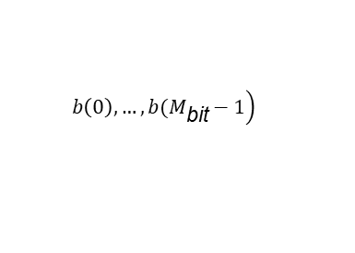
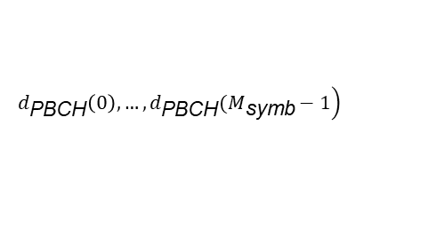
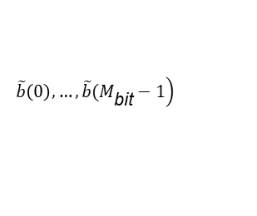
PBCH Transport Process
32 bits
BCH Data
$$\left. b\left(0\right), …, b(M_{\text{bit}}^{}−1\right)$$
PBCH payload generation
scrambling
1st scrambling stage with cell ID
M= SFN/2 mod4
Payload size
$$\left.\tilde{b}\left(0\right), …, \tilde{b}(M_{\text{bit}}^{}−1\right)$$
Scrambled bits + CRC
Scrambling
Modulation
Polar Coding
$$\left.d_{\text{PBCH}}\left(0\right),…,d_{\text{PBCH}}(M_{\text{symb}}−1\right)$$
Coded Bits
RE Mapping
2nd scrambling stage with cell ID
N=(SSB time index) mod4
N=(SSB time index) mod8
CRC attachment
Scramble bit
Channel Coding
Antenna Port 4000
frequency
PBCH
PBCH
PBCH
12 PRB
20 PRB
PSS
SSS
Rate matching
PBCH
symbols
Physical layer processing of PBCH and mapping to time-frequency resources
Notes:
BCH Payload Generation and other processing information
- Layer-1, after receiving the BCH data (24-bits), appends Eight additional timing related bits to generate PBCH payload bits (32-bits).
- A 24-bit CRC is appended to the PBCH payload which yields 56-bits in total.
- These 56-bits would result in 512-bits after channel coding (Polar coding) which then becomes 864-bits after rate matching. Since QPSK is used, just 432 REs are needed to transmit 432 QPSK symbols (864-bits).
- As discussed already, there are 576 REs dedicated for PBCH, remaining 144 REs (576-432) are used for PBCH DM-RS (see Table 7.4.3.1-1 from 38.211).
The PBCH payload size is 56 bits including 24-bit CRC. In NR, PBCH uses a single antenna port transmission scheme, using the same antenna port as PSS and SSS within the same SS block. The periodicity of PBCH is 80 ms.
The MIB data arrive at the PBCH processing unit in the form of one transport block (TB) every 80 ms and goes through the following steps as shown in Fig. 4.9: payload generation, scrambling, TB CRC calculation and attachment, channel coding, and rate matching.
The coded and modulated bits of PBCH are mapped onto the resource elements allocated for PBCH .
the PBCH content is encoded using the polar code.
Two scrambling operations are performed on PBCH which include one before CRC attachment and another one after the polar coding and rate matching.
In the first scrambling stage, initialization based on Cell ID, the sequence is partitioned into four non-overlapping portions.
The portion for transmission is selected based on the second and third least significant bits of the SFN.
In the second scrambling stage, initialization based on Cell ID, the sequence is partitioned into four or eight non-overlapping portions.
The portion for transmission is selected based on the second or third least significant bits of the SS block time index.

Slide 42
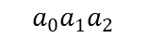
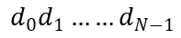
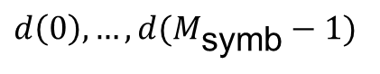
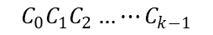
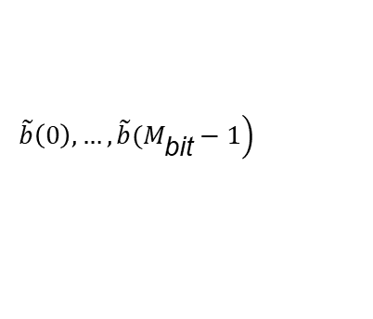
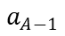
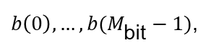
Scheduling information (DCI data)
$$\left.\tilde{b}\left(0\right), …, \tilde{b}(M_{\text{bit}}^{}−1\right)$$
Information element
multiplexing
TS 38.212 Section 7.3.1
Modulation
TS 38.211 Section 7.3.2.4
$$a_{0}a_{1}a_{2}$$
To
$$a_{A−1}$$
$d\left(0\right),…,d(M_{\text{symb}}−1)$
CRC attachment
TS 38.212 Section 7.3.2
Resource element mapping
TS 38.211 Section 7.3.2.5
$$C_{0}C_{1}C_{2}…⋯C_{k−1}$$
Channel coding
TS 38.212 Section 7.3.3
$$d_{0}d_{1}……d_{N−1}$$
Rate matching
TS 38.212 Section 7.3.4
Physical layer processing of NR PDCCH
Scrambling
TS 38.211 Section 7.3.2.3
$b\left(0\right), …, b(M_{\text{bit}}^{}−1)$,

Slide 43
Physical downlink Shared channel (PDSCH)
CRC
CRC
Transport block (TB)
TB CRC
LDPC base graph
Code Block
LDPC coding
Rate Matching
Rel 15 supports up to 2 TBS
TBS>3824 has 24 bits CRC
Else 16 bits CRS
Max CB size( Kcb) based LDPC base graph selection type1= 8448 Type 2: 3840
CB segmentation and CRC attachment 24 bits
LDPC based channel coding
Code bit to resource mapping
Antenna Port
VRB to PRB Mapping
VRB Mapping
Code Block Concatenation
Scrambling
Modulation
Layer Mapping
Antenna Port
Data is scrambled with 31 length gold sequence
Modulation table selection 64 QAM and 256 QAM
Modulation symbols are mapped to multiple layers
Virtual resource block are mapped to physical RBS interleaved or non interleaved

Slide 44
5G NR Physical Layer Standards & Massive MIMO Integration
TS 38.211: NR Physical Channels and Modulation
TS 38.213: NR Physical Layer Procedures for Control
Antenna Ports
Reference Signals
Layer Mapping
CSI Reporting
Beam Management
TCI States
MU-MIMO
• Physical channel mapping
• CSI-RS (Channel State Info)
• Data to layers
• CQI, PMI, RI
• Beam Measurement
• Beam indication
• Multi-user spatial
• Spatial multiplexing foundation
• SRS (Sounding Reference)
• Precoding interface
• L1-RSRP
• Beam Reporting
• PDSCH/PDCCH
• Interference mgmt
• SSB (Sync Signal Block)
• Codebook/Non-CB
• Beam Indication
• Dynamic config
• Resource allocation
• NZP/ZP CSI-RS configs
• Beam measurement
• Failure Recovery
• Multi-beam support
• Spatial separation
TS 38.214: NR Physical Layer Procedures for Data
TS 38.212: NR Channel Coding
PDSCH/PUSCH
Dynamic Beaming
Resource Allocation
Coding Impact on MIMO
Coding Schemes
• Data transmission
• Real-time beam selection
• Time-frequency resources
• Per-layer coding schemes
• LDPC for data channels
• Layer-to-antenna mapping
• Adaptive beamforming
• Spatial domain
• Error correction across streams
• Polar codes for control
• TCI state utilization
• Link adaptation
• Multi-layer support
• Rate matching for spatial layers
• Turbo codes (legacy)
• Spatial multiplexing
• Performance optimization
• MIMO rank adaptation
• HARQ for MIMO streams
• CRC attachment
Massive MIMO Key Benefits & Implementation
Spatial Multiplexing
Advanced Beamforming
Channel Estimation
Interference Mgmt
Performance Gains
Implementation
Multiple data streams
3D beamforming
High-resolution CSI
Spatial interference rejection
10x capacity increase
Active antenna systems
Higher spectral efficiency
Digital precoding
Massive CSI-RS configs
Zero-forcing precoding
Energy efficiency gain
Digital baseband processing
128+ antenna elements
Multi-user beamforming
Beam-specific measurement
Inter-cell coordination
Coverage enhancement
Real-time adaptation
Up to 16 layers DL
Null-steering
L1-RSRP reporting
ZP CSI-RS muting
Latency reduction
Machine learning opt.
Up to 4 layers UL
Reciprocity-based BF
SRS uplink sounding
Co-channel sharing
99.999% reliability
Sub-6GHz & mmWave
Precoding optimization
CSI-RS beam sweeping
TDD reciprocity
Multi-user orthogonality
Massive connectivity
Cloud-RAN integration
Key Frequency Bands & Deployment Scenarios
Sub-6 GHz (FR1)
mmWave (FR2)
TDD Reciprocity
FDD Challenges
Urban Deployment
Rural Coverage
Massive MIMO Performance Metrics
Capacity:
Spectral Efficiency:
Energy Efficiency:
Latency:
Reliability:
Connections:
Concurrent Beams:
Coverage:
10-20x increase vs 4G
30+ bps/Hz/cell
100x improvement
Sub-1ms URLLC
99.999% availability
1M devices/km²
64+ simultaneous
Cell edge +10dB

Slide 45
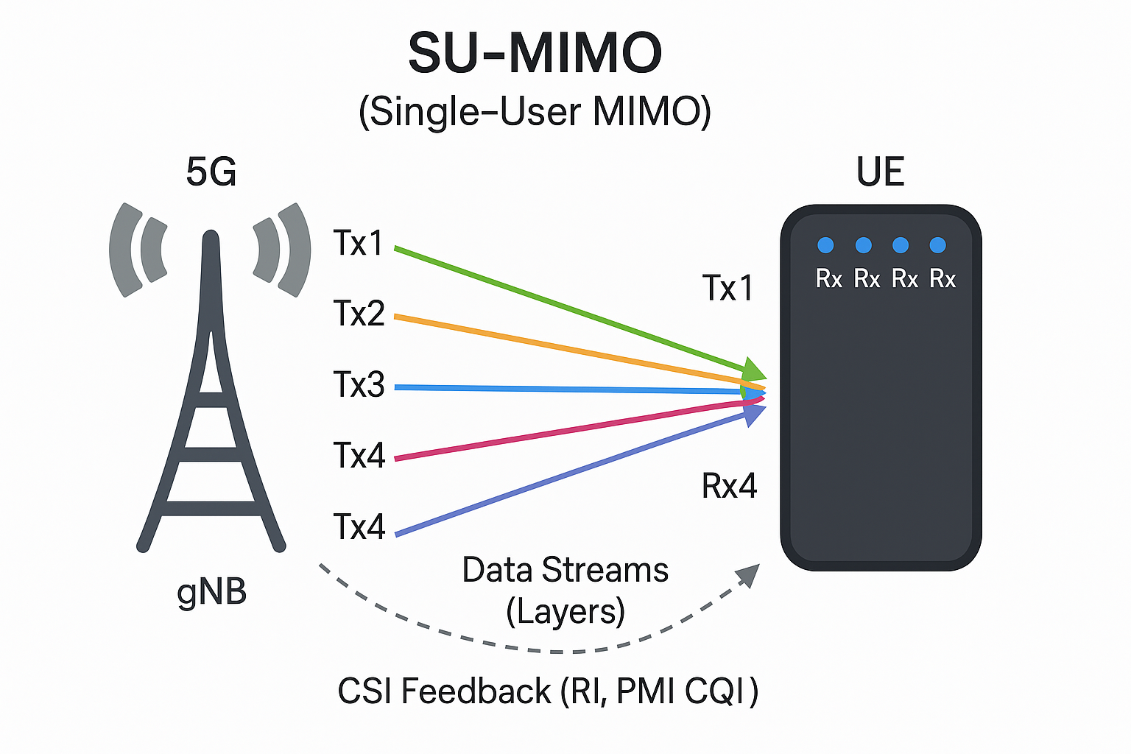
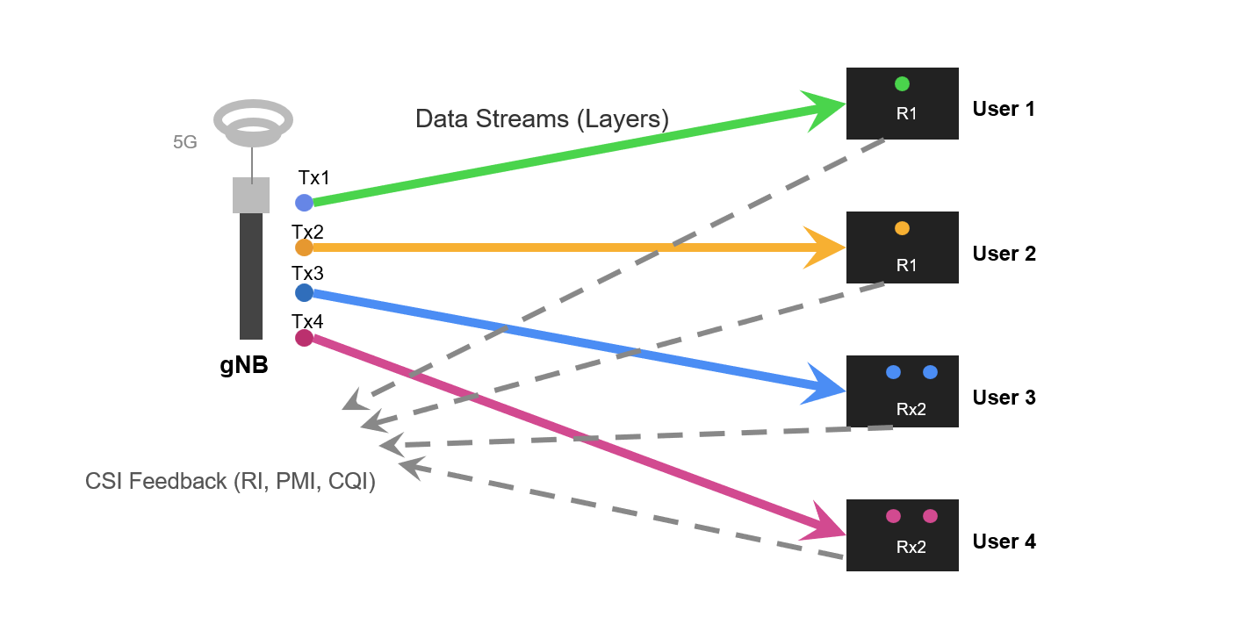
SU-MIMO & MU-MIMO
Notes:
1. What is MIMO?
At its core, MIMO (Multiple-Input Multiple-Output) is a wireless communication technology that uses multiple antennas at both the transmitter (e.g., the 5G base station, called gNB) and the receiver (e.g., the smartphone or user equipment, called UE). This allows for exploiting the spatial dimension of the radio channel to improve communication performance.
2. What is SU-MIMO (Single-User MIMO)?
SU-MIMO specifically refers to the scenario where the multiple antennas and associated processing at the gNB are used to communicate with only one UE within a specific time and frequency resource block. The primary goal of SU-MIMO in 5G is typically spatial multiplexing to increase the data rate for that single user.
3. Core Principle: Spatial Multiplexing
Concept: Imagine you have multiple separate paths (spatial streams or layers) between the gNB's transmit antennas and the UE's receive antennas. Spatial multiplexing allows the gNB to send different data streams simultaneously over these spatial paths using the same time and frequency resources.
Analogy: Think of it like having multiple parallel pipes between the gNB and UE, each carrying a portion of the total data concurrently.
Result: If the gNB can successfully transmit 'N' independent spatial layers, the peak data rate for that single UE can ideally be multiplied by 'N' compared to a single-antenna (SISO - Single-Input Single-Output) system, without requiring additional bandwidth.
4. Key Mechanisms and 3GPP Concepts for SU-MIMO in 5G NR:
Multiple Antennas: Both the gNB and the UE need multiple physical antennas. The number of antennas dictates the potential maximum number of spatial layers.
Layers (Spatial Streams): These are the independent data streams transmitted in parallel. The number of layers actually transmitted is called the Rank of the MIMO transmission. The rank is limited by the minimum of the number of transmit antennas and receive antennas (Rank ≤ min(N_Tx, N_Rx)), and also heavily dependent on channel conditions.
Channel State Information (CSI): For SU-MIMO spatial multiplexing to work effectively, the gNB needs to know the characteristics of the radio channel between each of its transmit antennas and each of the UE's receive antennas. This is CSI.
CSI Acquisition: The gNB transmits known reference signals, specifically CSI-RS (Channel State Information Reference Signals). The UE measures these CSI-RS to estimate the channel.
CSI Feedback: The UE processes the channel estimate and reports relevant information back to the gNB. This feedback is crucial for the gNB to adapt its transmission. The 5G NR CSI framework includes reporting:
RI (Rank Indicator): The UE recommends the number of spatial layers (rank) it believes the channel can reliably support. This is fundamental for SU-MIMO. If RI=1, it's not spatial multiplexing SU-MIMO (might be diversity or single-layer beamforming). If RI > 1, the UE is requesting spatial multiplexing.
PMI (Precoding Matrix Indicator): The UE recommends a specific precoding matrix from a predefined set (codebook) that the gNB should use to prepare the data streams for transmission. The precoder helps to spatially separate the layers and align them with the channel's characteristics.
CQI (Channel Quality Indicator): The UE indicates the highest data rate (Modulation and Coding Scheme - MCS) it estimates it can successfully decode per layer, assuming the gNB uses the recommended RI and PMI.
Precoding: This is the signal processing done at the gNB before transmission, based on the received CSI feedback (or sometimes based on gNB's own channel estimation in TDD).
Purpose: To manipulate the signals transmitted from each antenna such that the different spatial layers interfere minimally with each other at the UE's receiver antennas and are received with maximum possible power.
Codebook-Based Precoding: The most common type, where the gNB uses the PMI reported by the UE to select a precoding matrix from a standardized codebook (defined in 3GPP TS 38.214). This simplifies feedback but might not be perfectly optimal. 5G NR supports various codebooks, including more advanced Type II CSI reporting for potentially better performance (non-codebook or more detailed feedback).
How it works (simplified): The gNB takes the multiple data layers, multiplies them by the chosen precoding matrix, and the result determines the complex signal values to be sent from each physical (or virtualized) antenna port.
UE Receiver Processing: The UE receives the superimposed signals on its multiple antennas. Since the signals traveled through the wireless channel and were precoded, they are mixed up. The UE needs sophisticated receiver algorithms (like MMSE - Minimum Mean Square Error, or SIC - Successive Interference Cancellation) to:
Estimate the effective channel for each layer (using DMRS).
Separate the different spatial layers from the received mixture.
Decode the data from each layer individually.
Demodulation Reference Signals (DMRS): These reference signals are transmitted along with the data and are subjected to the same precoding as the data layers. The UE uses DMRS to estimate the effective channel experienced by each layer after precoding, which is essential for demodulating the data correctly. The configuration of DMRS (e.g., number of DMRS ports) is linked to the number of layers being transmitted.
5. Factors Influencing SU-MIMO Performance:
Channel Rank: The actual number of independent spatial paths the channel can support. This depends heavily on the richness of the multipath environment (scattering). A Line-of-Sight (LOS) channel often has a low rank (Rank=1), making spatial multiplexing difficult. Rich scattering environments are better for higher ranks.
Antenna Correlation: If the signals received at different UE antennas (or transmitted from different gNB antennas) are too similar (highly correlated), it's hard to separate the layers. Good antenna separation and design, along with a scattering environment, reduce correlation.
Signal-to-Noise Ratio (SNR): Higher SNR is generally required to support higher ranks and higher-order modulation schemes on each layer.
CSI Quality: The accuracy and timeliness of the CSI feedback are critical. Outdated or inaccurate CSI leads to imperfect precoding, resulting in Inter-Layer Interference (ILI), which degrades performance.
UE Processing Capability: Separating multiple high-data-rate streams requires significant processing power at the UE.
6. SU-MIMO vs. MU-MIMO:
SU-MIMO: Focuses on boosting the peak data rate for a single user at a given time/frequency resource. Improves user experience for demanding applications.
MU-MIMO (Multi-User MIMO): Serves multiple users simultaneously using the same time/frequency resource by spatially separating their signals. Improves overall cell capacity and spectral efficiency but may not necessarily maximize the peak rate for any single user involved compared to SU-MIMO.

Slide 46
MU-MIMO (Multi-User MIMO)
Data Streams (Layers)
R1
User 1
5G
Tx1
Tx2
R1
User 2
Tx3
Tx4
gNB
Rx2
User 3
CSI Feedback (RI, PMI, CQI)
Rx2
User 4

Slide 47

From 4G LTE to 5G NR Massive MIMO
4G LTE MIMO
5G NR Massive MIMO
Traditional Multi-Antenna Technology
Revolutionary Massive Antenna Arrays
Antenna Panel
Massive MIMO Array
8
Antennas
64+
Antennas
Targeted Beamforming
📱
📱
📱
Broad Coverage Area
📱
📱
📱
📱
📱
📱
4G LTE MIMO Specifications
5G NR Massive MIMO Specifications
🔹 Antenna Configuration: 2x2, 4x4, up to 8x8 MIMO
🔸 Antenna Configuration: 32x32, 64x64, up to 256x256 MIMO
🔹 Antenna Elements: 2-8 antenna elements typical
🔸 Antenna Elements: 32-256+ elements in dense arrays
🔹 Beamforming: Basic digital beamforming
🔸 Beamforming: Advanced 3D beamforming with beam steering
🔹 Coverage Strategy: Wide area, sector-based
🔸 Coverage Strategy: Precise user-specific targeting
🔹 Frequency Range: Sub-6 GHz (700 MHz - 2.6 GHz)
🔸 Frequency Range: Sub-6 GHz + mmWave (24-100 GHz)
🔹 Peak Data Rate: Up to 1 Gbps theoretical
🔸 Peak Data Rate: Up to 20 Gbps theoretical
🔹 User Capacity: Limited simultaneous users
🔸 User Capacity: Massive simultaneous connections
Key Innovation: 10x-100x More Antennas = Revolutionary Performance

Slide 48
Course Title / Slide Title
4G Style: Omnidirectional (Floodlight)
5G Beamforming: Controlled Interference Principle
5G Style: Beamforming (Spotlight Array)
UE1
UE1
UE2
UE2
gNB
gNB
NULL
UE3
NULL
UE3
⚠️ High Interference
✅ Minimal Interference
⚡ Energy Waste
⚡ Energy Efficient
📶 Higher Data Rates
Wave Interference Principle
Constructive Interference (BEAM)
Destructive Interference (NULL)
Wave 1
Wave 1
Wave 2
Wave 2
Combined
STRONGER!
Combined
CANCELLED!
Beamforming Control Parameters
Phase Control (Timing)
Amplitude Control (Power)
• Adjust signal timing from each antenna
φ₁
• Adjust signal power from each antenna
A₁
• Creates constructive/destructive interference
φ₂
• Controls beam shape and width
A₂
• Steers beam direction precisely
• Optimizes energy distribution
Result: Precise spatial control → Higher capacity, Better coverage, Reduced interference
Each user gets a dedicated "spotlight" of RF energy, while others experience "darkness" (nulls)

Slide 49
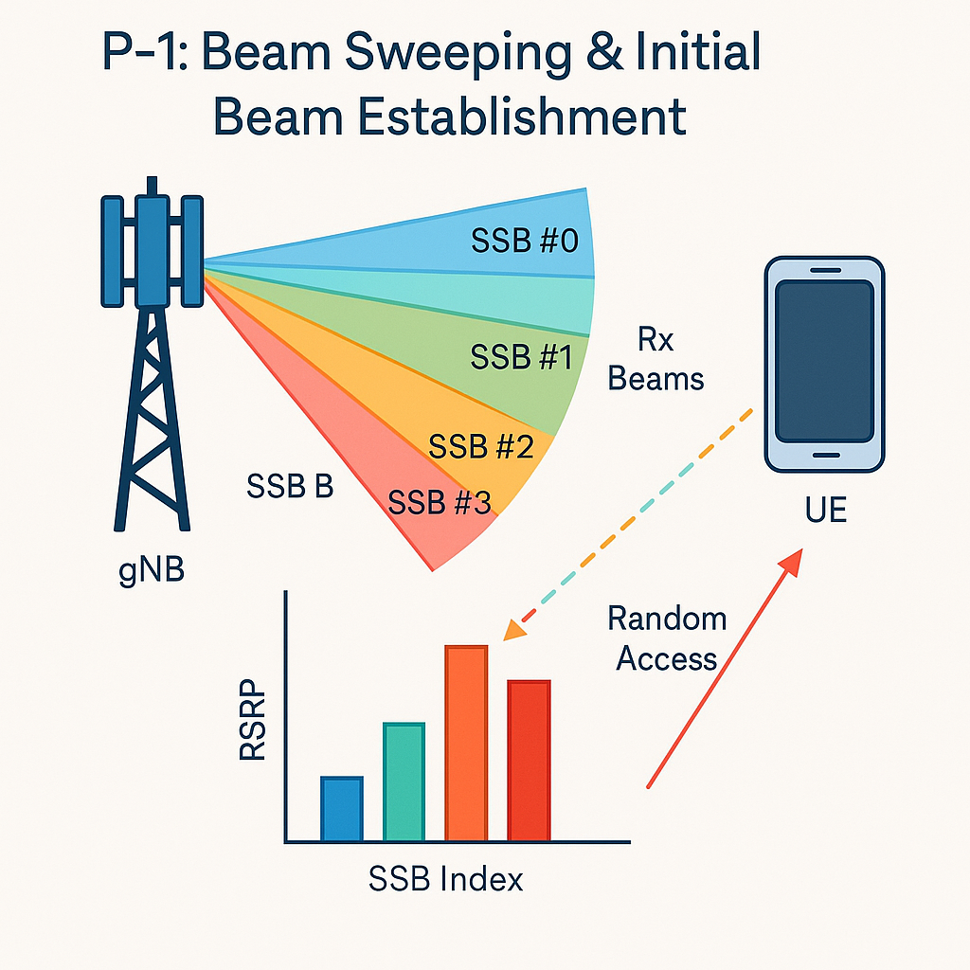
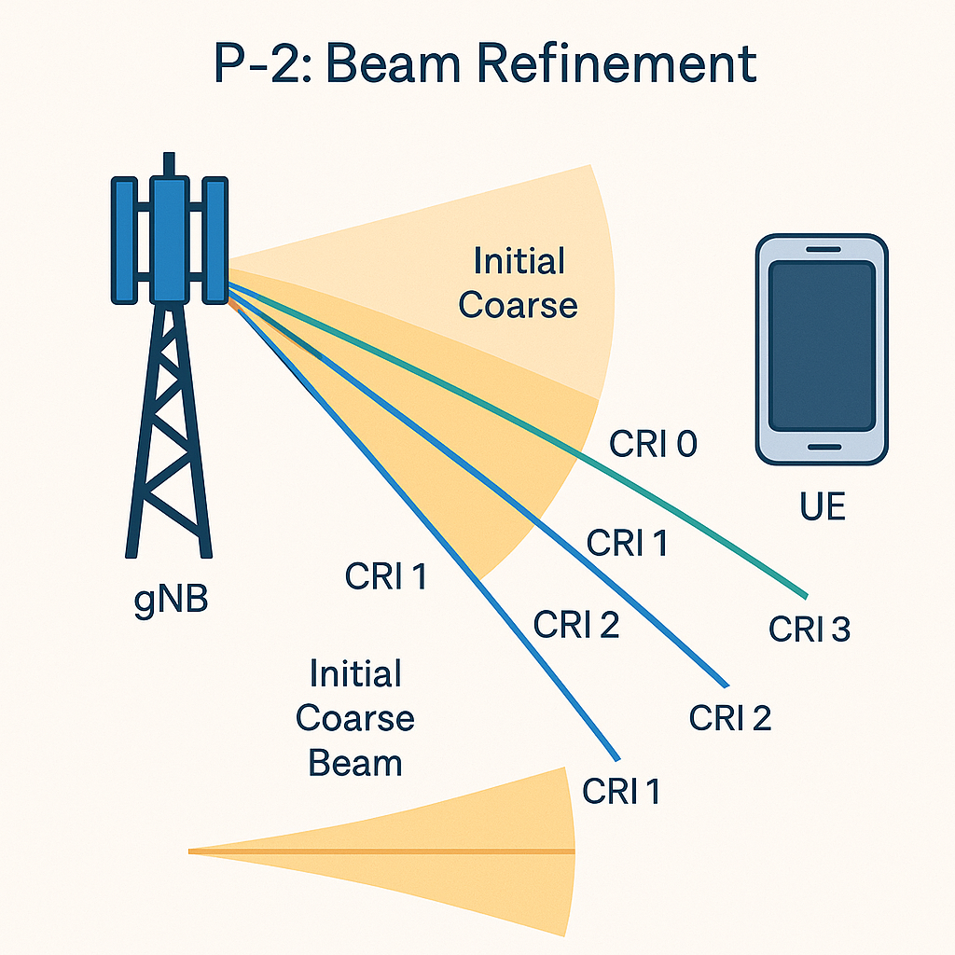
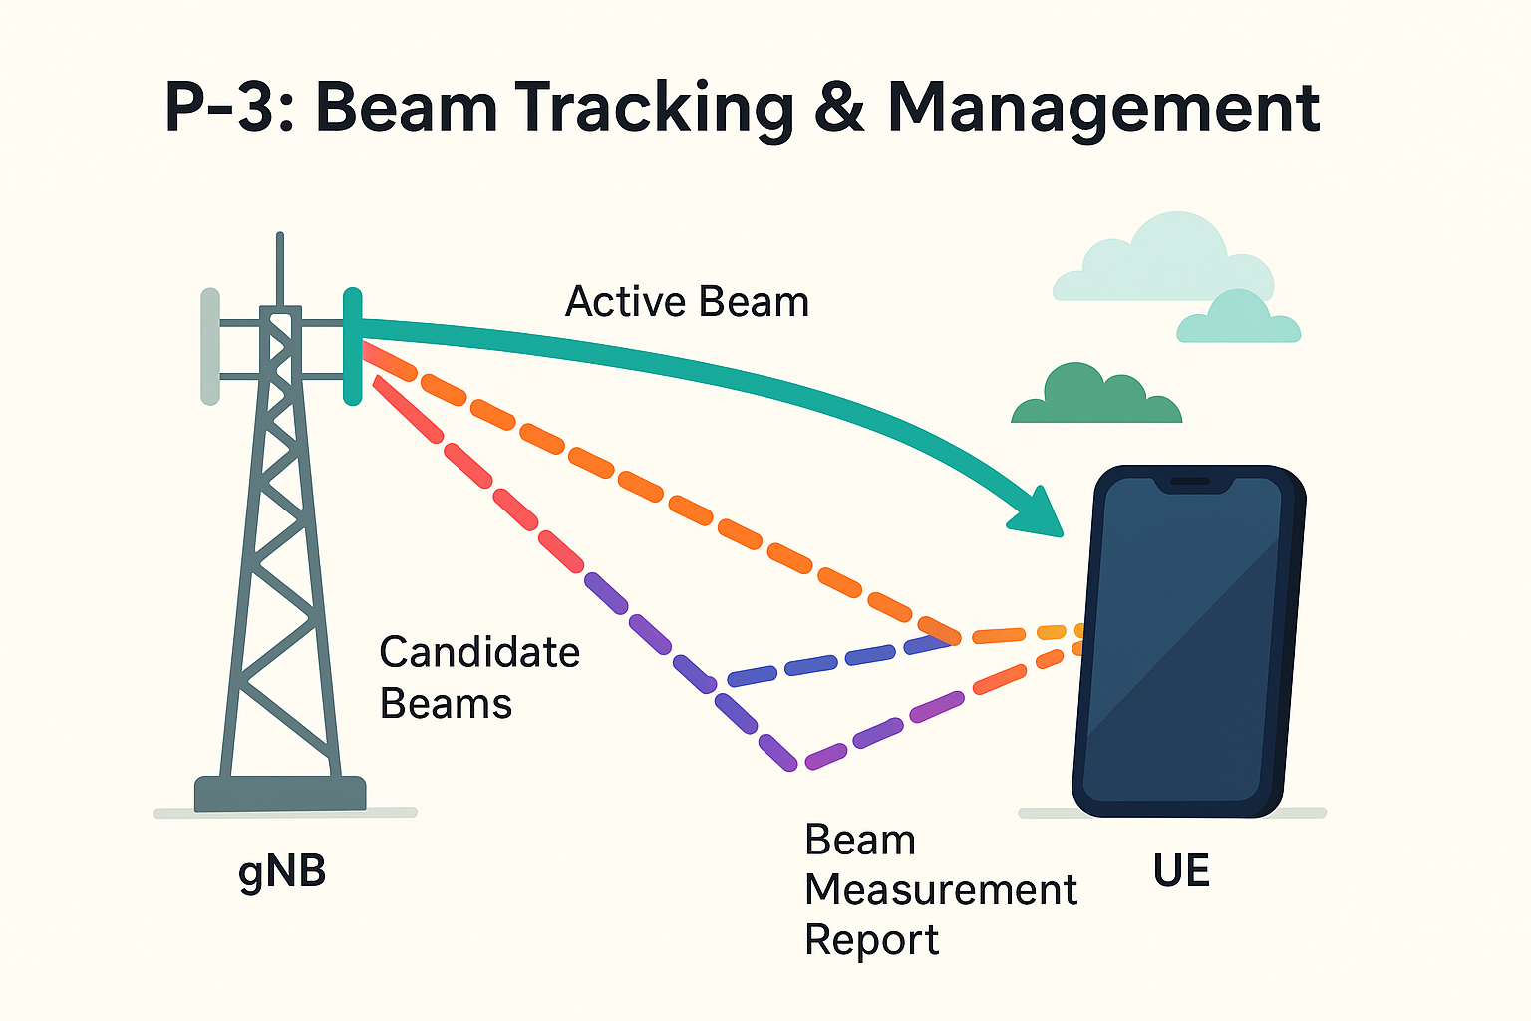
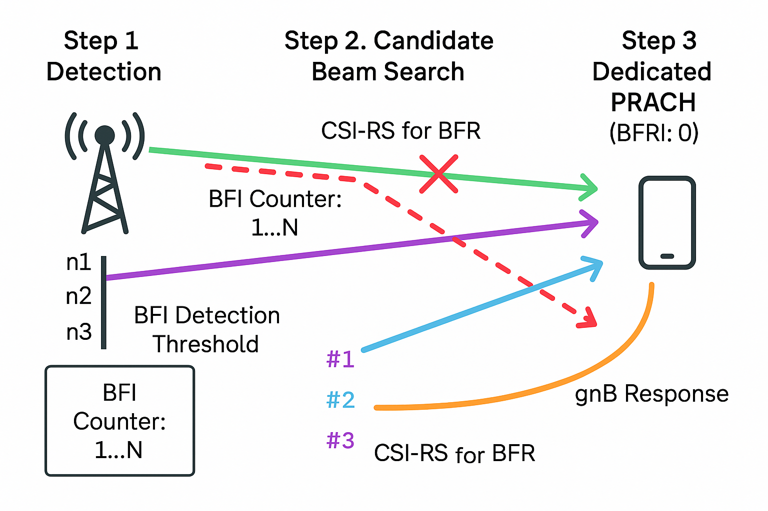
Beam management in 5G NR
(P-4): Beam Failure Recovery (BFR)

Slide 50
Why Beamforming is ESSENTIAL for 5G: Solving Critical Challenges
Frequency Band Comparison
Challenge 1: Overcoming High-Frequency Physics
Path Loss Physics
SOLUTION: Massive MIMO + Beamforming
Path Loss proportional to (frequency)squared
BLOCKED
• 700 MHz to 28 GHz = 40x frequency increase
Wall
• Path Loss increases by 40squared = 1,600x
Good Coverage
High Path Loss
• Signal becomes 32 dB weaker!
• Array Gain = 10 x log10(N) where N = antennas
Penetrates Obstacles
Easily Blocked
Communication nearly impossible
• 64 antennas gives 18 dB gain = 63x power boost!
4G Low Band (700MHz-2GHz)
5G mmWave (28GHz+) - WITHOUT Beamforming
Compensates for high path loss
Array Gain Mathematics
Problem: mmWave path loss = 32 dB higher than 4G
Solution: Massive MIMO Array Gain = 18 dB + Beamforming Gain = 15 dB = 33 dB total gain
Result: 33 dB gain greater than 32 dB loss makes mmWave viable!
For mmWave: Communication is PRACTICALLY IMPOSSIBLE without beamforming
Beamforming transforms 5G from impossible to practical
by concentrating scattered energy into focused, penetrating beams
Challenge 2: Enabling Massive Capacity (Thousands of Devices)
Traditional Approach: Time Division
SOLUTION: Multi-User MIMO (MU-MIMO) with Beamforming
UE1
UE2
UE1
UE2
t=1ms
UE4
UE3
waiting...
Stream 1
UE4
NULL
NULL
UE3
Stream 2
waiting...
waiting...
Stream 4
Stream 3
Users take turns leads to Low capacity
All users served simultaneously
Congestion in dense areas
Same frequency, same time gives Massive capacity
Capacity Multiplication Through Spatial Division
Traditional: 1 frequency x 1 time slot = 1 data stream
MU-MIMO: 1 frequency x 1 time slot x N spatial streams = N data streams
Example: 64-antenna array supports up to 8-16 simultaneous users = 8-16x capacity increase!
Critical: Null steering prevents interference between simultaneous beams
Real-World Impact: Stadium with 50,000 Users
Without MU-MIMO: Network congestion
With MU-MIMO: Spatial multiplexing
Users get less than 1 Mbps each
Users get 100+ Mbps each

Slide 51
Types of Beamforming in 5G NR: Implementation Trade-offs
Performance vs Complexity vs Cost
A. Analog Beamforming
B. Digital Beamforming
C. Hybrid Beamforming
"Single Garden Hose + Adjustable Sprinkler"
"Separate Faucet for Every Nozzle"
"8 Colored Faucets + Adjustable Sprinklers"
Architecture
Architecture
The PRACTICAL Solution!
Two-Stage Architecture
Baseband Processor
Baseband Processor
Baseband Processor
(Single Data Stream)
(Multiple Data Streams)
(Digital Precoding)
Single RF Chain
RF₁
RF₂
RF₃
RF₄
RF₅
RF₆
RF₁
Stage 1: Digital (Fewer RF Chains)
Analog Phase Shifters
Each Antenna = Dedicated RF Chain
RF₂
RF₃
RF₄
RF₅
RF₆
φ₁
φ₂
φ₃
φ₄
φ₅
φ₆
Antenna Array
Stage 2: Analog Phase Shifters
Antenna Array
Large Antenna Array (64+ elements)
UE1
UE2
UE1
UE2
Single Steerable Beam
Stream 1
UE3
Stream 2
Stream 1
Multiple Steered Beams (Best of Both Worlds)
Stream 2
UE1
Multiple Independent Beams
Stream 3
Smart Compromise Analogy
Garden Hose Analogy
Multiple Faucets Analogy
8 Colored Faucets
Each feeds sprinkler head
Single Hose
Same water (data) direction adjustable
Separate Computer-Controlled Faucets
Different data + analog steering = efficient precision
but only ONE stream possible
Different colored water (data) to different directions
Characteristics
Characteristics
Characteristics
PROS:
PROS:
PROS:
• Enables MU-MIMO
• Simple implementation
• Multiple independent beams
• Much lower cost than digital
• Low cost
• True MU-MIMO capability
• Reduced power consumption
• Low power consumption
• Highest precision and performance
• Practical for large arrays
• Fast beam steering
• Perfect interference nulling
• Best performance/cost trade-off
CONS:
CONS:
CONS:
• Only ONE beam at a time
• Extremely expensive
• More complex than analog
• No true MU-MIMO
• Massive power consumption
• Limited by number of RF chains
• Cannot send different data
• Computationally intensive
• Some performance compromise
simultaneously
• Complex implementation
USE CASE: 5G Mid-band and mmWave Deployments
USE CASE: mmWave Beam Sweeping
USE CASE: Theoretical Ideal
The workhorse of practical 5G Massive MIMO systems
Initial signal discovery and coarse beam alignment
Foundation principle but not practical for large arrays
Implementation Trade-off Summary
Analog: Simple + Cheap = One beam only
Digital: Perfect + Powerful = Too expensive
Hybrid: Smart compromise = 5G reality
Hybrid beamforming enables practical 5G by balancing performance, cost, and complexity

Slide 52
Analog Beamforming (RF Beamforming) Architecture
Analog Phase Control
Single RF Chain
Phase Shifter
Ant 1
Baseband
DAC
RF Front-end
Power
φ₁
UE
Processing
Digital to
Up-converter
Splitter
1
(Digital)
Analog
Power Amp
Phase Shifter
Ant 2
θ = 30°
Main Beam
φ₂
Phase Shifter
Ant 3
φ₃
Beam Steering
Phase Shifter
Ant 4
• Entire array steers together
• One beam direction at a time
φ₄
• Fixed beam width
Key Characteristics
Typical Use Cases
Cost-effective:
Initial Access (SSB Sweeping):
Requires fewer RF chains (one per beam/panel)
Broadcasting Synchronization Signal Block in mmWave bands
Power efficient:
gNB sweeps different pre-defined analog beams for coverage
Less power consumption due to fewer RF chains
Broad Coverage:
Limited Flexibility:
For sectors where a wide, fixed beam is sufficient
Can only form one beam per RF chain at a time
Lower Frequency Bands:
Cannot simultaneously serve multiple users
Where Massive MIMO capabilities are not strictly required
Spatial Multiplexing:
Simpler analog beamforming deployment
Difficult to achieve true spatial multiplexing
Frequency Band Applications
• mmWave (24-100 GHz): Primary use for initial access and beam sweeping in 5G NR
• Sub-6 GHz: Cost-effective solution for basic beamforming
Signal Flow:
RF Signal Path
Wireless Link
Phase Control
Limitation

Slide 53
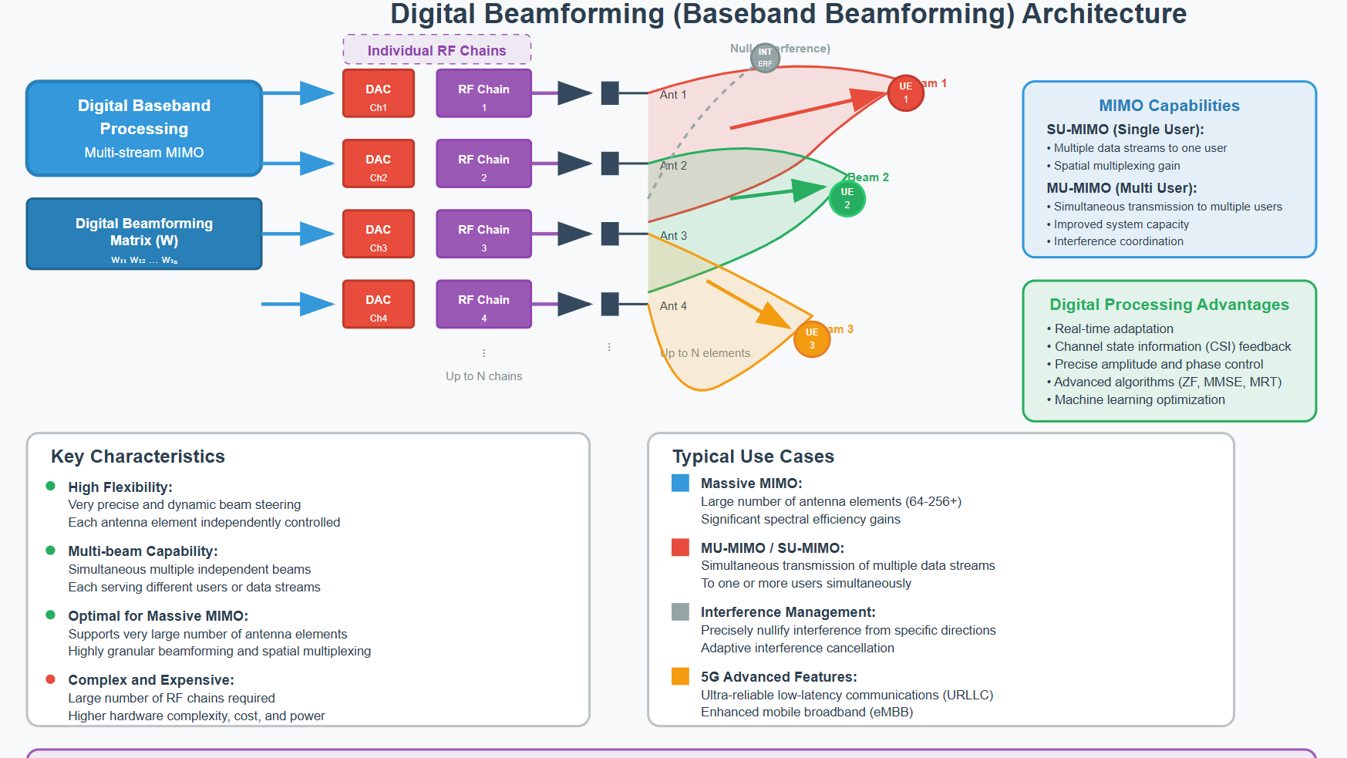

Slide 54
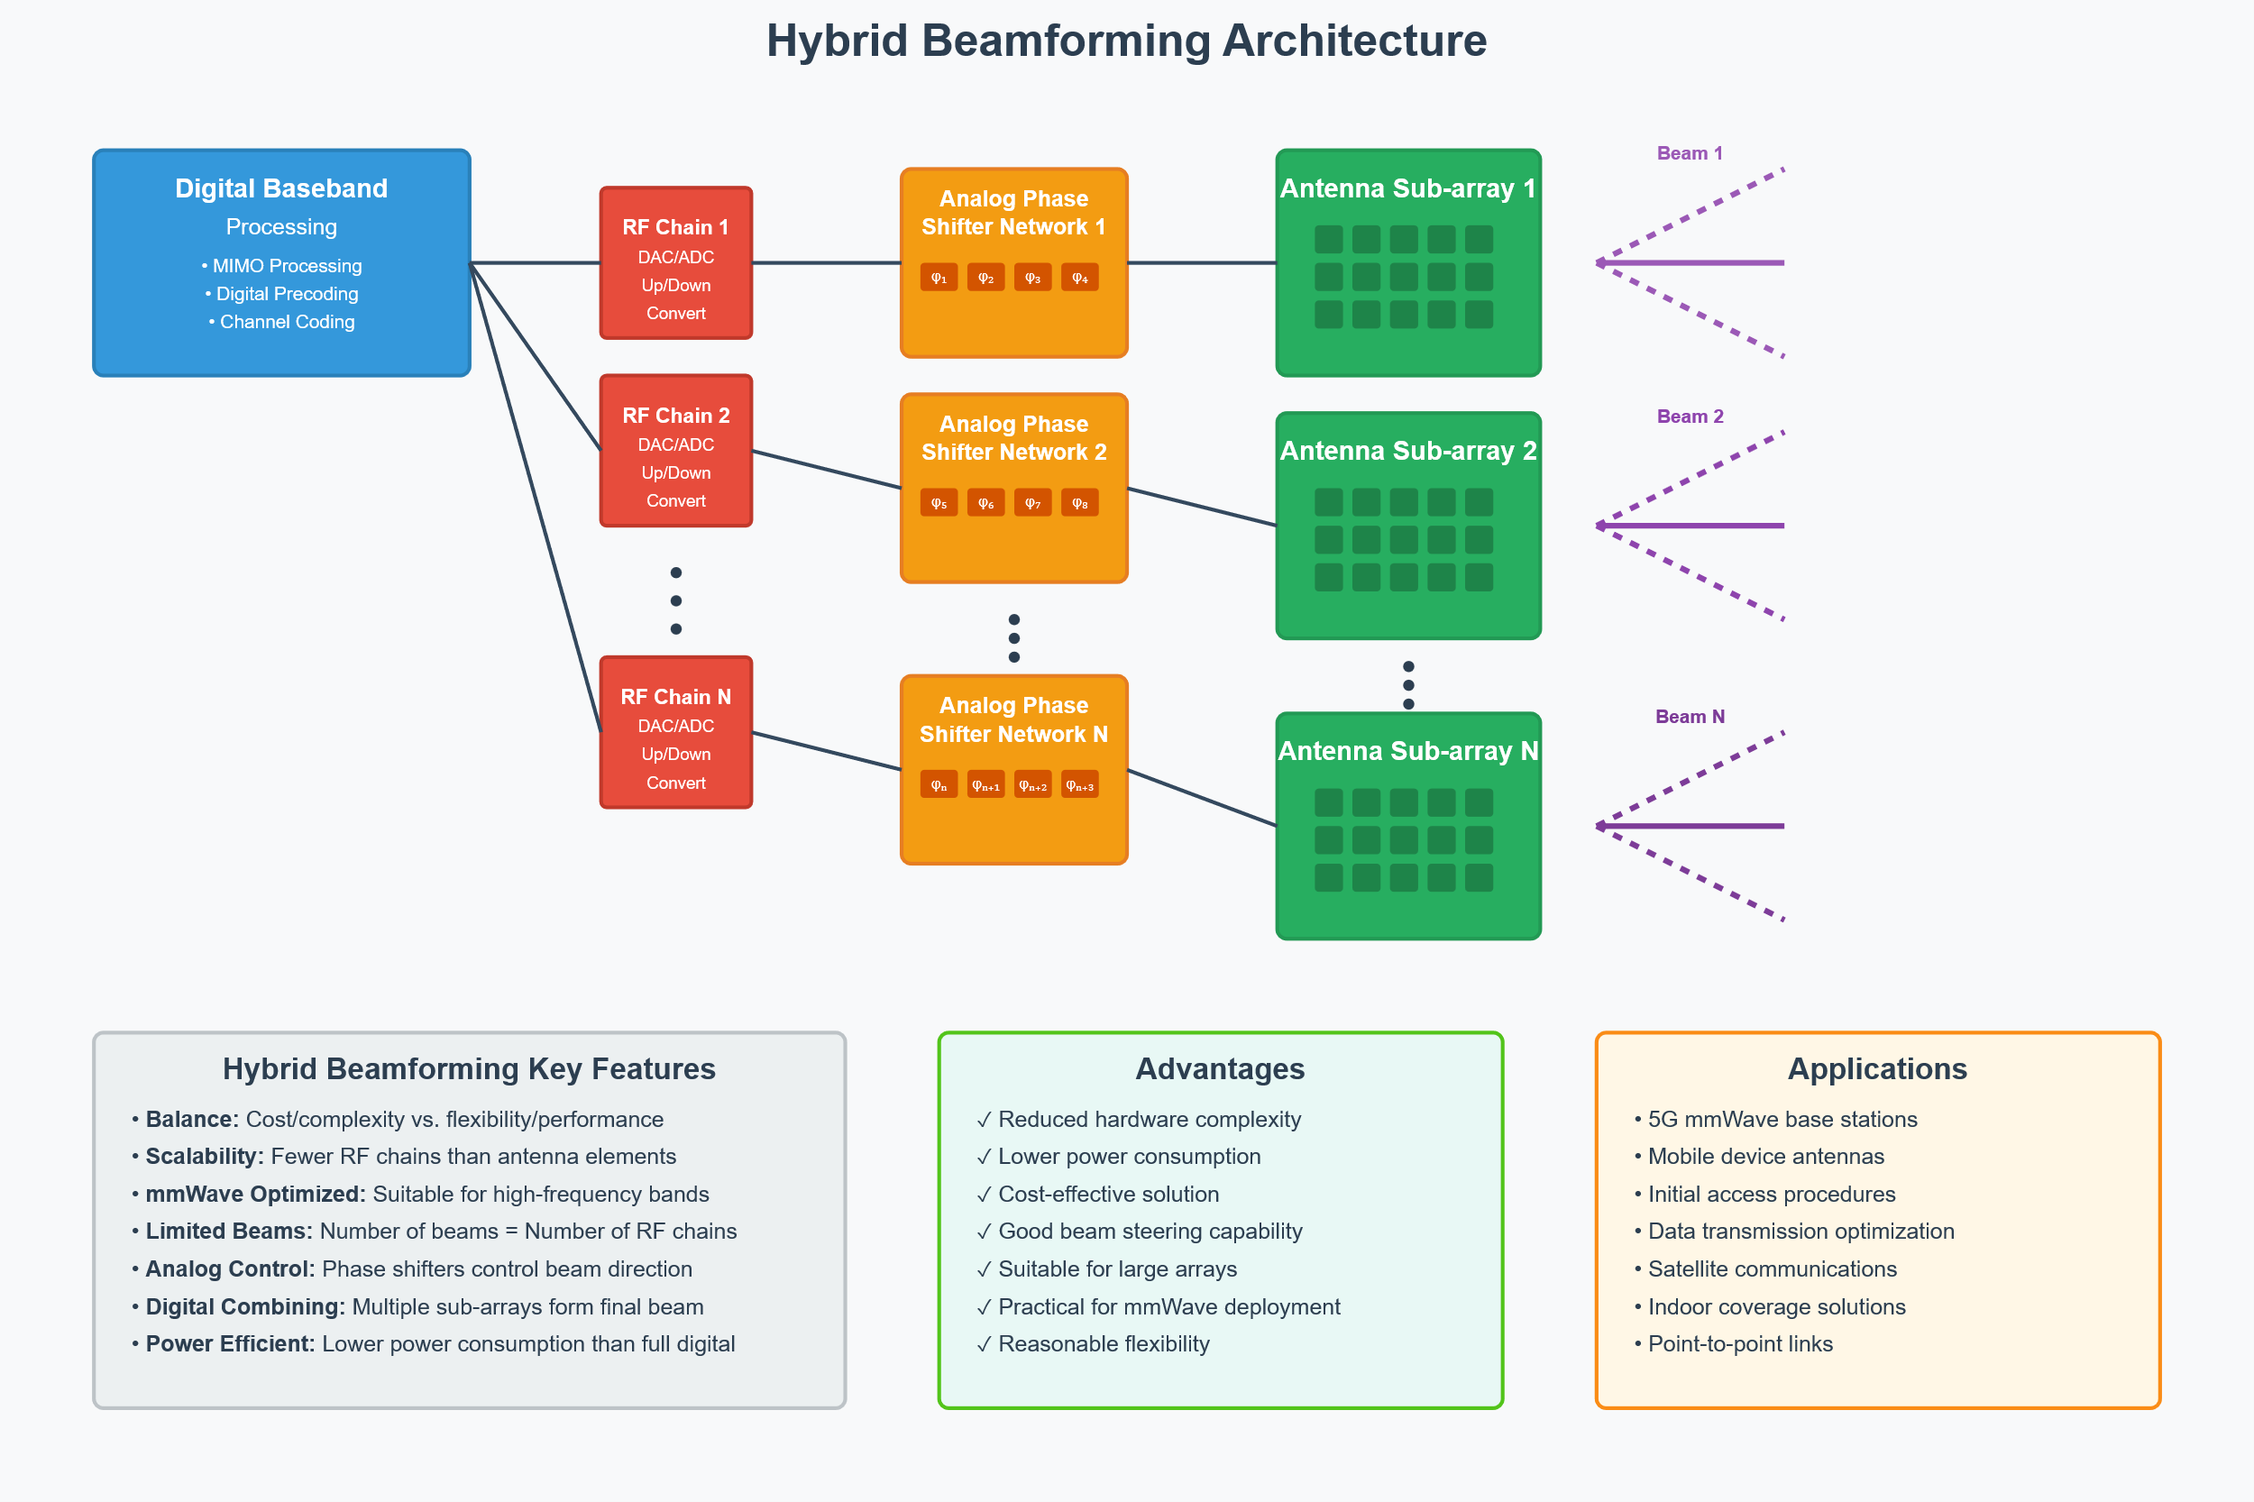

Slide 55
PDCP Split Bearer Function - Downlink (DL) and Uplink (UL) Data Flow
DOWNLINK (DL) Data Flow
UPLINK (UL) Data Flow
Core Network
UE PDCP Entity
(Data Packets/SDUs)
• Sequence Numbering
• Header Compression
• Ciphering
• Splitting Decision (ul-DataSplitThreshold)
MN PDCP Entity
• Sequence Numbering
• Header Compression (RoHC)
MCG Leg
SCG Leg
• Ciphering
• Splitting Decision
UE RLC/MAC/PHY
UE RLC/MAC/PHY
Direct to MN
to SN
MCG Leg
SCG Leg
SN (gNB/eNB)
MN RLC/MAC/PHY
Via Xn-U/X2-U
Forwards via Xn-U/X2-U
Direct to UE
to SN
Xn-U/X2-U Interface
Xn-U/X2-U Interface
MCG Air Interface
SN (gNB/eNB)
MN PDCP Entity
RLC/MAC/PHY
• Receives from MCG & SCG
• Reordering
SCG Air Interface
• Deciphering & Header Decompression
• Delivery to Core Network
UE PDCP Entity
• Receives from MCG & SCG
• Reordering (handles out-of-order)
Core Network
• Deciphering & Header Decompression
(Processed SDUs)
• Delivery to Upper Layers
Key PDCP Functions in Split Bearer Operation
3GPP Specification References
• Sequence Numbering:
• Ciphering/Header Compression:
• TS 38.323 (NR) / TS 36.323 (LTE):
Essential for reordering at receiving PDCP entity
Performed once by single PDCP entity
PDCP specification - Section 5.1.2 (PDCP PDU routing)
• Routing/Splitting Logic:
• Status Reporting:
• TS 38.331 (NR) / TS 36.331 (LTE):
Decision algorithm for MCG vs SCG path selection
Complex reporting across both legs for retransmissions
RRC specification - PDCP-Config IE, ul-DataSplitThreshold
• Reordering:
• UL Threshold Control:
• TS 38.300 (NR) / TS 36.300 (LTE):
Handles PDUs from two paths with different delays
ul-DataSplitThreshold determines routing decision
Architecture - Section 16 Dual Connectivity overview
Legend
Core Network
Master Node (MN)
Secondary Node (SN)
User Equipment (UE)
MCG Path
SCG Path

Slide 56
Module 3: Configuration Parameters, KPIs, and Troubleshooting

Slide 57
5G NR Numerology & Radio Frame Structure
Numerology Parameters
Key Formula
SCS = 2^μ × 15 kHz
μ
SCS
Slot Duration
Use Cases
Slot Duration = 1ms / 2^μ
0
15 kHz
1 ms
Wide coverage, LTE interworking
1
30 kHz
0.5 ms
Standard eMBB
2
60 kHz
0.25 ms
URLLC, Industrial IoT
3
120 kHz
0.125 ms
URLLC, mmWave
Radio Frame (10 ms) = 10 Subframes
1ms
1ms
... Subframes (1ms each) ...
Radio Frame Structure (10ms)
Slot Structure for Different Numerologies
Key 5G NR Features
μ=0 (15kHz):
1 Slot (1ms)
14 OFDM Symbols
Dynamic TDD: Flexible UL/DL allocation
Mini-slots: Sub-slot scheduling for URLLC
μ=1 (30kHz):
0.5ms
0.5ms
2 Slots per 1ms
Mixed Numerology: Multiple SCS in same cell
Self-contained: All signals within slot
μ=2 (60kHz):
0.25ms
0.25ms
0.25ms
0.25ms
4 Slots per 1ms
Symbols: D (DL), U (UL), F (Flexible)
μ=3 (120kHz):
8 Slots per 1ms
0.125ms
Latency Impact
Trade-off Visualization
Better Coverage ↑
μ=0: Higher Latency (1ms slots)
120kHz
μ=1: Medium Latency (0.5ms slots)
60kHz
Higher SCS →
μ=2: Lower Latency (0.25ms slots)
30kHz
15kHz
μ=3: Ultra-low Latency (0.125ms slots)

Slide 58
Accessibility KPI

Slide 59
5G NR Accessibility KPIs
1. Registration Success Rate (RSR)
2. Partial DRB Accessibility
Formula:
Per 5QI:
RSR = (∑ AMF.5GSRegisSucc.Type / ∑ AMF.5GSRegisAtt.Type) × 100%
Partial DRBAccessibility_5QI =
• AMF.5GSRegisSucc.Type: Successfully performed registrations
(∑RRC.ConnEstabSucc.Cause / ∑RRC.ConnEstabAtt.Cause) ×
• AMF.5GSRegisAtt.Type: Attempted registrations
(∑UECNTXT.ConnEstabSucc.Cause / ∑UECNTXT.ConnEstabAtt.Cause) ×
• Type: initial, mobility update, periodic update, emergency
(DRB.EstabSucc.5QI / DRB.EstabAtt.5QI) × 100
Per S-NSSAI:
Replace 5QI with SNSSAI in above formula
Note: Excludes mo-Signalling establishment cause
3. Total DRB Accessibility
Formula (per 5QI):
DRBAccessibility_5QI = 100 ×
[DRB.InitialEstabSucc.5QI + (DRB.EstabSucc.5QI - DRB.InitialEstabSucc.5QI) + DRB.ResumeSucc.5QI]
[DRB.InitialEstabAtt.5QI × (RRC connection setup success rate/100) ×
(UE-associated logical NG-connection success rate/100)] +
[(DRB.EstabAtt.5QI - DRB.InitialEstabAtt.5QI)] +
[DRB.ResumeAtt.5QI × (RRC Resume success rate/100)]
• RRC connection setup success rate = ∑RRC.ConnEstabSucc.Cause / ∑RRC.ConnEstabAtt.Cause
• UE-associated NG-connection success rate = ∑UECNTXT.ConnEstabSucc.Cause / ∑UECNTXT.ConnEstabAtt.Cause
• RRC Resume success rate = RRC.ResumeSucc.cause / RRC.ResumeAtt.cause (excludes RNA update)
Key Terms & Abbreviations
• 5QI: 5G QoS Identifier - Quality of Service Class Identifier
• S-NSSAI: Single Network Slice Selection Assistance Information
• DRB: Data Radio Bearer - Radio bearer for user data transmission
• RRC: Radio Resource Control - Layer 3 signaling protocol
• AMF: Access and Mobility Management Function
• UECNTXT: UE Context - User Equipment Context establishment
• mo-Signalling: Mobile Originated Signalling (excluded from calculations)

Slide 60
RACH Success Rate KPI Analysis
RACH Success Rate Formula:
RACH Success Rate = (Number of Successfully Completed RACH Procedures) / (Total Number of RACH Attempts) × 100%
UE
gNB
(User Equipment)
RACH Procedure Flow
(Base Station)
Msg1: Preamble
(Random Access)
Msg2: RA Response
(RAR)
Msg3: Contention
(if contention-based)
Msg4: Resolution
(Contention Resolution)
Success Criteria:
Root Causes for Low RACH Success Rate
✓ UE successfully transmits Preamble (Msg1)
1
Poor Radio Coverage/Quality
✓ gNB receives and processes Preamble
Weak signal strength, high path loss
✓ gNB sends RA Response (Msg2) successfully
2
Excessive Interference
✓ Contention resolution completed (if applicable)
Co-channel/adjacent-channel interference
3
Incorrect Power Control
Key Performance Indicators:
UE transmit power too low/high
4
Insufficient RACH Resources
Excellent
Good
Poor
Not enough PRACH occasions/preambles
≥95%
90-95%
<90%
5
Timing Advance Issues
Target Range
Acceptable
Needs Action
Preambles arrive outside reception window
Typical Measurement Period: 15 minutes to 1 hour
6
gNB Load/Capacity
• Measured per cell or per gNB
gNB overloaded, delayed processing
• Focus on Msg1-Msg2 handshake success
7
Misconfigured Parameters
Incorrect 3GPP parameter settings

Slide 61
Preamble Transmission Power & Ramping - KPI Impact Analysis
PreambleInitialReceivedTargetPower
gNB
• 3GPP: rach-ConfigCommon → rach-ConfigGeneric
Base Station
• Target power at gNB receiver (dBm)
• UE calculates: P_tx = TargetPower + PathLoss
Low Tx Power
• Typical Range: -120 to -90 dBm
• Recommended: -100 to -110 dBm
Legend
UE1
Power Calculation Formula
Low Power (Close UE)
Close
P_tx_preamble = PreambleInitialReceivedTargetPower + PathLoss
Low PL
Medium Power
Medium Tx Power
(PathLoss derived from RSRP measurements)
High Power (Far UE)
PL = Path Loss
UE2
Key Performance Indicators (KPIs) Improved
Medium
RACH Success Rate ↑
Med PL
High Tx Power
Connection Setup Time ↓
UE3
Preamble Retransmissions ↓
Far
UE Power Efficiency ↑
High PL
Inter-cell Interference ↓
Too Low Setting Impact
Optimal Setting Benefits
Too High Setting Impact
• Weak preamble detection
• First-attempt preamble detection
• Excessive interference
^{• Increased retransmissions}
^{• Minimized retransmissions}
^{• UE battery drain}
^{• Higher RACH failure rate}
^{• Reduced access delay}
^{• Receiver saturation}
^{• Poor connection success rate}
^{• Optimized power consumption}
^{• Reduced cell capacity}

Slide 62
5G RACH powerRampingStep Parameter Optimization
+30
OVERSHOOT
+20
SUCCESS
Transmit Power (dBm)
Optimal Detection Zone (+5 to +15 dBm)
+10
0
-10
1
2
3
4
5
6
7
8
Transmission Attempts
Power Ramping Scenarios:
1 dB Step (Too Small): Many attempts needed, high latency, may reach PreambleTransMax
4 dB Step (Optimal): Quick convergence to detection zone, balanced efficiency
8 dB Step (Too Large): Quick overshoot, excessive interference, resource waste
KPI Impact Analysis:
Latency Impact
Resource Efficiency
Interference Control
• Small steps → High latency
• Fewer retransmissions
• Prevents power overshoot
• Large steps → Quick but inefficient
• Reduced PRACH congestion
• Minimizes uplink interference
• Optimal: 4dB = Low latency
• Better success rate
• Optimal: 2-4 dB range
3GPP TS 38.331: rach-ConfigCommon → rach-ConfigGeneric → powerRampingStep

Slide 63
5G NR PreambleTransMax Parameter Impact Analysis
UE Device
gNB
(Smartphone)
(5G Base Station)
RACH Preamble Transmission Timeline
1
2
3
4
Attempt 1
Attempt 2
Attempt 3
SUCCESS!
Avoided
Waste
-120 dBm
-117 dBm
-114 dBm
-111 dBm
Power Ramping Process:
Initial Power (-120 dBm)
PreambleTransMax Settings Impact
+3 dB Step (-117 dBm)
+3 dB Step (-114 dBm)
Too Low (n3)
Optimal (n8-10)
Too High (n200)
+3 dB Step (-111 dBm) ✓
Gives up early
Balanced approach
Wastes resources
Poor success rate
Best performance
Long delays
KPI Performance Comparison
RACH Success Rate:
Average Access Delay:
Battery Impact:
75% (Too Low)
15ms (Too Low)
Low
95% (Optimal)
25ms (Optimal)
Moderate
90% (Too High)
80mas (Too High)
High
Key Insights:
Optimal Range: n8-n10 provides best balance between success rate and resource efficiency
Power Ramping: Each retry increases transmission power by ~3dB until detected
Trade-off: Too low = poor coverage, Too high = resource waste + delays
3GPP Path: rach-ConfigCommon → rach-ConfigGeneric → PreambleTransMax

Slide 64
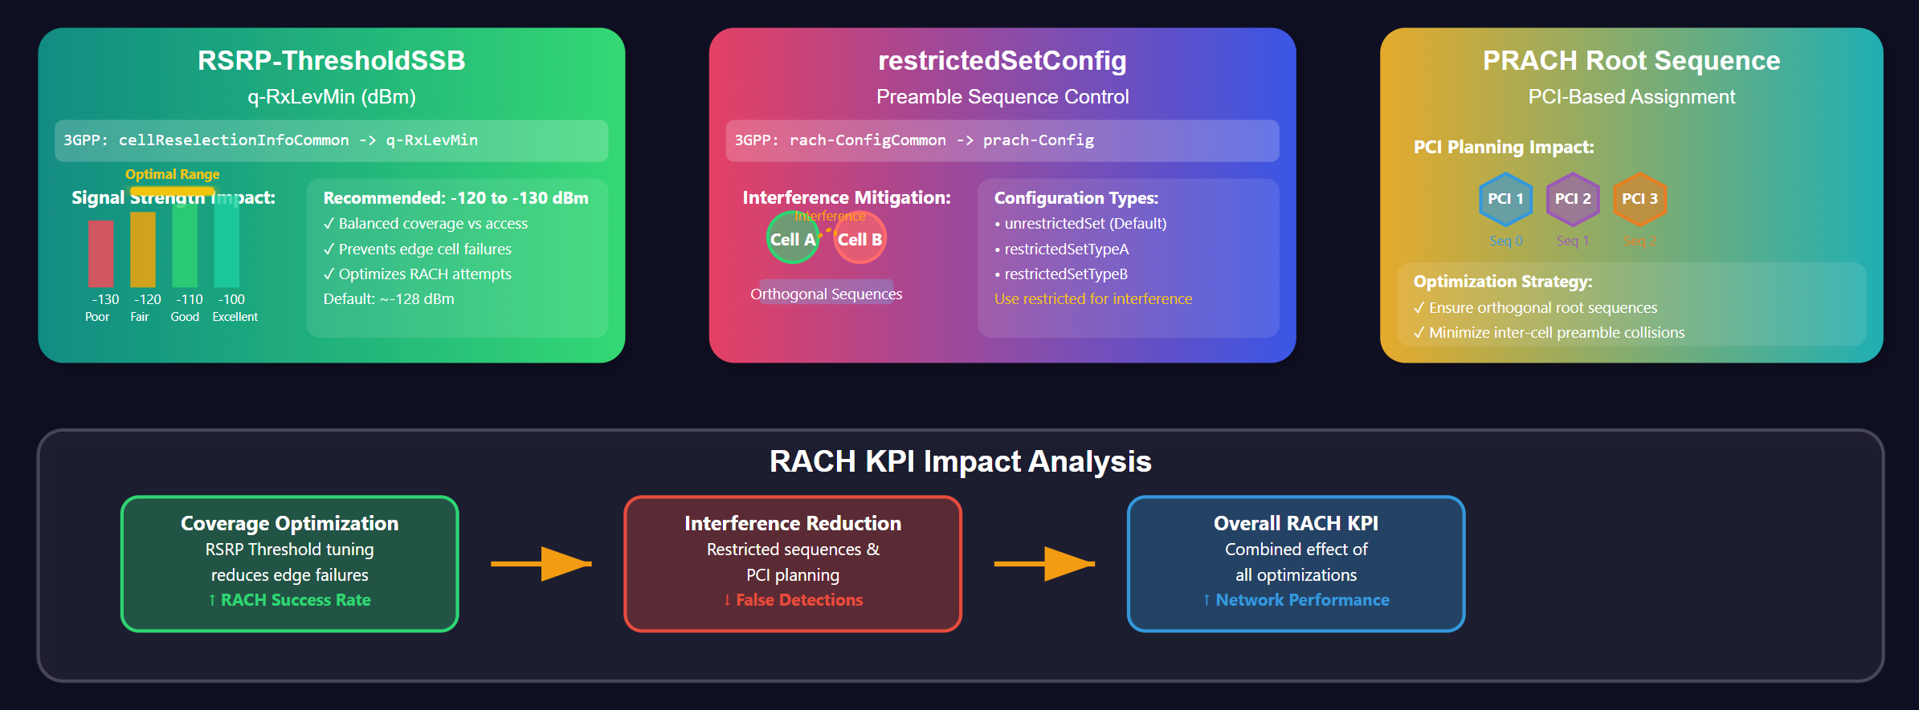
Cell Selection & Contention

Slide 65
5G RACH Contention Resolution Timer (ra-ContentionResolutionTimer)
UE
gNB
Msg1: RACH Preamble
Msg2: Random Access Response (RAR)
Msg3: Scheduled Transmission
Timer Starts
Contention Resolution
Timer Configuration
Timer Expiry Scenario
Timer Period
3GPP Reference:
If timer expires before Msg4:
sl32 or sl64
rach-ConfigCommon →
1. RACH procedure fails
(32 or 64 slots)
rach-ConfigGeneric →
2. UE may retry RACH
ra-ContentionResolutionTimer
3. Increased access delay
Recommended Setting:
4. Potential call setup failure
UE Monitors
sl32 or sl64 (32 or 64 slots)
Optimization Strategy:
for Msg4
Default/Typical:
Set timer considering:
Often sl64
• gNB processing time
Impact on KPIs:
• Network load conditions
• Too Short: UE aborts RACH early
Msg4: Contention Resolution Message
• Too Long: Increases latency
• Optimal: Balances success rate
and latency performance
Timer Stops
Timer Start
Time →
Msg4 Received

Slide 66
RACH Success Rate Optimization Strategy
1. MONITOR & BASELINE
2. ANALYZE ROOT CAUSES
3. ITERATIVE ADJUSTMENT
4. VERIFY &
• Monitor RACH Success Rate KPI
• Drive tests & counters analysis
• Parameter optimization
RE-EVALUATE
• Identify problematic cells
• Msg1/Msg2 failure analysis
• Power control tuning
• Monitor KPI changes
• Establish baseline metrics
• Resource limitation check
• Resource configuration
• Validate improvements
• Identify problematic areas
• Coverage optimization
• Check trade-offs
• Coverage issue identification
POWER CONTROL PARAMETERS
RESOURCE CONFIGURATION
ANALYSIS TOOLS & METHODS
PreambleInitialReceivedTargetPower
PRACH-ConfigIndex
Drive Test Analysis
PowerRampingStep
msg1-FDM
Counter Monitoring
PreambleTransMax
ra-ResponseWindow
Trace Analysis
RSRP-ThresholdSSB
restrictedSetConfig
PCI Planning
Purpose: Optimal initial power
Purpose: Capacity optimization
Purpose: Root cause identification
and efficient ramping control
Resource allocation tuning
Performance validation
Balance success vs latency
Msg2 reception improvement
Issue troubleshooting
Coverage edge optimization
Interference mitigation
Network optimization
KEY OPTIMIZATION CONSIDERATIONS
Legend:
Trade-offs to Monitor:
Success Metrics:
Process Steps
• Increasing PreambleTransMax improves success rate but increases latency
• RACH Success Rate improvement (target: >95%)
Analysis Phase
• Higher PowerRampingStep reduces attempts but may cause interference
• Reduced average RACH attempts per success
Feedback Loop
• More PRACH resources improve capacity but consume spectrum
• Improved cell edge performance
Continuous Process:
Monitor → Analyze → Adjust → Verify → Repeat

Slide 67
RRC Connection Setup Success Rate Analysis
KPI DEFINITION
Success Rate = (Successful RRC Setup Procedures) / (Total RRC Setup Attempts)
Target: >98% | Typical Range: 95-99%
RRC CONNECTION SETUP PROCEDURE FLOW
UE
gNB
PUSCH
1. RRCSetupRequest (Msg3)
PDCCH+PDSCH
✓
✗
PDCCH+PUSCH
2. RRCSetup (PDSCH)
SUCCESS
FAILURE
3. RRCSetupComplete
ROOT CAUSES FOR LOW SUCCESS RATE
PRECEDING RACH
RADIO CONDITIONS
RESOURCE
TIMER EXPIRATION
CONFIGURATION
NETWORK & UE
FAILURE
Poor RSRP/SINR
AVAILABILITY
T300 Timer (UE)
ISSUES
ISSUES
Msg1/Msg2 Issues
UL Interference
C-RNTI Shortage
T302 Timer (UE)
Wrong Parameters
Backhaul Delays
PRACH Detection
DL Coverage Issues
PUSCH/PDSCH
gNB RRC Timer
SIB Errors
Core Network
Power Control
Mobility Issues
Processing Load
Scheduling Delays
RRC IE Issues
UE Implementation
Resource Conflicts
Channel Quality
Memory Issues
Processing Delays
Security Config
UE Capability
MOST COMMON
COVERAGE RELATED
CAPACITY RELATED
TIMING RELATED
PARAMETER RELATED
EXTERNAL FACTORS
~60-70% of failures
~20-25% of failures
~5-10% of failures
~3-5% of failures
~2-3% of failures
~1-2% of failures
OPTIMIZATION STRATEGY & KEY PARAMETERS
1. RACH OPTIMIZATION
2. COVERAGE ANALYSIS
3. RESOURCE TUNING
4. TIMER OPTIMIZATION
5. CONFIG REVIEW
6. MONITORING
• Fix underlying RACH
• RF optimization
• C-RNTI pool sizing
• T300/T302 tuning
• Parameter validation
• Continuous KPI tracking
• Power control tuning
• Interference mitigation
• PUSCH/PDSCH allocation
• Scheduling efficiency
• SIB consistency
• Root cause analysis
• Resource optimization
• Cell planning review
• Processing capacity
• Processing delays
• RRC IE correctness
• Performance validation
Primary Impact: 60-70%
Primary Impact: 20-25%
Primary Impact: 5-10%
Primary Impact: 3-5%
Primary Impact: 2-3%
Ongoing Process
KEY PARAMETERS TO MONITOR & OPTIMIZE
RRC Timers:
Resource Parameters:
Coverage Parameters:
Processing Parameters:
• T300 (RRC Setup Timer) • T302 (RRC Reject Timer)
• C-RNTI Pool Size • PUSCH/PDSCH Allocation
• Reference Signal Power • Coverage Thresholds
• Scheduling Efficiency • Load Balancing
OPTIMIZATION PRIORITY: Start with RACH (highest impact) → Coverage → Resources → Timers → Configuration

Slide 68
5G RRC Connection Setup Timers - Technical Architecture
3GPP TS 38.331 | Critical Parameters for Latency & Success Rate Optimization
UE (User Equipment)
gNB (Base Station)
T300 Timer
1. RRCSetupRequest
gNB Processing Time (Critical Window)
Internal Timers
Started: RRCSetupRequest
T300 Timer Started
Resource Allocation | Authentication | Bearer Setup
RRCSetupRequest Processing
Stopped: RRCSetup received
RRCSetup Transmission
Expire: Connection Failed
2. RRCSetup
RRCSetupComplete Wait
Recommended: 200-300ms
Must arrive before T300
Performance Factors
Balance: Speed vs Reliability
3. RRCSetupComplete
• CPU Load & Processing
Default: 300ms typical
Connection Established
• C-RNTI Pool Availability
• Backhaul Latency
UE Process Flow
Timeout/Failure → Restart RACH
• Scheduling Efficiency
1. Send RRCSetupRequest
Vendor Tunable
2. Start T300 Timer
Internal Algorithm Optimization
KPI Impact Analysis
RRC Setup Success Rate
Connection Setup Latency
Too Short T300
High Load Impact: 50% increase
• Premature timeout during load spikes
• Higher failure rate in edge coverage
Too Long T300
Optimized: 40% improvement
• Resource waste on bad connections
Optimal T300 + gNB tuning = Best UX
Optimization Strategy (3GPP TS 38.331)
UE Side:
gNB Side:
• T300 = 200-300ms (balance reliability vs speed)
• Adequate CPU/memory provisioning
• Monitor coverage conditions for adaptive timeout
• C-RNTI pool sizing, efficient scheduling algorithms
3GPP TS 38.331 - MeasAndMobParametersMRDC
Target: >95% Success Rate, <100ms Setup Time

Slide 69
RACH Parameters - Prerequisites for RRC Setup
UE
gNB
MSG1: PRACH Preamble
MSG1 Parameters
Configuration
• PreambleInitialReceivedTargetPower
• msg1-FDM
• powerRampingStep
• PreambleTransMax
• PRACH-ConfigIndex
(Max attempts)
MSG2: RAR (Random Access Response)
MSG2 Timing
• ra-ResponseWindow
(Window to receive RAR)
MSG3: RRC Setup Request
RRC Connection Starts
MSG4: Contention Resolution
Contention Resolution
• ra-ContentionResolutionTimer
(Critical for contention-based RACH)
RRC Connected
Power Ramping Process
Parameter Relationships
Critical Timer Windows
P1
P2
P3
P4
🔗 PRACH-ConfigIndex defines time/frequency
ra-ResponseWindow (MSG2 timeout)
🔗 msg1-FDM affects preamble multiplexing
Initial Power + (Attempt × powerRampingStep)
🔗 Power ramping prevents interference
ra-ContentionResolutionTimer (MSG4)
Max attempts = PreambleTransMax
🔗 Timer windows ensure reliability
Each step increases transmission power
🔗 All parameters must be optimized together
Timers ensure proper procedure completion
Failure triggers retransmission or abort

Slide 70
3GPP Parameters for RRC Connection Setup Success Rate Improvement
Parameter Name | 3GPP Reference (IE Path in SIB1) | Explanation | Default/Typical Setting | Recommended Setting | How it Helps Improve RRC KPI
I. RRC Connection Setup Timers (Critical for Latency & Success)
T300 (ms) | servingCellConfigCommon -> rrc-SetupCommon -> T300 (implicitly derived from rrc-config in some structures, or similar) | The UE starts this timer when it sends RRCSetupRequest. If no RRCSetup message is received before T300 expires, the UE aborts the RRC connection attempt. | ms300 (300ms) | ms200 or ms300 (200-300ms) | Crucial. If too short, UE aborts prematurely, even if gNB is slightly delayed, leading to RRC failures. If too long, increases latency. Ensures UE waits long enough for gNB response.
ra-ContentionResolutionTimer (slots) | rach-ConfigCommon -> rach-ConfigGeneric -> ra-ContentionResolutionTimer | In contention-based RACH, this timer is started by the UE after transmitting Msg3 (RRCSetupRequest). If Msg4 (Contention Resolution) is not received before this timer expires, the RACH (and thus RRC) procedure fails. | sl64 (64 slots) | sl32 or sl64 (32-64 slots) | Indirect but Critical. For contention-based RRC setup, a too-short timer can cause failure even if the gNB is processing Msg3. Ensures UE waits sufficiently for Msg4, completing the prerequisite RACH before RRCSetup.
II. Physical Layer and Resource Configuration for RRC Messages
msg3-DeltaPreamble (dB) | rach-ConfigCommon -> msg3-DeltaPreamble | Power offset between the last transmitted preamble (Msg1) and the first uplink transmission on UL-SCH (Msg3, which carries RRCSetupRequest). | 0 dB | 0 dB or 1 dB | Direct. Optimizes the transmit power for RRCSetupRequest. If too low, RRCSetupRequest might not be detected. If too high, causes excessive UL interference. A balanced value ensures reliable reception.
msg3-TransformPrecoding | rach-ConfigCommon -> msg3-TransformPrecoding | Enables or disables transform precoding for Msg3 transmission. Transform precoding improves UL coverage and power efficiency. | Enabled for FR1 typically | Enabled | Direct. Enhances the reliability of RRCSetupRequest transmission, especially at cell edge, by providing better SINR at the gNB, reducing Msg3 detection failures.
PDCCH-ConfigCommon (via controlResourceSetZero and searchSpaceZero) | sib1 -> controlResourceSetZero, searchSpaceZero | These configure the common CORESET and search space where the UE monitors PDCCH for initial access, including the scheduling of RRCSetup and the UL grant for RRCSetupComplete. | Varies by SIB1 and pdcch-ConfigSIB1 settings. | Ensure optimal power allocation for PDCCH and robust MCS (e.g., QPSK) for common search space. | Direct. If PDCCH is not reliably received, the UE cannot get the scheduling information for RRCSetup (DL) or the UL grant for RRCSetupComplete (UL), leading to RRC failures.
pdsch-ConfigCommon (relevant for RRCSetup message) | sib1 -> pdsch-ConfigCommon | Defines common PDSCH configurations, including MCS tables, resource allocation types, and rate matching. Affects how RRCSetup is transmitted on PDSCH. | Varies (e.g., MCS table, R-match pattern) | Ensure robust MCS (e.g., lower order modulation like QPSK) and proper rate matching for common channels. | Direct. The RRCSetup message is critical. Using robust physical layer settings for its transmission ensures it can be reliably decoded by the UE, even in challenging radio conditions.
pusch-ConfigCommon (relevant for RRCSetupComplete message) | sib1 -> pusch-ConfigCommon | Defines common PUSCH configurations, including MCS tables and transform precoding for common channels. Affects how RRCSetupComplete is transmitted on PUSCH. | Varies | Similar to pdsch-ConfigCommon, ensure robust MCS and optimal transform precoding for UL common channels. | Direct. RRCSetupComplete confirms the RRC connection. Robust UL settings ensure this final critical message is reliably received by the gNB, preventing RRC setup failures.

Slide 71
3GPP Parameters for RRC Connection Setup Success Rate Improvement
Parameter Name | 3GPP Reference (IE Path in SIB1) | Explanation | Default/Typical Setting | Recommended Setting | How it Helps Improve RRC KPI
III. RACH Resource & Signaling (Prerequisites for RRC)
PreambleInitialReceivedTargetPower (dBm) | rach-ConfigCommon -> rach-ConfigGeneric -> PreambleInitialReceivedTargetPower | The target power level at which the gNB expects to receive the first preamble transmission from the UE. UE calculates its initial preamble TX power based on this. | -100 dBm to -110 dBm | Adjust between -120 dBm and -90 dBm. Lower for larger cells/poor coverage, higher for good coverage. | Indirect but foundational. Successful RACH is a prerequisite for RRC setup. Optimal preamble power ensures the first step of initial access is robust, allowing the UE to proceed to RRCSetupRequest.
powerRampingStep (dB) | rach-ConfigCommon -> rach-ConfigGeneric -> powerRampingStep | Step size by which the UE increases its preamble transmit power for subsequent retransmissions if the previous attempt fails. | 4 dB | 2 dB or 3 dB | Indirect but foundational. Efficient power ramping helps the UE quickly find the optimal power for preamble detection, reducing RACH retransmissions and improving the chance of reaching the RRC setup phase.
PreambleTransMax | rach-ConfigCommon -> rach-ConfigGeneric -> PreambleTransMax | Maximum number of preamble retransmissions allowed before the RACH procedure is considered a failure by the UE. | n10 or n20 (10 or 20) | n8 or n10 (8 or 10) | Indirect but foundational. A balanced value allows sufficient attempts for preamble detection without excessive delay, ensuring the UE doesn't give up too early on RACH.
ra-ResponseWindow (slots) | rach-ConfigCommon -> rach-ConfigGeneric -> ra-ResponseWindow | The time window during which the UE monitors PDCCH for the Random Access Response (RAR/Msg2) after transmitting a preamble. | sl20 (20 slots) | sl20 or sl40 (20-40 slots) | Indirect but foundational. A sufficiently long window ensures the UE receives Msg2 from the gNB, allowing the RACH procedure to complete and the UE to send RRCSetupRequest.

Slide 72
3GPP Parameters for RRC Connection Setup Success Rate Improvement
Parameter Name | 3GPP Reference (IE Path in SIB1) | Explanation | Default/Typical Setting | Recommended Setting | How it Helps Improve RRC KPI
III. RACH Resource & Signaling (Prerequisites for RRC)
PRACH-ConfigIndex | rach-ConfigCommon -> prach-Config -> prach-ConfigIndex | Points to a 3GPP table specifying PRACH configuration (preamble format, SCS, periodicity, slots, etc.). | Varies by deployment | Select an index providing sufficient PRACH capacity/frequency for expected RACH load. | Indirect but foundational. Determines the availability and type of PRACH resources. Insufficient or misaligned PRACH resources can lead to preamble collisions or inability to find resources, failing RACH before RRC setup.
msg1-FDM (Frequency Division Multiplexing) | rach-ConfigCommon -> rach-ConfigGeneric -> msg1-FDM | Specifies the number of frequency-multiplexed PRACH occasions within a given time resource. | 1 or 2 | 2, 4, or 8 (increase for higher load) | Indirect but foundational. Increases the number of available RACH resources per PRACH occasion, enhancing the capacity for simultaneous random accesses. This reduces preamble collisions and congestion, boosting RACH success.
restrictedSetConfig | rach-ConfigCommon -> prach-Config -> restrictedSetConfig | Restricts the set of Zadoff-Chu sequences (preambles) that can be used. | unrestrictedSet | unrestrictedSet as default. Use restrictedSetTypeA or restrictedSetTypeB in interference-limited scenarios. | Indirect but foundational. Helps reduce inter-cell preamble interference and false detections, leading to more reliable Msg1 reception and hence more successful RACH procedures.
IV. Cell Selection/System Information (Foundational for Initial Access)
q-RxLevMin / ssb-RSRP (dBm) | cellReselectionInfoCommon -> q-RxLevMin (for LTE/NR inter-RAT); servingCellConfigCommon -> ssb-RSRP (for NR cell selection) | Minimum RSRP level required for a UE to select a cell for initial access and RRC setup. | -128 dBm (often) | Between -120 dBm and -130 dBm. | Indirect but essential. If set too low, UEs might attempt RRC setup on cells with very poor radio conditions where success is unlikely, artificially lowering the KPI. Ensures attempts are made on cells with a reasonable chance of success.
pdcch-ConfigSIB1 / pdsch-ConfigSIB1 | sib1 -> pdcch-ConfigSIB1, pdsch-ConfigSIB1 (implicit) | These common configurations define how SIB1 is scheduled and transmitted (e.g., CORESET, search space, MCS for SIB1). | Varies by vendor/deployment | Ensure robust MCS (e.g., QPSK) and adequate power for SIB1 transmission. | Foundational. SIB1 carries all the essential parameters (including many above) for initial access and RRC setup. If SIB1 is not reliably received, the UE cannot even attempt RACH or RRC.

Slide 73
Retainbility KPI

Slide 74
Call Drop Rate Analysis - Radio Link Failure (RLF) Root Causes
Call Drop Rate Formula:
Key Definition:
CDR = (Number of abnormal call/session terminations)
• Network legitimate reasons (e.g., session timeout)
÷ (Total number of successfully established calls/sessions)
Primary Root Cause: Radio Link Failure (RLF)
• User actions (e.g., end call button)
Abnormal terminations are those NOT initiated by:
7 Primary Causes of Call Drops Leading to RLF
1
Poor Radio Conditions
2
Mobility Issues
3
Interference
• Persistent weak signal (RSRP)
• Failed handovers (inter/intra-gNB)
• High UL/DL interference
^{• Low SINR in UL/DL}
^{• Corrupted data signals}
^{• Inter-RAT handover failures}
^{• Control signal corruption}
^{• Signal degradation}
^{• Beam mobility failures (FR2)}
4
Resource Limitations
5
gNB/Core Network Issues
6
UE Issues
• Insufficient PDCCH capacity
• Network overload conditions
• Faulty UE hardware
^{• Scheduling failures}
^{• Hardware/software faults}
^{• Software bugs/issues}
^{• PUSCH/PDSCH RB shortage}
^{• Backhaul congestion}
^{• Abnormal UE behavior}
7
Protocol/Timer Mismatches
• Incorrect timer configurations at RLC, PDCP, or RRC layers
• Premature RLF declaration due to timer mismatches
• Protocol stack synchronization issues
RLF
CALL DROP
5G Network Optimization: Understanding and Mitigating Call Drop Scenarios
Comprehensive analysis of RLF root causes for improved network performance and user experience

Slide 75
Call Drop Rate Improvement Plan
RLC Parameters (Acknowledged Mode - AM, most relevant for call drops):
Parameter Name | 3GPP Reference (Relevant Context) | Explanation | Default/Typical Setting | Recommended Setting | How it Helps Improve Call Drop KPI
maxRetxThreshold | RLC-Config -> am-Config -> maxRetxThreshold | Defines the maximum number of retransmissions for an RLC PDU (Protocol Data Unit) or SDU (Service Data Unit) before the RLC entity indicates a failure to the higher layer (PDCP). | t8 (8 retransmissions), t16 (16 retransmissions), t32 (32 retransmissions) | t16 or t32 (Higher value for robustness, especially in cells with fluctuating radio conditions) | Direct. A higher maxRetxThreshold allows the RLC layer more attempts to successfully deliver data over the air interface, increasing robustness against transient radio issues and delaying the declaration of RLF. This directly reduces call drops caused by temporary data loss.
pollPDU | RLC-Config -> am-Config -> pollPDU | Specifies that a POLL (request for RLC Status Report) is triggered every pollPDU number of RLC SDUs transmitted. | p4, p8, p16, p32, p64, p128, p256, pInfinity (often p8 or p16) | p4 or p8 (Lower value to detect errors faster) | Direct. A lower pollPDU value means the UE/gNB requests status reports more frequently. This allows faster detection of missing RLC PDUs and quicker retransmission initiation, reducing overall data loss and preventing RLF from prolonged data stalls.
pollByte | RLC-Config -> am-Config -> pollByte | Specifies that a POLL is triggered every pollByte number of bytes transmitted. | kB1, kB2, kB4, etc. (often kB2 or kB4) | kB1 or kB2 (Lower value to detect errors faster) | Direct. Similar to pollPDU, a lower pollByte value triggers status reports more often. This is beneficial for applications with large data bursts, ensuring timely error detection and retransmissions, thus contributing to call stability.
t-PollRetransmit (ms) | RLC-Config -> am-Config -> t-PollRetransmit | Timer for retransmitting a POLL (status report request) if no corresponding STATUS PDU is received. | ms45, ms50, ms55, ..., ms500 (e.g., ms100) | ms80 to ms150 (Adjust based on latency requirements and radio conditions) | Direct. If a POLL is sent but no status report is received, this timer dictates how long the RLC entity waits before sending another POLL. A shorter timer leads to faster retransmission attempts, improving the chances of recovering lost RLC PDUs before RLF is triggered.
t-Reassembly (ms) | RLC-Config -> am-Config -> t-Reassembly | Timer used by the receiving RLC entity to reassemble an SDU from received RLC PDUs. If parts of an SDU are missing and this timer expires, the partial SDU is discarded. | ms35, ms40, ms45, ..., ms500 (e.g., ms100) | ms100 to ms200 (Slightly higher value for robustness in poor conditions) | Indirect. If this timer expires due to missing segments, the entire SDU is discarded, leading to data loss at the RLC layer. A slightly longer t-Reassembly gives more time for delayed or retransmitted segments to arrive, improving in-sequence delivery and reducing data loss that might contribute to higher layer failures.
t-StatusProhibit (ms) | RLC-Config -> am-Config -> t-StatusProhibit | Timer that prevents an RLC entity from sending too many STATUS PDUs (reports) in a short period. | ms0, ms5, ms10, ..., ms500 (e.g., ms10 or ms20) | ms10 to ms30 (Balance between rapid error reporting and resource consumption) | Indirect. While higher values can reduce signaling overhead (saving resources), excessively high values might delay the gNB/UE from receiving critical status information about lost PDUs, potentially slowing down recovery and contributing to RLF. A balanced value ensures timely reporting without overwhelming the control channels.

Slide 76
Call Drop Rate Improvement Plan
Parameter Name | 3GPP Reference (Relevant Context) | Explanation | Default/Typical Setting | Recommended Setting | How it Helps Improve Call Drop KPI
I. Radio Link Failure (RLF) Detection & Recovery
T310 (ms) | RRCReconfiguration / RRCSetup -> radioLinkMonitoringConfig -> T310 | Timer started by the UE when it detects "out-of-sync" conditions (e.g., too many consecutive negative physical layer indications from lower layers like PHY/MAC). | ms0, ms200, ms500, ms1000, ms2000 (e.g., ms500) | ms1000 or ms2000 (Higher for robustness) | Critical. A higher T310 allows the UE to tolerate longer periods of poor radio conditions (e.g., temporary fading or interference) before declaring an RLF, thus preventing premature call drops.
N310 | RRCReconfiguration / RRCSetup -> radioLinkMonitoringConfig -> N310 | Number of consecutive "out-of-sync" indications from the physical layer required for the UE to start T310. | n1, n2, n3, n4, n6, n8, n10, n20 (e.g., n10) | n10 or n20 (Higher for robustness) | Critical. A higher N310 makes the RLF detection more robust to sporadic physical layer issues, preventing the premature start of T310 and declaration of RLF.
T311 (ms) | RRCReconfiguration / RRCSetup -> radioLinkMonitoringConfig -> T311 | Timer started by the UE upon declaring an RLF. During this time, the UE attempts RRC re-establishment. If re-establishment fails, the connection is dropped. | ms1000, ms3000, ms5000, ms10000, ms30000 (e.g., ms5000) | ms5000 or ms10000 (Higher for more recovery time) | Critical. A longer T311 gives the UE more time to successfully re-establish an RRC connection (e.g., by performing a handover to a better cell) after an RLF, thereby salvaging the call.
N311 | RRCReconfiguration / RRCSetup -> radioLinkMonitoringConfig -> N311 | Number of consecutive "in-sync" indications from the physical layer required to stop T310. | n1, n2, n3, n4, n5, n6, n8, n10 (e.g., n1) | n1 or n2 (Lower for faster recovery from T310 start) | Important. A lower N311 allows the UE to quickly stop T310 if radio conditions improve rapidly, preventing unnecessary RLF declarations.
II. Mobility and Handover Optimization
A3-Offset (dB) | MeasObjectNR -> reportConfigNR -> reportConfigA3 -> a3-Offset | Defines the offset for the A3 event, which triggers inter-frequency/inter-RAT handovers when neighbor cell RSRP becomes serving cell RSRP + offset. | 0 to 6 dB (e.g., 2 dB) | 1 dB to 3 dB (Lower for quicker handover, higher for stickiness) | Crucial. An optimized A3-Offset ensures timely handovers to stronger target cells, preventing the serving cell's signal from degrading to a point where RLF is triggered. Too high a value can delay HO, too low can cause ping-pong.
Hysteresis (dB) | MeasObjectNR -> reportConfigNR -> reportConfigA3 -> hysteresis | Margin applied to measurement events to prevent frequent triggering (ping-pong effect). | 0 to 4 dB (e.g., 0 dB or 1 dB) | 0 dB to 2 dB (Lower for faster HO, higher for stability) | Important. Prevents unnecessary handovers back and forth between cells, which can consume resources and lead to instability, reducing the chance of mobility-related drops.
TimeToTrigger (ms) | MeasObjectNR -> reportConfigNR -> reportConfigA3 -> timeToTrigger | Duration for which a measurement event condition must be continuously met before the UE sends a measurement report. | ms0, ms40, ms64, ms100, ..., ms5120 (e.g., ms256) | ms128 to ms512 (Balance between fast reaction and avoiding spurious triggers) | Crucial. A well-tuned TimeToTrigger ensures the UE only initiates handover when the target cell's signal is consistently better, preventing drops from "bad" handovers to temporarily strong but unstable cells.
drx-Config (drx-onDurationTimer, drx-inactivityTimer, etc.) | DRX-Config (part of MAC-CellGroupConfig) | Defines the Discontinuous Reception (DRX) cycle, balancing power saving vs. latency. | Varies greatly (e.g., onDurationTimer=psf16, inactivityTimer=psf256) | Tune based on traffic profile: Shorter timers/cycles for active users, longer for inactive. | Indirect. While primarily for power saving, an overly aggressive DRX configuration (too long drx-inactivityTimer, too short drx-onDurationTimer) can cause delays in receiving DL assignments, leading to data buffering issues at gNB/UE, potentially triggering RLC/PDCP failures that contribute to RLF.

Slide 77
The Three Key Parameters
Parameter | Layer | Description
t-PollRetransmit | RLC (Radio Link Control) | Determines how long the RLC entity waits for a Status Report from its peer after sending a PDU with a "POLL" bit. A POLL is a request for the receiver to report what it has successfully received.
maxRetxThreshold | RLC (Radio Link Control) | The maximum number of times a single RLC SDU (Service Data Unit) or a segment of it can be retransmitted. It's a failure counter, not a timer.
t310 | RRC (Radio Resource Control) | The "Radio Link Failure" timer. It starts when the UE's physical layer detects a serious problem (N310 consecutive "out-of-sync" indications). If the link doesn't recover before t310 expires, the UE declares a Radio Link Failure (RLF) and drops the connection.

Slide 78
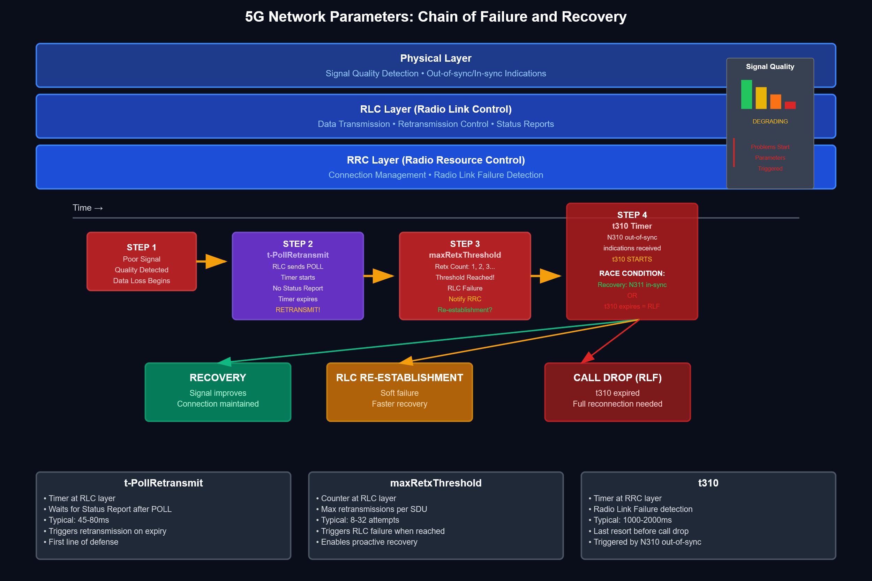

Slide 79
Call Drop Rate Improvement Plan
Scenario | maxRetxThreshold Setting | t-PollRetransmit (ms) Setting | t310 (ms) Setting | Rationale & Goal | Pros | Cons
Excellent Coverage / Stable RF (e.g., Indoor Small Cell, FWA) | Low (e.g., 4, 8) | Short (e.g., 45-80 ms) | Short (e.g., 500-1000 ms) | Goal: High Performance. Failures are rare and likely permanent. Detect and act on them quickly for low latency. | Fast Failure Detection: Quickly identifies non-recoverable links. ,Low Latency: Reduces delays caused by waiting for retransmissions. | Low Resilience: Can be too sensitive to brief, transient interference, leading to unnecessary connection drops.
Cell Edge / Poor RF (e.g., Rural, Indoor Fringe) | High (e.g., 16, 32) | Long (e.g., 120-200 ms) | Long (e.g., 2000-4000 ms) | Goal: High Stability. Packet loss is expected. Tolerate temporary link degradation to maintain the connection. | High Connection Stability: Prevents drops during temporary fades. ,Improved User Experience: The user perceives a slow but connected session rather than a dropped one. | Slow Failure Detection: Masks underlying permanent issues. ,Increased Latency: High buffer delay as the system waits longer to retransmit and recover.
High Mobility (e.g., Vehicle, High-Speed Train) | Medium (e.g., 8, 16) | Medium (e.g., 80-120 ms) | Medium-Long (e.g., 1000-2000 ms) | Goal: Balance. Tolerate handover-related interruptions but don't wait indefinitely if the handover fails or the UE loses coverage. | Robust Handover Performance: t310 is long enough to allow a handover to complete. ,Good compromise: Balances stability with responsiveness. | Can be a sub-optimal "one-size-fits-all" setting if the user stops or enters a very poor coverage zone.
Massive IoT (mMTC) (e.g., Smart Meters, Sensors) | High (e.g., 16, 32, or higher) | Long (e.g., 200-500 ms) | Very Long (e.g., 4000-6000 ms) | Goal: Maximize Battery & Connection. Latency is not a concern. Avoid RRC state transitions (Idle <-> Connected) which drain power. | Excellent Connection Retention: Keeps devices connected even in deep indoor locations with fluctuating links. ,Power Savings: Avoids costly re-establishment procedures. | Extremely Slow Reaction: Unsuitable for any application needing timely data. ,Can tie up network resources for devices that are permanently out of reach.

Slide 80
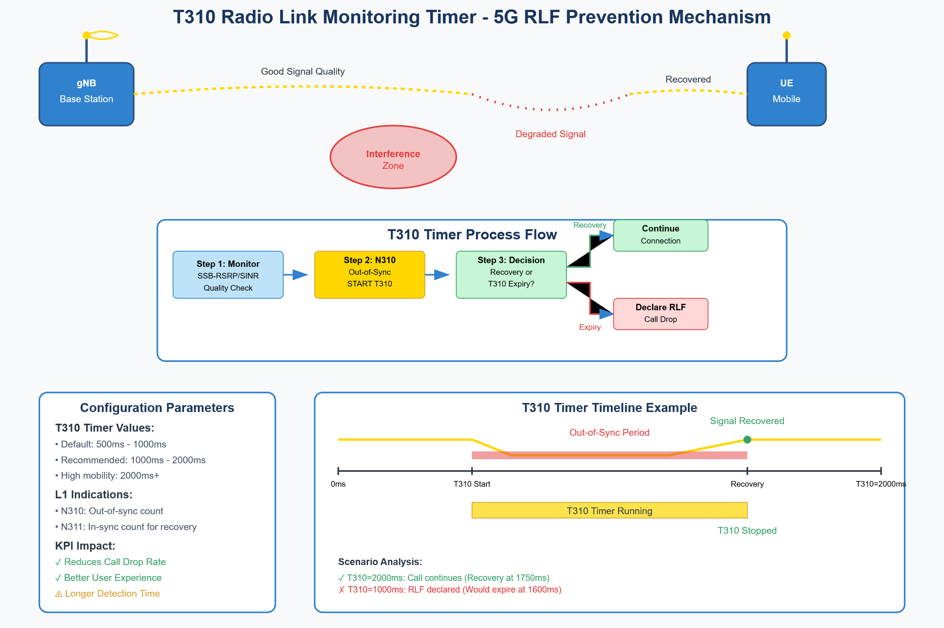

Slide 81
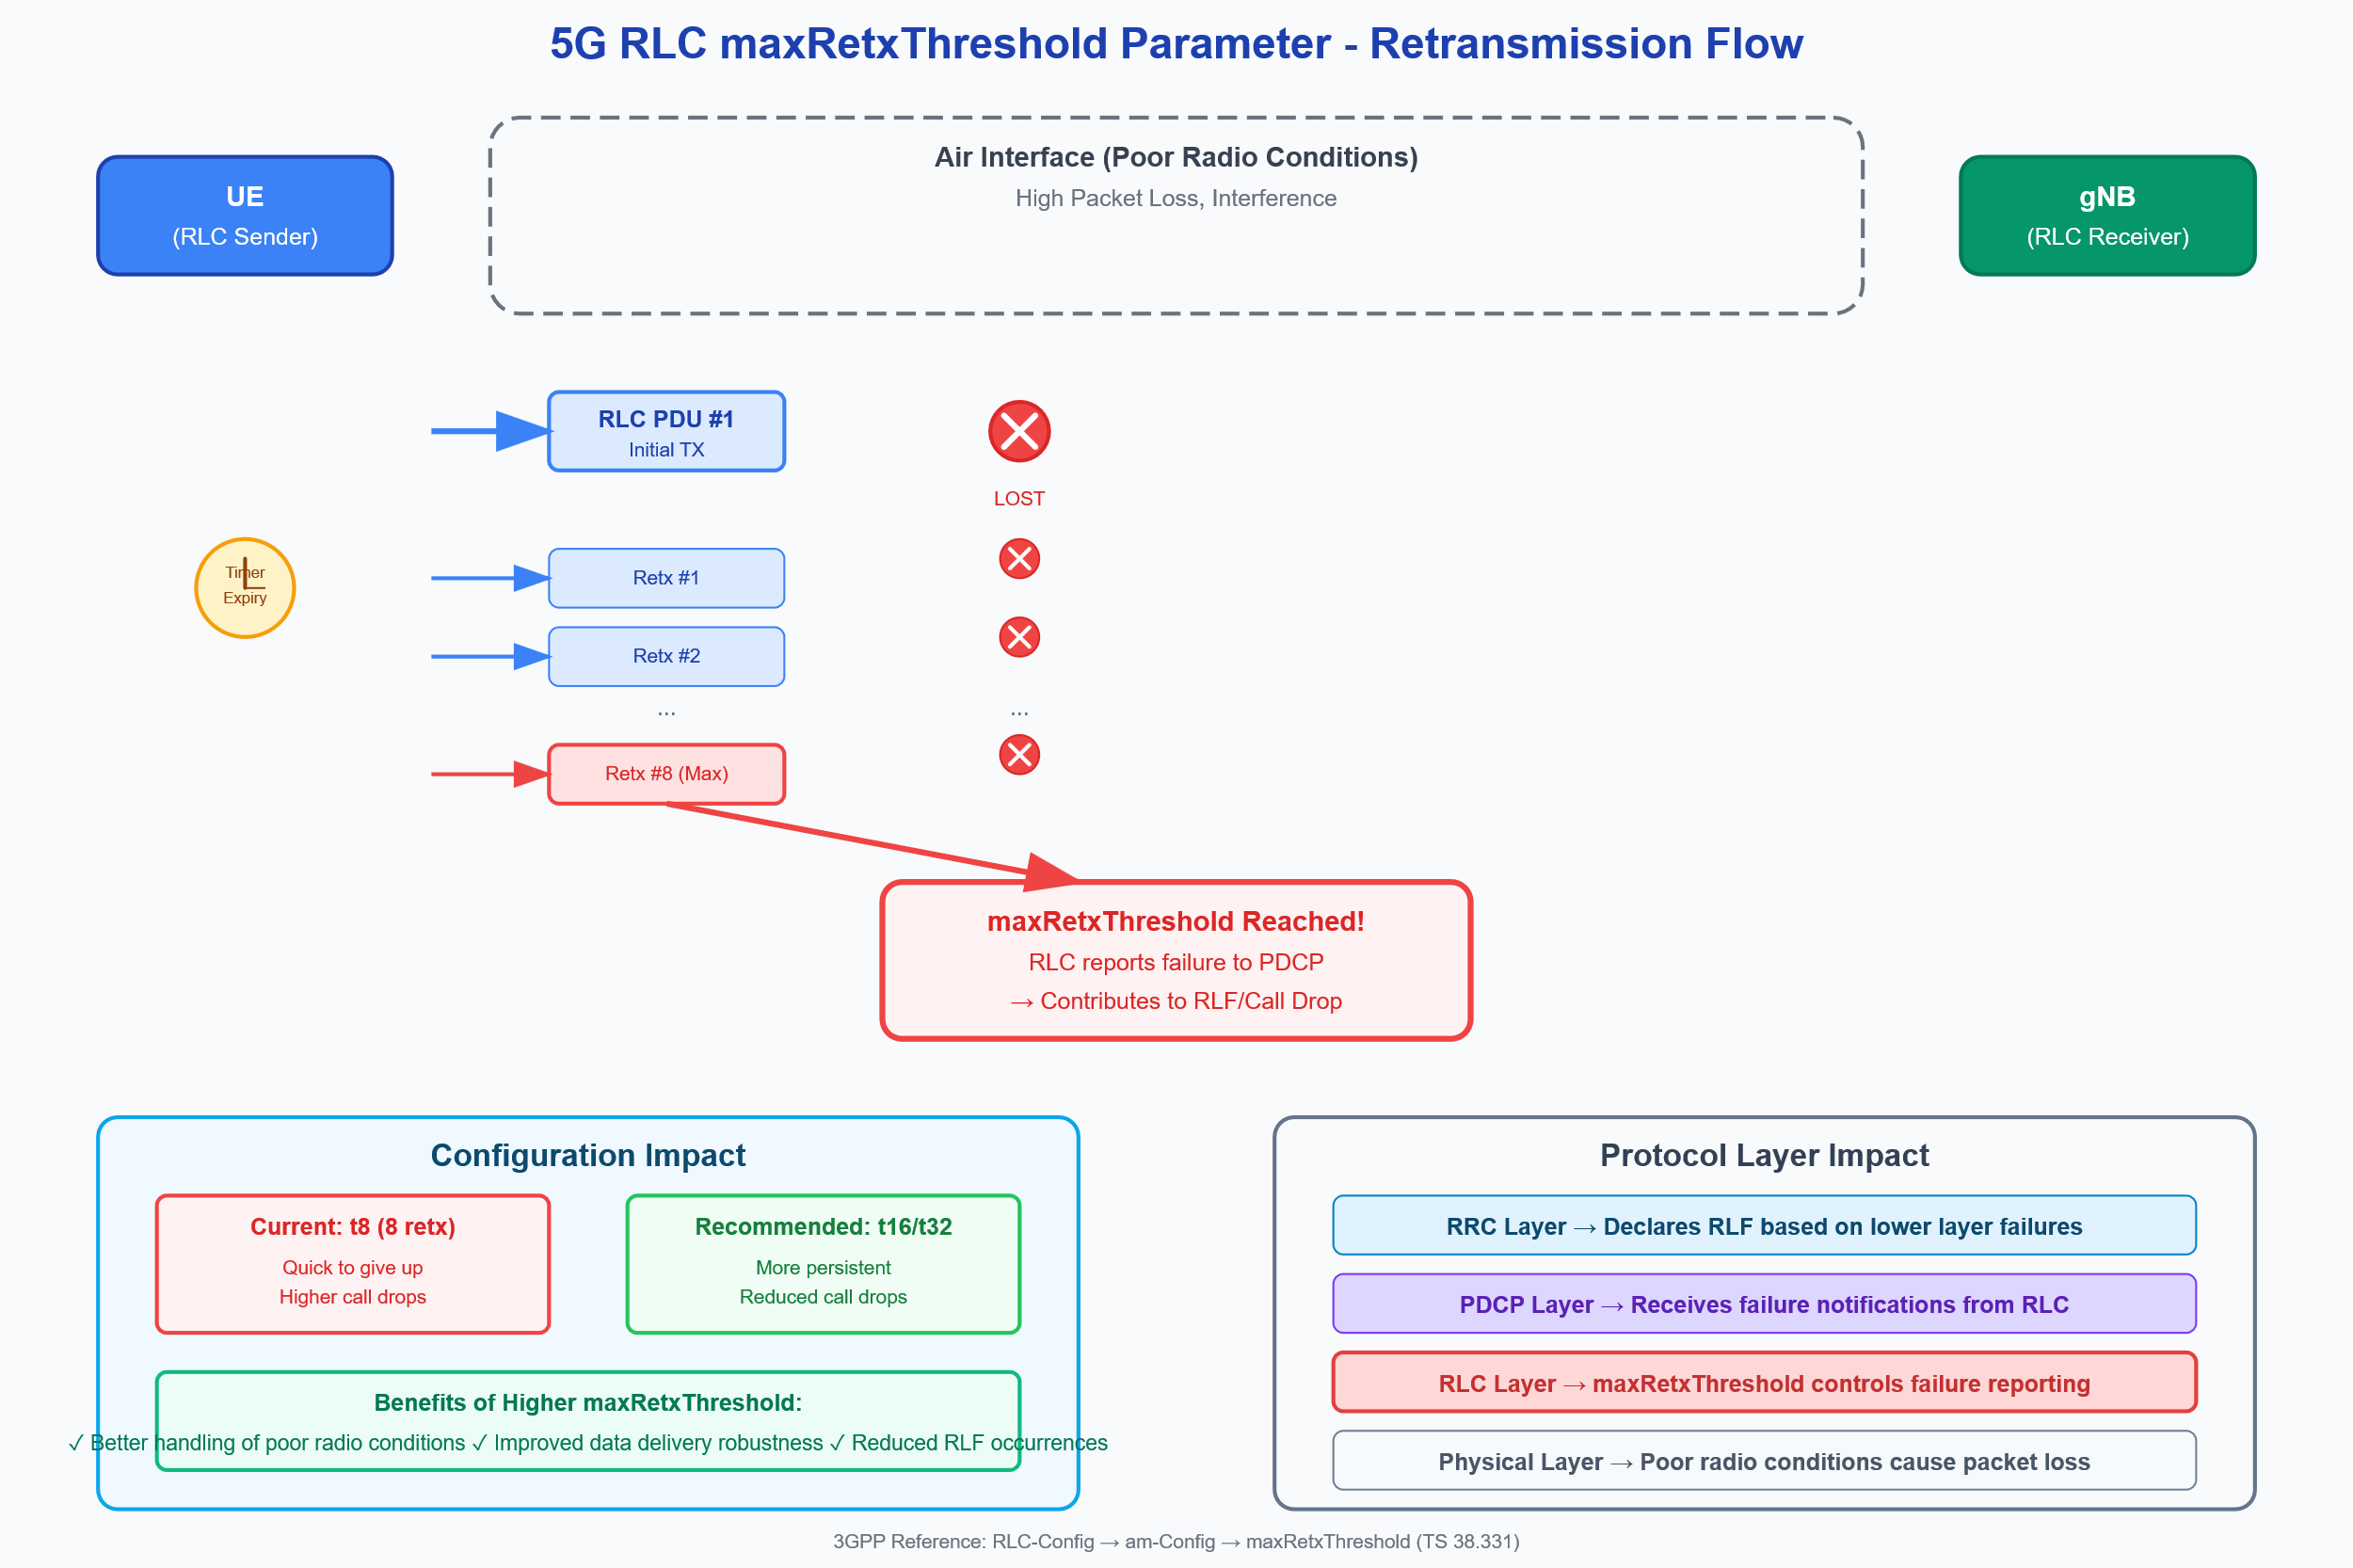

Slide 82
t-PollRetransmit Timer - 5G RLC Acknowledged Mode Error Recovery
5G Protocol Stack
PDCP
RLC AM
t-PollRetransmit
MAC
gNB
t-PollRetransmit Process Flow & Timeline
UE
RLC Sender
Time →
RLC Receiver
t-PollRetransmit
STATUS PDU
Timer
T0
T1
T2
T3
T4
Generator
Step 1
RLC PDU + POLL
Lost STATUS
Step 4
RE-POLL + Data
Send Data + POLL
✗
STATUS PDU Lost
t-PollRetransmit
Configuration Guide
Start t-PollRetransmit
STATUS PDU (LOST)
Timer Continues
EXPIRES
Scenario Analysis
Re-POLL + Retx Data
Timer Values:
Normal Case
Restart Timer
High Timer (200ms)
❌ Too High (≥200ms):
STATUS PDU Received
• Slow error recovery
STATUS PDU (ACK)
Stop Timer
• STATUS PDU lost
• Higher layer timeouts
• Wait 200ms for retry
• Data stall → RLF risk
✅ Optimal (80-150ms):
t-PollRetransmit Timer Duration
Result: Call Drop ✗
• Fast error detection
Timer Stopped (STATUS received)
≤ 100ms (Good)
Optimal Timer (100ms)
• Balanced signaling overhead
• STATUS PDU lost
⚠️ Too Low (≤50ms):
Timer Expires → Retransmission Triggered
≥ 200ms (Slow Recovery)
• Quick retry in 100ms
• Excessive control signaling
• Fast data recovery
• Network congestion
Result: Call Continues ✓
KPI Impact:
RLC AM Algorithm Summary
Performance:
✓ Reduces Call Drop Rate
1. Send RLC PDU(s) → Set POLL bit → Start t-PollRetransmit
• Recovery Time: 50% faster
✓ Faster Data Recovery
2. If STATUS PDU received → Stop timer | If timer expires → Re-POLL + Retransmit unACKed data
• Call Drop: 20-30% reduction
✓ Better Throughput
• Throughput: 15% improvement
3GPP Technical Implementation Details
3GPP Reference:
Implementation Notes:
• TS 38.322 (RLC Protocol Specification)
• Works in conjunction with pollPDU and pollByte parameters
• RLC-Config → am-Config → t-PollRetransmit
• Sender maintains VT(S), VT(A), VT(MS) state variables
• Timer values: ms5, ms10, ms15, ms20, ms25, ms30, ms35, ms40, ms45, ms50,
• STATUS PDU contains ACK_SN and NACK_SN information
ms55, ms60, ms65, ms70, ms75, ms80, ms85, ms90, ms95, ms100, ms105, ms110,
• Retransmission triggered for SN < VT(A) + AM Window Size
ms115, ms120, ms125, ms130, ms135, ms140, ms145, ms150, ms155, ms160...
• maxRetxThreshold limits total retransmission attempts
• Configured per RLC bearer during RRC connection setup
• RLC failure indication sent to upper layers if threshold exceeded

Slide 83
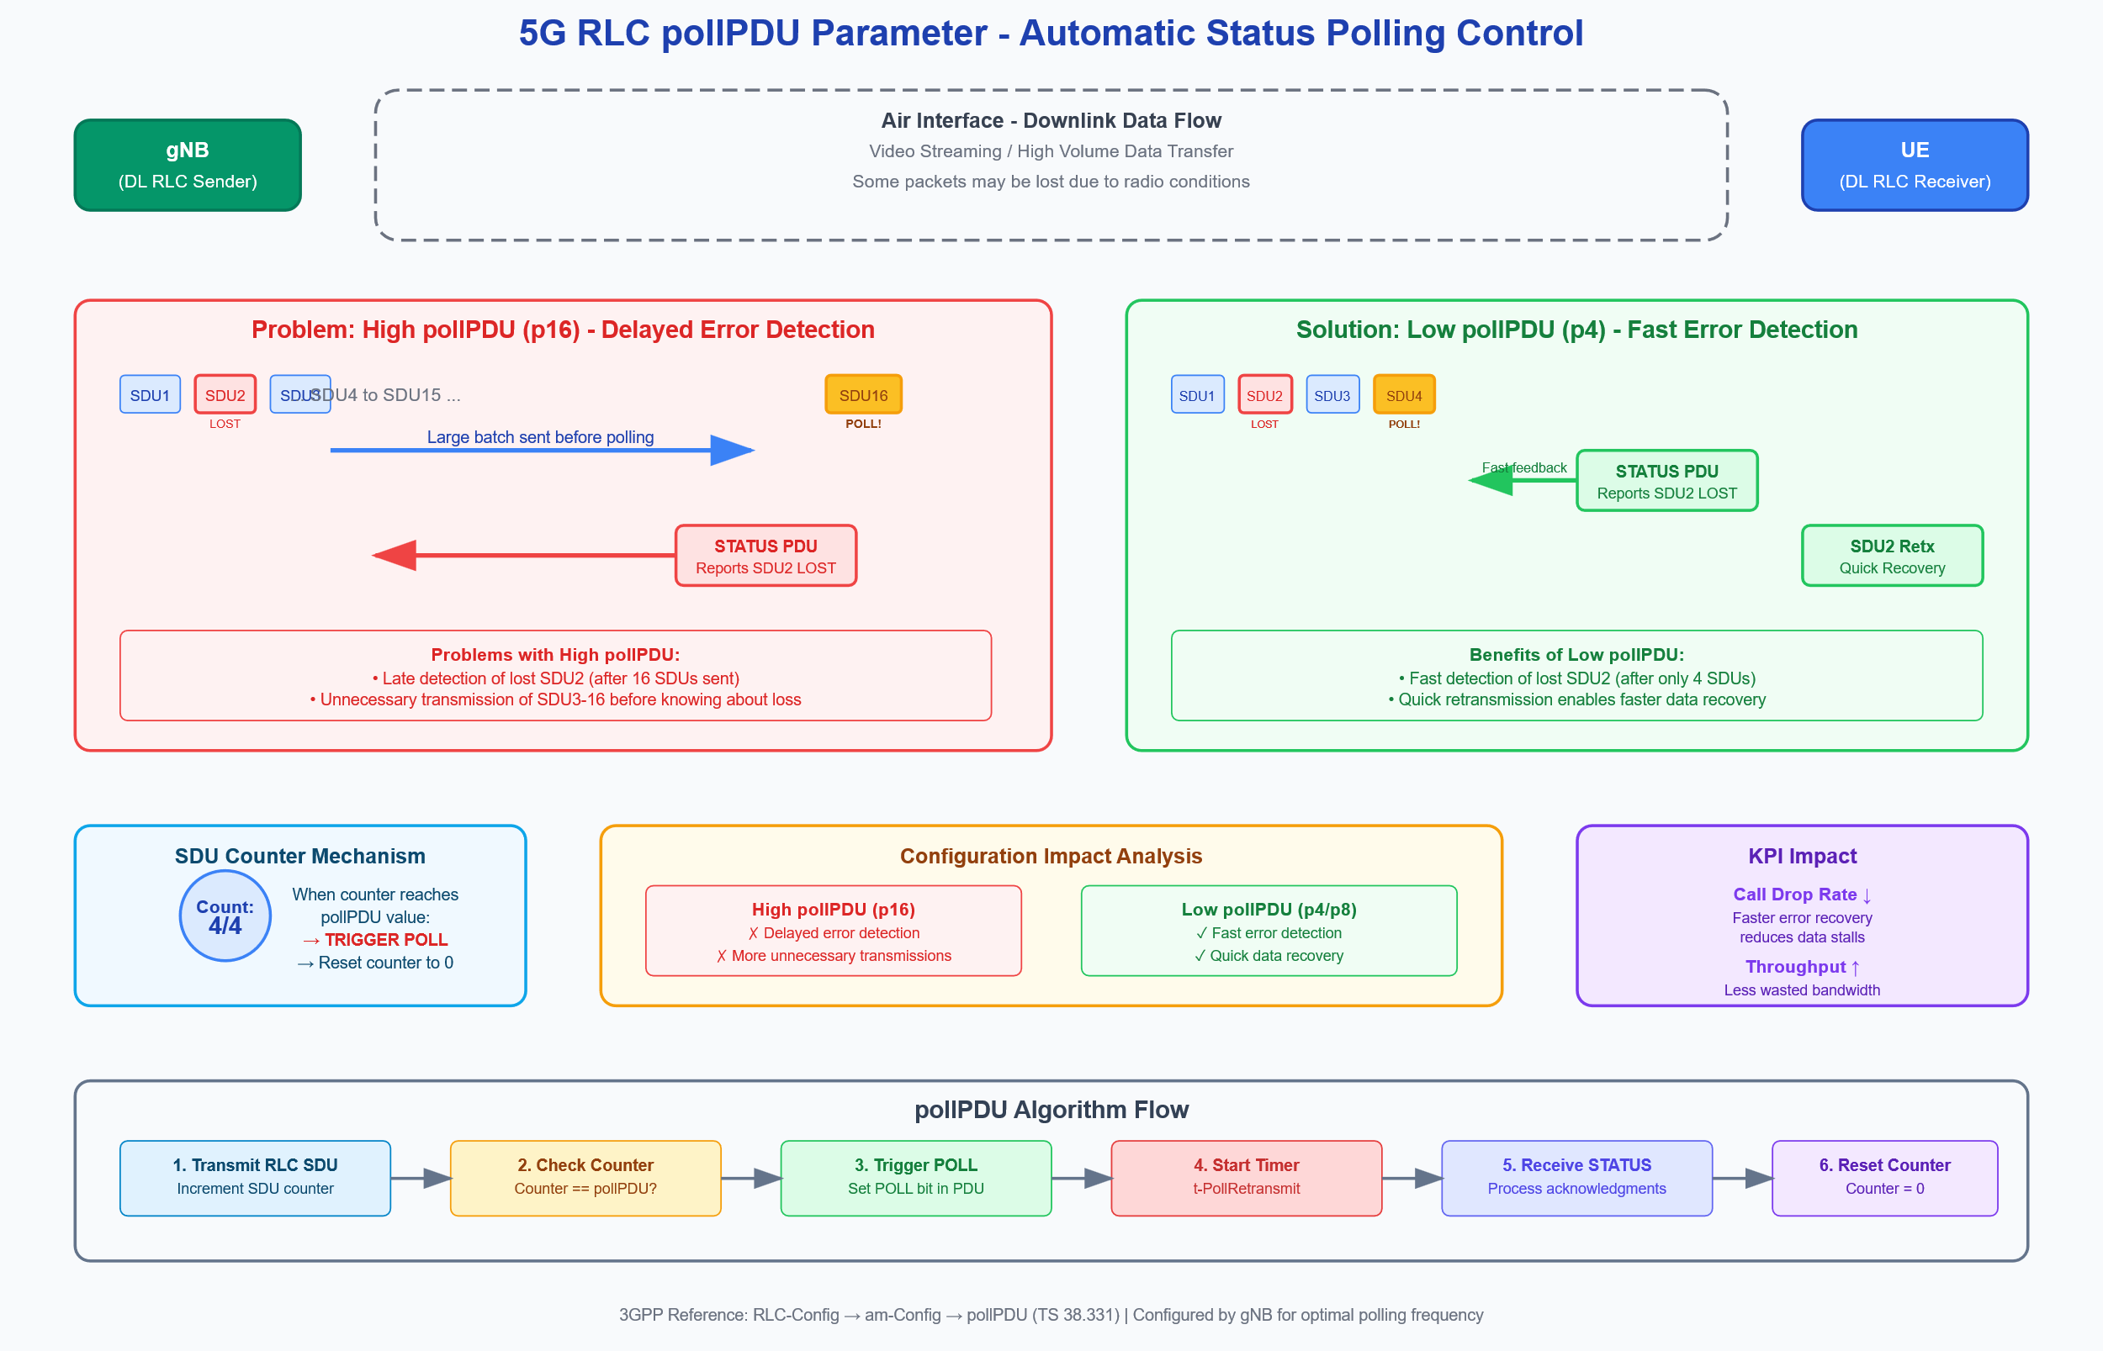

Slide 84
5G RLC t-Reassembly Timer Mechanism
Legend:
Preventing Premature SDU Discard in Acknowledged Mode
Successfully Received PDU
Retransmitted PDU
Missing/Lost PDU
Timer Active
RLC SDU Reassembly Process Timeline
Time
T0
T1
T2
T3
T4
Transmitter (gNB/UE)
RLC SDU Segmentation
Retx
PDU#1
PDU#2
PDU#3
PDU#2
LOST
Receiver (UE/gNB)
PDU#1
PDU#3
PDU#2
✓ Received
Out of Order
✓ Gap Filled
Gap Detected!
Key Parameters
t-Reassembly Timer Active (100ms)
Timer Stopped
3GPP Reference:
Problem: Short Timer (50ms)
Solution: Optimal Timer (100-200ms)
RLC-Config → am-Config → t-Reassembly
• Timer expires before retransmission
75% elapsed
• More time for retransmissions to arrive
Default Setting:
• Incomplete SDU discarded prematurely
• Reduced premature SDU discards
• Higher layer must request full retransmission
Complete SDU Delivered
ms100 to ms150
• Better RLC layer reliability
Recommended Setting:
• Increased call drop probability
• Improved call success rate
ms100 to ms200
• Poor user experience in high-loss areas
• Enhanced user experience

Slide 85
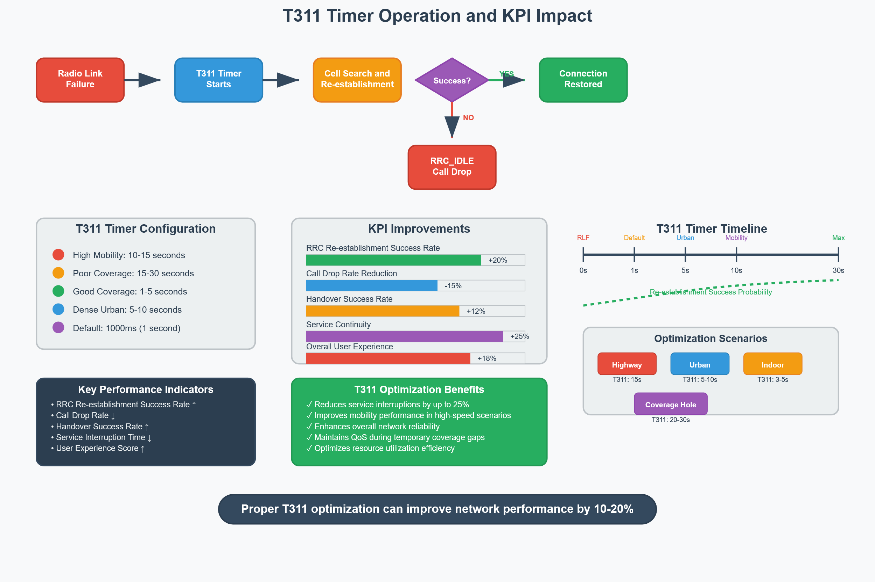

Slide 86
Mobility Optimization

Slide 87
FR1: 3.5 GHz (n78)
5G Core Network
FR1 : 2.6 GHz
AMF | SMF | UPF | PCF | NSSF
SA Architecture
Xn Interface
3
HO Preparation
Target Cell (gNB-2)
Xn Signaling
HO Execution
PCI: 428
Source Cell (gNB-1)
2
Handover Decision
4
BW: 100 MHz
PCI: 237
TTT: 160 ms
RRC Reconfig
RSRP: -80 dBm
BW: 100 MHz
HO Completion
RSRP: -95 dBm
1
Measurement Reports
5
Path Switch Req
Event A3 Triggered
Velocity: 60 km/h
SINR: 10 dB
SINR: 22 dB
UE
IMSI: 311480012345678
Technical Parameters
5G NR Handover Process
Connection Status
• HO Margin: 3 dB
• A3 Offset: 2 dB
Active Data Connection
• HO Type: Intra-frequency
• MIMO: 4x4
3GPP TS 38.300 | Release 17 | SA Architecture
Xn/X2 Interface

Slide 88
Types of Handover in 5G NR
Intra-frequency Handover
Inter-frequency Handover
Inter-RAT Handover
Cell A (3.5 GHz)
Cell B (3.5 GHz)
Cell A (3.5 GHz)
Cell B (2.1 GHz)
5G NR Cell
LTE Cell
Same Frequency Band
Different Frequency Bands
Different Radio Technologies
Handover Complexity
Inter-RAT
Inter-frequency
Intra-frequency
Complexity Level
Key Considerations
Signal Measurement: UE measures RSRP, RSRQ, and SINR of serving and neighboring cells
Handover Margin: Controls handover trigger point (typically 2-3 dB)
Time-to-Trigger (TTT): Prevents ping-pong effect (range: 0-5120ms)

Slide 89
5G NR Measurement Configuration & Reporting
1. Measurement Configuration
Neighbor Cell 1
RSRP: -92 dBm
Serving Cell
RSRQ: -11 dB
RSRP: -85 dBm
SINR: 12 dB
RSRQ: -9 dB
Serving gNB
SINR: 18 dB
Neighbor gNB 1
Neighbor gNB 2
PCI: 254
PCI: 368
PCI: 472
Signal Measurements
3. Measurement Reports
• RSRP: Reference Signal Received Power
UE
• RSRQ: Reference Signal Received Quality
• SINR: Signal to Interference plus Noise Ratio
• SSB: Synchronization Signal Block
2. Measurement Configuration Parameters
Measurement Objects
Reporting Configuration
Measurement Attributes
• NR Intra-freq: SSB Freq 640000
• Event A3: Neighbor > Serving+Offset
• Quantity: RSRP, RSRQ, SINR
• NR Inter-freq: SSB Freq 643000
• Offset: 3 dB
• Max Cells: 8
• Inter-RAT: ARFCN 2850 (LTE)
• Time-To-Trigger (TTT): 320 ms
• Filter Coefficient: fc4
• FR1 Band: n78 (3.5 GHz)
• Report Interval: 240 ms
• Cell-Individual Offset: 0 dB
• Report Amount: Infinity
• Measurement IDs: 1, 2, 3

Slide 90
5G NR Measurement Types
Key metrics for handover decisions in next-generation networks
RSRP
RSRQ
SINR
Reference Signal Received Power
Reference Signal Received Quality
Signal-to-Interference-plus-Noise Ratio
UE
UE
-80
-12
Signal
I+N
-120 dBm
-100 dBm
-80 dBm
-20 dB
-15 dB
-5 dB
15 dB
15
What it measures:
What it measures:
0 dB
10 dB
20+ dB
• Linear average power of
• Ratio of RSRP to total
What it measures:
Cell-specific Reference Signals
received power (RSSI)
• Ratio of desired signal power
Indicates:
Indicates:
to interference plus noise
• Pure signal strength
• Signal quality relative to
Indicates:
• Higher = stronger signal
interference and noise
• Direct signal quality
• Higher potential data rates
Handover Decision Framework
1
2
3
RSRP
RSRQ
SINR
Trigger Point
Quality Verification
QoS Prediction
Target > Serving + Margin
Ensures target cell quality
Expected throughput

Slide 91
Abbreviations
5G NR Handover Decision
• RSRP: Reference Signal Received Power
• RSRQ: Reference Signal Received Quality
• SINR: Signal-to-Interference-plus-Noise Ratio
Measurement Reports
UE
Source gNB
Target gNB
Serving Cell
Neighboring Cell
Handover Decision Analysis
Signal Trends
Measurement Comparison:
Decision Result
Crossover
Source: RSRP -102 dBm | Target: RSRP -88 dBm
Hysteresis
Time-to-Trigger
✓
Handover
Threshold: 3 dB
Value: 320 ms
Source Cell
Target Cell
Status: Satisfied
Initiate to Target gNB

Slide 92
5G NR Idle Mode: Cell Reselection Process
System Information
Network Parameters
Parameters in SIB1:
• s-NonIntraSearchP/Q
• q-Hyst, q-OffsetFreq
• t-ReselectionNR
UE
Measures
UE-Autonomous Decision
Measures
Rs = Qmeas,s + QHyst
RSRP/RSRQ
RSRP/RSRQ
Rn = Qmeas,n - Qoffset
If Rn > Rs for t-Reselection → Reselect
Neighbor Cell
Serving Cell
Rn = Qmeas,n - Qoffset
Rs = Qmeas,s + QHyst
Reselection Criteria
1. S-Criteria met
2. Rn > Rs
3. For t-Reselection time
Key Parameters
RSRP: Reference Signal Received Power
RSRQ: Reference Signal Received Quality
SIB: System Information Block

Slide 93
Event A1: Serving Cell Becomes Better Than Threshold
5G NR Event A1 Parameters (Example):
TTT = 320ms
-90
• Threshold_A1 = -100 dBm (RSRP)
Serving Cell RSRP
• Hysteresis = 2 dB
-94 dBm
• Time-to-Trigger (TTT) = 320 ms
-100 dBm
-100
• Frequency = 3.5 GHz (n78)
Threshold_A1
(-100 dBm)
-107 dBm
Event A1 Triggered
Hysteresis (2dB)
-110
RSRP (dBm)
-120
-120 dBm
-130
-134 dBm
-140
0
200
400
600
800
Time (ms)
RRC Signaling:
Event A1 Condition:
MeasConfig→MeasIdList→MeasId→MeasObjectId:1, ReportConfigId:A1
Mp + Hys > Threshold_A1

Slide 94
Event A2: Serving Cell Below Threshold
Condition: Ms < Threshold_A2 (Serving cell quality becomes worse than configured threshold)
-80 dBm
-80 dBm
Example Values:
-82 dBm
Threshold_A2 = -90 dBm
Threshold Crossing
• Threshold_A2: -90 dBm
-90 dBm
Hysteresis: 2 dB
-92 dBm
• Hysteresis: 2 dB
Signal Strength (RSRP)
• Time-to-Trigger: 1.2s
-100 dBm
1.2 sec
• Serving Cell RSRP: -92 dBm
Event A2 Triggered
After Time-to-Trigger: 1.2s
-104 dBm
-110 dBm
Purpose of Event A2:
0s
2s
4s
6s
8s
10s
12s
14s
Initial Strong Signal (-80 dBm)
• Early warning for degrading
Time (seconds)
signal quality
• Triggers intensified neighbor
cell measurements
Degraded Signal (-92 dBm)
Serving gNB
UE
gNB configures Event A2
UE monitors RSRP
RSRP < Threshold
Event A2 Triggered
UE sends Report
Threshold: -90 dBm
Initial value: -80 dBm
-92 dBm < -90 dBm
After TTT: 1.2 seconds
Measurement Report

Slide 95
Technical Notes:
Event A3: Neighbor Cell Better Than Serving Cell
• Primary handover event
• Used for both intra and inter
• Relative comparison
Condition: Mn + Offset_A3 > Ms (Neighbor cell becomes better than serving cell by an offset)
• Network can tune offset to
control handover aggressiveness
• Prevents ping-pong effects
-85 dBm
-85 dBm
-90 dBm
Mn + Offset_A3 > Ms
Event A3 Triggered
Event A3 Parameters:
-90 dBm
Offset_A3 = +3 dB
• Offset_A3: +3 dB
-92 dBm
• Time-to-Trigger: 1 second
-95 dBm
• Hysteresis: 1 dB
Signal Strength (RSRP)
TTT: 1s
• reportAmount: infinity
-93 dBm
• triggerQuantity: RSRP
-100 dBm
-100 dBm
• reportQuantity: RSRP,RSRQ
Evaluation:
-105 dBm
-110 dBm
4s
-89 dBm + 3 dB (-86 dBm) > -92 dBm
0s
2s
6s
8s
10s
12s
14s
Time (seconds)
Serving Cell
UE
Neighbor Cell
RSRP: -92 dBm
RSRP: -89 dBm
Configure Event A3
UE Measures Cells
A3 Condition Met
Event A3 Triggered
UE Reports to gNB
Offset_A3: +3 dB, TTT: 1s
Serving: -92 dBm, Neighbor: -89 dBm
-89 dBm + 3 dB > -92 dBm
After Time-to-Trigger (1s)
Measurement Report (A3)

Slide 96
Event A4: Neighbor Cell Better Than Threshold
Condition: Mn > Threshold_A4 (Neighbor cell becomes better than absolute threshold)
Event A4 Use Cases:
-85 dBm
Mn > Threshold_A4
Event A4 Triggered
• Proactive handover before
-88 dBm
serving cell degradation
-90 dBm
TTT: 1.5s
Threshold_A4 = -90 dBm
• Load balancing to good
-92 dBm
-91.5 dBm
quality neighbor cells
Signal Strength (RSRP)
• Anticipating serving cell
-95 dBm
-95 dBm
failure or maintenance
-100 dBm
-100 dBm
-94 dBm
-97 dBm
A4 Parameters:
-103 dBm
• Threshold_A4: -90 dBm
-110 dBm
Time (seconds)
Meets Threshold_A4 = -90 dBm
• Time-to-Trigger: 1.5s
0s
2s
4s
6s
8s
10s
12s
14s
Key Distinction:
• Absolute neighbor threshold
Neighbor Cell 1
• Independent of serving cell
Serving Cell
UE
RSRP: -88 dBm
(Above threshold)
RSRP: -94 dBm
(Acceptable quality)
Neighbor Cell 2
RSRP: -97 dBm
(Below threshold)
Configure Event A4
UE Measures Neighbors
Neighbor 1 > Threshold
Event A4 Triggered
UE Reports to gNB
Threshold_A4: -90 dBm
Multiple neighbor cells
-88 dBm > -90 dBm
After Time-to-Trigger
Measurement Report (A4)

Slide 97
Event A5: Dual Threshold Handover Trigger
Condition: Ms < Threshold_A5_1 AND Mn > Threshold_A5_2
-85 dBm
Mn > Threshold_A5_2
-85 dBm
A5 Use Cases:
-88.5 dBm
Threshold_A5_2 = -88 dBm
-88 dBm
Event A5
• Reliable handover triggering
-90 dBm
-91 dBm
-90 dBm
Dual Condition Met
• Preventing unnecessary
-92 dBm
AND
Threshold_A5_1 = -92 dBm
handovers
-95 dBm
-91.5 dBm
• Ensuring suitable target
Signal Strength (RSRP)
cell is available
-95 dBm
Ms < Threshold_A5_1
-96 dBm
-100 dBm
TTT: 1s
Event A5 Triggered
Key Feature:
-110 dBm
Event A5 Condition:
• Combined condition approach
0s
2s
4s
6s
(-96 dBm < -92 dBm) AND (-85 dBm > -88 dBm)
8s
10s
12s
14s
• "Serving cell bad AND
Time (seconds)
neighbor cell good"
Compared to:
Serving Cell
UE
Neighbor Cell
• A2: Only checks serving cell
RSRP: -96 dBm
RSRP: -85 dBm
• A3: Relative comparison
< Threshold_A5_1
> Threshold_A5_2
• A4: Only checks neighbor cell
Configure Event A5
UE Monitors Cells
Condition 1 Met
Condition 2 Met
Event A5 Triggered
Threshold_A5_1: -92 dBm
Serving: -92 dBm → -96 dBm
Ms < Threshold_A5_1
Mn > Threshold_A5_2
Both conditions met
Threshold_A5_2: -88 dBm
Neighbor: -95 dBm → -85 dBm
-96 dBm < -92 dBm
-85 dBm > -88 dBm
UE sends Measurement Report

Slide 98
Event A6: Neighbor Cell Better Than Secondary Cell
Carrier Aggregation Scenario in 5G NR
Event A6 Condition:
Event A6 Parameters:
Mn + Offset_A6 > Ms2 (Neighbor better than SCell by offset)
Event A6 Trigger Point
• Measurement: RSRP
-90
PCell (Primary)
• Offset_A6 = 3 dB
TTT = 160ms
• Time-to-Trigger (TTT) = 160 ms
-100
• Frequencies: PCell 2.5 GHz, SCell 3.7 GHz
SCell (Secondary)
-110
Offset_A6 = 3dB
RSRP (dBm)
Mn + Offset_A6
-110 dBm
-113 dBm
-120
-130
Neighbor Cell
-140
0
UE
200
400
600
800
Time (ms)
CA Active
P
S
N
Action After Event A6:
SCell change from current SCell to better Neighbor Cell

Slide 99
Event B1: Inter-RAT Neighbor Better Than Threshold
Condition: Mn_RAT > Threshold_B1 (Inter-RAT neighbor cell becomes better than threshold)
5G NR Serving Cell
Event B1 Use Cases:
-85 dBm
-85 dBm
Mn_RAT > Threshold_B1
Event B1 Triggered
-87 dBm
• Coverage extension via LTE
• Fallback when exiting 5G
-90 dBm
Threshold_B1 = -90 dBm
• Inter-RAT load balancing
-93 dBm
TTT: 1s
• Energy efficiency (switching
-95 dBm
to LTE to save battery)
Signal Strength (RSRP)
-98 dBm
-93 dBm
Inter-RAT Handover
-100 dBm
-102 dBm
B1 Parameters:
LTE (Inter-RAT) Neighbor Cell
• Threshold_B1: -90 dBm
• Time-to-Trigger: 1s
-110 dBm
Time (seconds)
• measurementType: RSRP
0s
2s
4s
6s
8s
10s
12s
14s
Inter-RAT Handover
5G NR vs. LTE:
• 5G NR: Higher capacity, speed
• LTE: Wider coverage, lower freq.
5G NR Cell
LTE Cell
• Different frequency bands
RSRP: -102 dBm
RSRP: -87 dBm
• Different cell IDs and PCIs
(Degrading coverage)
> Threshold_B1 (-90 dBm)
Inter-RAT Handover Components:
UE
• S1/X2 or N2/Xn interfaces
• RAT-specific measurement objects
Configure Event B1
Inter-RAT Measurement
LTE > Threshold
Event B1 Triggered
Inter-RAT Handover
Threshold_B1: -90 dBm
UE measures LTE cells
-87 dBm > -90 dBm
UE sends Measurement Report
5G NR → LTE

Slide 100
Event B2: Serving Cell Becomes Worse Than Threshold 1 AND
Inter-RAT Neighbor Becomes Better Than Threshold 2
Threshold_B2_2 = -85 dBm
LTE Cell
-80 dBm
LTE Above Threshold
AND
RSRP
-90 dBm
Threshold_B2_1 = -90 dBm
Event B2 Triggered
5G Below Threshold
-100 dBm
-110 dBm
Time
5G NR Serving Cell
Inter-RAT Handover
5G NR Cell
UE
LTE Cell
-100 dBm
-80 dBm
Configure B2
5G Below Threshold
LTE Above Threshold
B2 Triggered
Handover to LTE

Slide 101
Traffic Profile Collection Framework
Weekly Traffic Profile Collection
Monday
Tuesday
Wednesday
Thursday
Friday
Saturday
Sunday
Business Hours
Business Hours
Business Hours
Business Hours
Business Hours
Shopping Hours
Leisure Hours
Peak: 9-11 AM
Peak: 9-11 AM
Peak: 9-11 AM
Peak: 9-11 AM
Peak: 9-11 AM
Peak: 11-4 PM
Peak: 10-6 PM
Peak: 2-5 PM
Peak: 2-5 PM
Peak: 2-5 PM
Peak: 2-5 PM
Evening Peak
Evening: 6-9 PM
Evening: 7-10 PM
24h Collection
24h Collection
24h Collection
24h Collection
24h Collection
24h Collection
24h Collection
Hourly Collection Parameters
Per-Cell Traffic Collection
Collection Interval:
Hourly (00:00-23:00, 24 datapoints/day)
Coverage Type:
Urban, Suburban, Rural (separate baselines)
Aggregation:
15-minute samples averaged per hour
Cell Types:
Macro, Micro, Small Cell, Indoor
Duration:
Minimum 1 full week for baseline
Sectors:
All sectors in each site collected separately
Critical Hours:
Busy Hour per cell identified separately
Focus Areas:
Cells with high handover rates prioritized
Traffic Metrics Collected
Traffic Profile Analysis
• RRC Connected Users (average, peak)
• Hour-by-hour traffic variation pattern
• Throughput (DL/UL in Mbps)
• Day-of-week variation pattern
• PRB Utilization (%, DL/UL)
• Busy Hour determination per cell/area
• SINR Distribution (% of samples in each range)
• Correlation with mobility events (handovers)

Slide 102
5G Handover Failure Analysis & Optimization
Handover Failures
Too Many Attempts
Preparation Failures
Execution Failures
CAUSES:
Execution Failure Types
• Aggressive handover triggering
• Small cell sizes, high user density
*_PrepFail_TimeOut
*_PrepFail_Fail
*_PrepFail_CpFail
• Fast-moving users
CAUSES:
CAUSES:
CAUSES:
*_Fail_
*_Fail_
*_Fail_
*_Handover
*_RRE
OPTIMIZATION:
• Network congestion
• Target gNB
• Source gNB
RrcTimeOut
TimeOut
CpFail
Cancel
• Increase a3-offset
• Interface issues
rejecting requests
internal issues
RrcTimeOut
TimeOut
HandoverCancel/RRE
• Increase a3-hysteresis
• Slow gNB response
• Config mismatch
• Resource exhaustion
Cause: UE loses
Cause: Network
Cause: Source
• Increase a3-time-to-trigger
OPTIMIZATION:
OPTIMIZATION:
OPTIMIZATION:
connection before
congestion, slow
cell cancels HO or
• Increase TimeOut
• Check target gNB
• Check source gNB
receiving message
interface response
severe radio link
• Consider cell size and overlap
• Optimize interface
logs for reasons
resource usage
Optimization:
Optimization:
problems
• Load balancing
• Correct configs
• Adjust call
• Trigger HO earlier
• Increase TimeOut
Optimization:
• Address root cause
• Adjust admission
admission control
• Increase t304 timer
parameters
• Adjust A3/A5 events
• Improve coverage
• Investigate
• Check coverage
• Reduce interference
root cause
• Investigate interf.
Key Configuration Parameters
A3 Event Parameters
Timers
Interface Parameters
Other
a3-offset: 2-4 dB
t304: 500-2000 ms
Xn_AdmissionControl_MaxCalls
max-call-count
a3-hysteresis: 1-2 dB
InterXnOut_PrepFail_XnTimeOut:
Xn_Interface_BufferSize
max-drb-count
a3-time-to-trigger: 320-640 ms
5000-10000 ms
E1_MaxLoadPercentage
loadBalancing
a3-MaxReportCells: 4-8
PreparationTimer: 10000 ms
NG_InterfaceTimeout
interference
reportInterval: 240-480 ms
t311: 10000-30000 ms
F1_MaxConnections
rsrpThreshold
Always test parameters in controlled environment first!

Slide 103
5G NR Intra-Handover Optimization Framework
Key Performance Indicators (KPIs)
HOSR
HIT
Ping-Pong Rate
Too Late HO Rate
Too Early HO Rate
Handover Success Rate
Handover Interruption Time
Back-and-forth HOs
RLF due to late HO
Unnecessary HOs
Target: >99.5%
Target: <20ms
Minimize
Minimize
Minimize
Group 1: Measurement Configuration
Group 2: Handover Triggering (Event A3)
Group 3: Mobility Robustness
L3 Filter Coefficient
A3 Event: M_n + O_cn - Hys > M_s + O_cs + A3_Offset
A3 Offset
Hysteresis
Time to Trigger
t310 Timer
n310 Counter
n311 Counter
Default: 320ms
Default: 1000ms
Default: n1
Default: n1
fc2-fc3
fc4
fc6-fc8
Default: 3dB
Default: 1-2dB
↓ Fast UEs
↑ for urban
↑ for glitches
Keep low
High Speed
Default
Low Speed
↓ Reduces Too Late
↑ Reduces Ping-Pong
↑ Ping-Pong
RLF Detection Process
UEs
UEs
Ping-Pong ← → Too Late HO
Optimization Balance
Out-of-Sync
n310 × ?
t310 Start
F_new = (1-α) × F_old + α × M_new
n311 consecutive In-Sync → Stop t310
More smoothing → More stable, Less responsive
t310 expires → RLF Declaration
Less smoothing → More responsive, Less stable
Optimization Strategies by UE Mobility
High-Speed UEs (Vehicles)
Medium-Speed UEs
Low-Speed UEs (Pedestrians)
Advanced: MSE-Based
• Filter Coefficient: fc2-fc3
• Filter Coefficient: fc4
• Filter Coefficient: fc6-fc8
• Mobility State Estimation
• Time to Trigger: 80-160ms
• Time to Trigger: 320ms
• Time to Trigger: 480-640ms
• Dynamic parameter adaptation
• A3 Offset: 2-2.5dB
• A3 Offset: 3dB
• A3 Offset: 4-5dB
• Speed-based profile switching
• Hysteresis: 1-2dB
• Hysteresis: 2dB
• Hysteresis: 3dB
• ML-assisted optimization
• Priority: Reduce Too Late HO
• Priority: Balanced approach
• Priority: Reduce Ping-Pong
• Real-time KPI monitoring
Key Optimization Principles
Trade-off Management
UE Mobility Segmentation
Continuous Monitoring
Network-Specific Tuning
Balance Ping-Pong vs Too Late HO
Speed-based parameter sets
Real-time KPI tracking
Environment-aware settings
Holistic parameter tuning approach
Adaptive optimization strategies
Data-driven adjustments
Vendor-specific optimizations
Quick Reference: Parameter Impact Summary
Reduce Ping-pong
Reduce Too Late HO
Improve HOSR
Reduce HIT
Environment-based
Monitoring Kpis
↑ Hysteresis
↓ Time To Trigger
Optimize A3 Params
Prevent RLF
Urban: ↑ T310, ↑ N310
Hosr > 99.5%
↑ Time To Trigger
↓ A3 Offset
↑ T310 Timer
Fast HO Execution
Highway: ↓ TTT, ↓ FC
HIT < 20ms
↑ A3 Offset
↓ Filter Coefficient
Tune N310/N311
Network Optimization
Indoor: ↑ Hysteresis
Ping-pong < 2%
↑ Filter Coefficient
↑ T310 Timer
Prevent RLF
Vendor-specific
Dense: ↑ A3 Offset
RLF Rate < 0.5%

Slide 104
Handover Scenario A: n78 (3500 MHz) → n2600 (n7) Coverage-Triggered
HANDOVER
n78 Cell
Event A5 Triggered
n2600 Cell
3500 MHz
📱
n7 Band
Source
UE
Target
Signal Weakening
Strong Signal
MeasConfig Parameters Design (n78 → n2600)
Event A5 Trigger Logic
3GPP Parameter
Value/Description
Purpose
PRIMARY TRIGGER:
MeasObjectNR
arfcn-ValueNR: 531000
Defines n2600 layer
Serving n78 RSRP < -110 dBm (threshold1)
ssb-SubcarrierSpacing: kHz30
measurement target
AND
ReportConfigNR
reportType: eventTriggered, eventId: eventA5
Event A5 trigger definition
SECONDARY CONDITION:
eventA5.a5-Threshold1
rsrp: 30 (Actual: -140 + 30 = -110 dBm)
Serving n78 RSRP threshold
Neighbor n2600 RSRP > -105 dBm (threshold2)
eventA5.a5-Threshold2
rsrp: 35 (Actual: -140 + 35 = -105 dBm)
Neighbor n2600 RSRP threshold
reportConfigNR.hysteresis
dB3 (3 dB)
Prevents ping-pong
HYSTERESIS: 3 dB margin prevents ping-pong
reportConfigNR.timeToTrigger
ms320 (320 milliseconds)
Stability duration
reportConfigNR.reportQuantityCell
rsrp
Report RSRP values
TIME TO TRIGGER: Conditions must persist for 320ms
reportConfigNR.maxReportCells
3
Best 3 n2600 cells
MeasGapConfig
gapPattern: gp0 (MGRP 40ms, MGL 6ms)
TDD UE measurement gaps
RESULT: Measurement Report Sent
MeasIdToAddMod
measId: 1, measObjectId: (n2600 object)
Links measurement & reporting
→ Handover Decision Triggered
reportConfigId: (Event A5 config)
Legend
🚨 CRITICAL DESIGN CONSIDERATIONS
n78 (3500 MHz) - Source Cell
Handover Direction
• Creates 6ms gap every 40ms for TDD UE FDD frequency measurement
n2600 (n7) - Target Cell
• Event A5 ensures dual condition: weak serving + strong target
User Equipment (UE)
• 320ms stability prevents unnecessary handovers on temporary fading
Objective: Coverage-triggered handover before signal loss
• 3 dB hysteresis prevents ping-pong between cells
• Reports best 3 n2600 cells for optimal target selection

Slide 105
MeasConfig Parameters Design: n78 (3500 MHz) → n2600 Inter-Frequency Handover
n78 gNB
HANDOVER EXECUTION
n2600 gNB
RSRP Measurement
RSRP Measurement
ARFCN: 647232
ARFCN: 531000
Event A5 Coverage-Triggered Handover with Measurement Gap Configuration
3500 MHz
UE
2655 MHz (n7)
Serving Cell
Measuring
Target Cell
Handover Decision Zone
MeasConfig Parameters Design (n78 → n2600)
Event A5 Trigger Logic Flow
3GPP Parameter (within RRC IE)
Example Value / Description
Purpose in this Scenario
CONDITION 1: Serving Cell Check
MeasObjectNR
arfcn-ValueNR: 531000 (example for n7 @ 2655 MHz)
n78 RSRP < -110 dBm (Threshold1)
ssb-SubcarrierSpacing: kHz30
Tells the UE what to measure:
⬇ AND ⬇
referenceSignalConfig: Defines SSB measurement timing
specific frequency and parameters
of the n2600 layer
CONDITION 2: Target Cell Check
ReportConfigNR
reportType: eventTriggered
Defines the trigger for sending a
n2600 RSRP > -105 dBm (Threshold2)
eventId: eventA5
MeasurementReport
eventA5.a5-Threshold1
rsrp: 30 (Actual value: -140 + 30 =
Primary Trigger:
-110 dBm
If the serving n78 cell's RSRP drops
HYSTERESIS: ±3 dB margin applied
)
below this critical threshold...
eventA5.a5-Threshold2
rsrp: 35 (Actual value: -140 + 35 =
...AND
-105 dBm
the neighbor n2600 cell's RSRP is above
TIME TO TRIGGER: 320ms stability check
)
this minimum acceptable threshold, the
event is triggered. Ensures we don't jump
to another bad cell.
reportConfigNR.hysteresis
dB3 (3 dB)
Prevents ping-pong.
The trigger condition must be met by this margin.
MEASUREMENT GAP: 6ms every 40ms
reportConfigNR.timeToTrigger
ms320 (320 milliseconds)
The trigger condition must be
continuously met for this duration before
a report is sent. Prevents reporting on
reportConfigNR.reportQuantityCell
rsrp
transient signal fluctuations.
RESULT: MeasurementReport Sent
The UE should report RSRP values.
→ Handover Command Initiated
reportConfigNR.maxReportCells
3
Report the best 3 cells found on the n2600 frequency.
MeasGapConfig
gapPattern: gp0 (MGRP 40ms, MGL 6ms)
CRITICAL.
Measurement Gap Repetition Period: 40ms
Creates a 6ms gap every 40ms for
⚡ ENGINEERING CONSIDERATIONS
Measurement Gap Length: 6ms
the TDD UE to measure the FDD
frequency, preventing call drops.
🔸 ARFCN 531000 corresponds to n7 band center frequency calculation
MeasIdToAddMod
measId: 1
Links the n2600 measurement object
🔸 TDD-FDD measurement requires dedicated gaps to avoid interference
measObjectId: (points to n2600 object)
with the Event A5 reporting configuration.
🔸 320ms TTT balances mobility robustness vs. handover delay
reportConfigId: (points to Event A5 config)
🔸 Dual threshold (A5) prevents handover to weak cells
Frequency Allocation & Measurement Timing
🔸 3 dB hysteresis compensates for measurement uncertainty
n78: 3500 MHz
GAP
n2600 (n7): 2655 MHz
t = 0ms: Start measurement
🔸 Max 3 cells reported for optimal target selection algorithm
ARFCN: 647232
6ms/40ms
ARFCN: 531000
t = 320ms: TTT expires
Serving (TDD)
Pattern gp0
Target (FDD)
t = 325ms: Report sent
t = 350ms: HO command

Slide 106
Throughput Optimization

Slide 107
5G NR Signal Quality Parameters and Throughput Impact
gNB
UE Device
5G Base Station
RSRP
RSRQ
SINR (CRITICAL)
Reference Signal Received Power
Reference Signal Received Quality
Signal-to-Interference-plus-Noise Ratio
-120 dBm
-100 dBm
-80 dBm
-20 dB
-15 dB
-10 dB
0 dB
15 dB
30 dB
Weak Signal
Strong Signal
High Interference
Low Interference
Poor Quality
Excellent Quality
!
!
!
Low SINR forces Lower MCS which Reduces Throughput
MCS vs Throughput Impact
How to Monitor and Check
High
Drive Test Tools
• TEMS Investigation
MCS 17-28
• Nemo Handy/Outdoor
• Real-time RF measurements
Medium
UE Traces and Logs
Throughput
MCS 10-16
• Device engineering mode
• Network signaling traces
• Layer 1/2/3 measurements
Low
MCS 0-9
gNB Performance Counters
Poor SINR
Good SINR
Excellent SINR
• Average cell RSRP/SINR
Signal Quality
• SINR distribution stats
• MCS usage statistics
KEY INSIGHT: SINR is the most critical parameter for 5G throughput!

Slide 108
5G NR: MCS and CQI Impact on Throughput Performance
Channel Quality
CQI Reporting
MCS Selection
Throughput Impact
Signal Strength (RSRP)
Reports
UE to gNB
Selects
gNB Decision
Determines
Bits per Symbol
Signal Quality (SINR)
CQI Index: 0-15
MCS Index: 0-28
Spectral Efficiency
Interference Level
Periodic/Aperiodic
DL and UL
Data Rate
Fading Conditions
Wideband/Subband
Adaptive
User Experience
MCS Index vs Modulation Scheme vs Throughput Impact
MCS Index
Modulation
Bits/Symbol
Code Rate
Channel Condition
Relative Throughput
Performance
0-9
QPSK
2
Low (0.15-0.6)
Poor SINR
25-50%
Low Throughput
10-16
16QAM
4
Medium (0.4-0.7)
Moderate SINR
60-80%
Medium Throughput
17-22
64QAM
6
High (0.6-0.8)
Good SINR
85-95%
High Throughput
23-28
256QAM
8
Very High (0.8-0.95)
Excellent SINR
95-100%
Peak Throughput
Key Performance Monitoring Parameters
gNB Counters to Monitor
UE Traces to Check
Optimization Actions
Expected Outcomes
DL/UL MCS Index Distribution
CQI Reporting Frequency
Antenna Tilt Adjustment
Higher MCS Usage
Average CQI per Cell/UE
SINR/RSRP Measurements
Power Control Optimization
Improved User Throughput
Poor
Channel Quality Impact on Performance
Excellent

Slide 109
5G NR Block Error Rate (BLER) Impact on Throughput
Air Interface
gNB
UE
(Base Station)
(User Equipment)
Interference and Noise
Low BLER (1-5%)
High BLER (>10%)
HARQ Retransmission Process
Most blocks decoded successfully
Many blocks with errors
Initial TX
NACK
ReTX
ACK
Minimal retransmissions
Frequent retransmissions
Resources consumed for retransmission
High Effective Throughput
Low Effective Throughput
instead of new data transmission
Legend
BLER Impact Analysis
Successfully decoded block
Retransmission
Block with error (NACK)
Effective Throughput
Resource Utilization
95% (Low BLER)
Peak: 1 Gbps → Effective: 950 Mbps
60% (High BLER)
Low BLER
High BLER
Peak: 1 Gbps → Effective: 600 Mbps
90% New Data
60% New Data
10% Retrans
40% Retrans
Key Factors Affecting BLER in 5G NR
Signal Quality (SINR/SNR)
Interference
MCS Selection
Mobility/Doppler
Network Load
Channel Estimation
Poor RF conditions increase BLER
Co-channel, adjacent channel interference
Higher MCS = Higher BLER risk
Fast movement affects channel estimation
High load increases interference
Inaccurate estimation increases errors
BLER Targets:
PDSCH: 1-10% (first transmission)
PUSCH: 1-10% (first transmission)
PUCCH: 1-5%
After HARQ: <1%

Slide 110
5G MIMO Rank and Spatial Multiplexing
MIMO Rank Indicator RI
Multiple Antennas
Rank 1
Single Layer
Stream 1
Rank 2
2 Spatial Layers
Stream 2
5G gNB
UE
Rank 4
4 Spatial Layers
Base Station
Device
Stream 3
Stream 4
Spatial Multiplexing
Multiple data streams on same time-frequency resources
What to Monitor
Throughput Impact Analysis
1
gNB Counters:
2
UE Traces:
Good Channel Conditions
Poor Channel Conditions
Average DL MIMO Rank
RI Reports from UE
High MIMO Rank 4-8
Low MIMO Rank 1-2
Rank Distribution Percentages
Channel Quality Indicators
Multiple spatial streams
Limited spatial multiplexing
Spatial Multiplexing Efficiency
PMI Precoding Matrix Index
Throughput multiplied by rank
Reduced throughput gain
3
Performance Impact:
4
Channel Conditions:
Optimization Strategies:
Throughput per spatial layer
SINR per antenna port
1. Antenna Diversity: Use spatially separated antennas
Spectral efficiency gains
Correlation between antennas
2. Beamforming: Optimize precoding matrices
3. Adaptive Rank: Adjust based on conditions
4. Interference Management: Coordinate cells
5. UE Positioning: Consider mobility patterns
Key Formula:
Throughput = Base Rate × MIMO Rank × Coding Rate × Modulation Efficiency
Key Performance Indicators KPIs
Average MIMO Rank
Rank 4+ Usage
Rank 1 Usage
Spectral Efficiency
Target: Greater than 2.5
Target: Greater than 30%
Target: Less than 20%
Target: Greater than 4 bps/Hz
Good: Greater than 3.0
Excellent: Greater than 50%
Alert: Greater than 40%
Excellent: Greater than 6 bps/Hz

Slide 111
Throughput Check and Diagnosis (What to Check)
Parameter Name | Layer | Primary KPI Impact | 3GPP Reference (IE Path in SIB/RRC) | Default/Typical Setting | Recommended Setting
I. Modulation & Coding Scheme (MCS) / Signal Quality
mcs-Table (for PDSCH) | L1/L3 | DL Throughput | pdsch-ConfigCommon -> mcs-Table | qam64 | qam256 (if channel quality and UE support allow)
ssb-transmittedPower (dBm) | L1 | DL Throughput, Coverage | servingCellConfigCommon -> ssb-transmittedPower | Varies (e.g., 20-24 dBm) | Adjust to optimize SINR, balancing coverage and inter-cell interference.
reportQuantity (for CSI-RS measurements) | L3 | DL Throughput | MeasObjectNR -> reportConfigNR -> reportConfigType -> csi-RS-RLM -> reportQuantity (e.g., ssb-rsrp, ssb-rsrq, csi-rs-rsrp) | ssb-rsrp or csi-rs-rsrp | Ensure UE reports accurate CSI-RS based RSRP/RSRQ/SINR for optimal scheduling.
periodicityAndOffset (for CSI-RS reporting) | L3 | DL Throughput | MeasObjectNR -> reportConfigNR -> reportConfigType -> csi-RS-RLM -> periodicityAndOffset | Varies (e.g., sl160) | Shorter periodicities (e.g., sl20, sl40) for faster channel adaptation in high-mobility/dynamic channels.
II. Bandwidth & Resource Allocation
scellConfig (for Carrier Aggregation) | L3 | DL Throughput | RRCReconfiguration -> scellConfig (configured per SCell) | N/A (requires explicit configuration) | Configure max supported component carriers (CCs) and frequency bands based on spectrum availability and UE capabilities.

Slide 112
Throughput Check and Diagnosis (What to Check)
Parameter Name | Layer | Primary KPI Impact | 3GPP Reference (IE Path in SIB/RRC) | Default/Typical Setting | Recommended Setting
scellConfig (for Carrier Aggregation) | L3 | DL Throughput | RRCReconfiguration -> scellConfig (configured per SCell) | N/A (requires explicit configuration) | Configure max supported component carriers (CCs) and frequency bands based on spectrum availability and UE capabilities.
initialDownlinkBWP (and subsequent BWP-Downlink) | L1/L3 | DL Throughput | sib1 -> initialDownlinkBWP (and RRCReconfiguration for BWP-Downlink) | Varies (e.g., initial BWP matching full carrier BW, SCS 30kHz) | Configure wider BWPs with higher SCS (e.g., 60kHz, 120kHz for FR2) and enable BWP switching for data-hungry users.
subcarrierSpacing (within BWP configuration) | L1 | DL Throughput | BWP-Downlink -> subcarrierSpacing | Varies (e.g., 30kHz for FR1, 120kHz for FR2) | Use higher SCS for wider bandwidths to achieve higher peak throughput (e.g., 60kHz in FR1, 120kHz in FR2).
controlResourceSetZero (PDCCH configuration) | L1/L3 | DL Throughput | sib1 -> controlResourceSetZero | Varies by vendor/PCI | Ensure sufficient CCE capacity and robust PDCCH transmission power for efficient scheduling.
searchSpaceZero (PDCCH configuration) | L1/L3 | DL Throughput | sib1 -> searchSpaceZero | Varies by vendor/PCI | Ensure sufficient candidates and monitoring occasions for timely DL grants.
III. MIMO & Beamforming
dmrs-TypeA-Position (PDSCH) | L1 | DL Throughput | pdsch-ConfigCommon -> dmrs-TypeA-Position | pos2 (Symbol 2) | Depends on channel characteristics; pos2 generally efficient. Ensure consistency.

Slide 113
Throughput Check and Diagnosis (What to Check)
Parameter Name | Layer | Primary KPI Impact | 3GPP Reference (IE Path in SIB/RRC) | Default/Typical Setting | Recommended Setting
tci-State (TCI-State IE) | L1/L3 | DL Throughput | PDSCH-Config -> tci-StatePDCCH-r16 (and other TCI-related IEs) | Dynamically configured/Vendor-specific | Configure sufficient TCI states and enable efficient beam management (especially for FR2) to maximize spatial multiplexing and beamforming gain.
csi-RS-Resource (CSI-RS configuration) | L1/L3 | DL Throughput | CSI-RS-ResourceMapping | Varies by deployment | Optimize CSI-RS density and periodicity to provide accurate channel state information for beamforming and precoding.
reportConfigNR (PMI/RI reporting) | L3 | DL Throughput | MeasObjectNR -> reportConfigNR -> reportConfigType -> semiPersistentOnPUSCH or periodic CSI-RS reporting | Varies (e.g., periodic CSI-RS with moderate periodicity) | Ensure UEs provide necessary PMI (Precoding Matrix Indicator) and RI (Rank Indicator) feedback for optimal MIMO layer selection and precoding.
IV. Efficiency & Reliability (DL)
maxRetxThreshold (for DL RLC) | L2 (RLC) | DL Throughput, Call Drop | RLC-Config -> am-Config | t16 (16 retransmissions) | t16 or t32 (Higher for more robustness, lower for faster error reporting)
t-PollRetransmit (for DL RLC) | L2 (RLC) | DL Throughput, Call Drop | RLC-Config -> am-Config | ms100 to ms200 | ms80 to ms150 (Faster re-polling for quick error recovery)
pollPDU / pollByte (for DL RLC) | L2 (RLC) | DL Throughput, Call Drop | RLC-Config -> am-Config | p8/kB4 | p4/kB2 (More frequent polling for faster error detection)
headerCompression (for DRBs) | L2 (PDCP) | DL Throughput (Effective) | pdcp-Config for Data Radio Bearers (DRBs) | Enabled/Disabled by default | Enabled (e.g., ROHC - Robust Header Compression)

Slide 114
PDCCH Parameters for Downlink Throughput Optimization
Parameter Name | Layer | Primary KPI Impact | 3GPP Reference (IE Path in SIB/RRC) | Default/Typical Setting | Recommended Setting | How it Helps Improve Downlink Throughput
I. CORESET Configuration (Capacity & Diversity)
frequencyDomainResources (bitmask) | L1/L3 | DL Throughput, PDCCH Capacity | controlResourceSetZero (in SIB1) / ControlResourceSet (in PDCCH-Config) | Varies (e.g., typically a high % of BW for CORESET0) | Increase the number of Resource Blocks (RBs) allocated for CORESETs (especially for CORESETs used for dedicated scheduling). | Direct. More RBs in a CORESET directly translate to more available CCEs, thus increasing the PDCCH capacity. Higher capacity means more DL/UL scheduling grants can be sent simultaneously, enabling higher throughput for more UEs.
duration (OFDM symbols) | L1/L3 | DL Throughput, PDCCH Capacity | controlResourceSetZero (in SIB1) / ControlResourceSet (in PDCCH-Config) | 1 or 2 symbols | 2 or 3 symbols | Direct. Longer CORESET duration (more OFDM symbols) also increases PDCCH capacity (more CCEs available per slot). This allows for scheduling of more users or larger grants, boosting throughput. (Trade-off: consumes more data symbols).
cce-REG-MappingType | L1/L3 | DL Throughput, PDCCH Reliability | controlResourceSetZero (in SIB1) / ControlResourceSet (in PDCCH-Config) | interleaved | interleaved (for diversity), non-interleaved (for beamforming) | Indirect. interleaved provides frequency diversity, improving PDCCH reliability in channels with frequency-selective fading. non-interleaved is better for dedicated beamforming, allowing targeted PDCCH for higher SINR. Choose based on scenario.
precoderGranularity | L1/L3 | DL Throughput, PDCCH Reliability | ControlResourceSet (in PDCCH-Config) | sameAsREG-bundle | sameAsREG-bundle (default); allContiguousRBs (for wider beams/less precise precoding) | Indirect. Impacts how precisely beamforming can be applied to PDCCH. Optimal setting ensures PDCCH is reliably received by the UE's specific beam, increasing its decodability and speeding up scheduling.

Slide 115
PDCCH Parameters for Downlink Throughput Optimization
Parameter Name | Layer | Primary KPI Impact | 3GPP Reference (IE Path in SIB/RRC) | Default/Typical Setting | Recommended Setting | How it Helps Improve Downlink Throughput
II. Search Space Configuration (Timeliness & Reliability)
monitoringSlotPeriodicityAndOffset | L1/L3 | DL Throughput, Scheduling Latency | searchSpaceZero (in SIB1) / SearchSpace (in PDCCH-Config) | Varies (e.g., n1, n2 - every 1st or 2nd slot) | n1 or n2 (more frequent monitoring) | Direct. Defines how often the UE monitors for PDCCH. More frequent monitoring (n1) means the gNB can send scheduling grants more quickly, reducing latency and allowing for faster data transfer, thus boosting throughput.
monitoringSymbolsWithinSlot | L1/L3 | DL Throughput, Scheduling Latency | searchSpaceZero (in SIB1) / SearchSpace (in PDCCH-Config) | Varies (e.g., s0Ands1 - symbols 0 and 1) | Ensure symbols align with CORESET duration (e.g., s0Ands1Ands2Ands3 if CORESET duration is 4 symbols). | Direct. Defines which OFDM symbols within a slot the UE monitors. More monitoring symbols (aligned with CORESET duration) provide more opportunities for PDCCH detection, especially in dynamic channels.
aggregationLevel (AL) & numCandidates | L1/L3 | DL Throughput, PDCCH Capacity/Reliability | searchSpaceZero (in SIB1) / SearchSpace (in PDCCH-Config) | ALs: al4, al8, al16 for common SS; ALs: al1, al2, al4, al8, al16 for dedicated SS. numCandidates typically 1, 2, 4. | Balance. For common search spaces (SIB1), use higher ALs (e.g., al8, al16) for robustness in wider coverage. For dedicated search spaces, allow lower ALs (e.g., al1, al2) for UEs in good conditions to save CCEs, and higher ALs for UEs at cell edge.
dci-Formats (e.g., dci-0-1, dci-1-1) | L1/L3 | DL Throughput (Efficiency) | searchSpaceZero (in SIB1) / SearchSpace (in PDCCH-Config) | dci-0-1, dci-1-1 are common. | Ensure the scheduler primarily uses efficient DCI formats (e.g., dci-1-1 for DL, dci-0-1 for UL) that are optimized for common traffic patterns to minimize overhead.

Slide 116
5G NR Carrier Aggregation (CA) Throughput Optimization Parameters
Parameter Name | 3GPP Reference | Default/Typical Value | Recommended Setting for CA Throughput | Optimization Tips
1. UE Capabilities (Implicit) | TS 38.306, 38.331 | Varies per UE model | Maximize (Utilize highest supported capabilities) | - maxNumberServingCells: Configure as many SCells as the UE supports.<br>- supportedBandCombination: Prioritize UEs supporting wider and higher-order band combinations (e.g., 2FR1+FR2, 3+CA).<br>- maxNumberMIMO-Layers: Utilize the maximum supported MIMO layers per CC.
2. SCell Activation Timer (sCellActivationTimer) | TS 38.331 (RRC), 38.321 (MAC) | Typically 200-500 ms | Shorter (e.g., 50-200 ms) | - Faster SCell activation reduces latency when new data arrives, quickly bringing additional capacity online.<br>- Too short can lead to frequent, unnecessary activations and increased control overhead/power consumption. Balance with sCellDeactivationTimer.
3. SCell Deactivation Timer (sCellDeactivationTimer) | TS 38.331 (RRC), 38.321 (MAC) | Typically 1000-5000 ms | Longer (e.g., 3000-5000 ms) | - Keeps SCells active for longer periods, reducing the need for re-activation for bursty traffic, thus lowering latency and signaling overhead for subsequent data.<br>- Too long can lead to wasted power consumption at the UE if SCells remain active without data.
4. Bandwidth Part (BWP) Configuration | TS 38.331 (RRC) | Active BWP covers full CC bandwidth | Ensure Active BWP utilizes the full configured bandwidth of the Component Carrier. | - For throughput, the active BWP should encompass the widest possible contiguous frequency range within the CC.<br>- BWP switching introduces latency; minimize unnecessary switches by keeping a wide BWP active during high-throughput sessions.
5. MCS Table Selection (mcs-Table) | TS 38.214 (PDSCH) | qam64 (default in many cases) | qam256 for good channel conditions, qam64 for moderate, qam16 for poor. | - Higher order modulation (e.g., 256QAM) allows more bits per symbol, directly increasing spectral efficiency and throughput.<br>- Requires good SINR. Monitor BLER; if high, revert to a lower modulation order.<br>- Dynamic MCS adaptation is key.
6. HARQ Processes (harq-NumProcess) | TS 38.321 (MAC) | 16 (DL), 16 (UL) | Maximize (16 for NR) | - More HARQ processes allow for more parallel transmissions and retransmissions, improving the effective data rate by reducing the impact of errors.<br>- NR supports up to 16 processes, which is generally used.
7. DMRS Configuration (dmrs-Type, dmrs-AdditionalPos, nrofDMRS-Symbol) | TS 38.211, 38.214 (PDSCH/PUSCH) | Type1 (2 ports) | Type2 if supporting 8+ layers MIMO, Type1 otherwise. Use more DMRS symbols for challenging channels. | - dmrs-Type2 offers more DMRS ports (up to 12), enabling higher rank MIMO (more spatial layers), which directly increases throughput.<br>- dmrs-AdditionalPos: Can add more DMRS symbols for improved channel estimation in challenging scenarios, but increases overhead.

Slide 117
EN_DC 3GPP Parameter Design for Throughput
Parameter Name (3GPP IE) | Belongs To | RRC Message Container | Function / Impact | Default / Typical | Recommended Setting for High Throughput
ul-DataSplitThreshold | DRB-ToAddMod | secondaryCellGroupConfig | CRITICAL: Threshold to start sending data to the SN (gNB). Lower value = more data over NR. | infinity (off) | b0 (0 Bytes). Send all data to NR immediately.
maxNumberMIMO-LayersPDSCH | PDSCH-Config | spCellConfig -> physicalCellGroupConfig | Sets the max number of DL MIMO spatial layers. Directly multiplies throughput. | two | four or eight, matching gNB/UE capability.
mcs-Table | PDSCH-Config | spCellConfig -> physicalCellGroupConfig | Selects the MCS table. qam256 table is essential for high spectral efficiency. | qam64 | qam256. Enable the 256QAM table.
sCellToAddModListNR | NR-Config | secondaryCellGroupConfig | Configures NR Secondary Cells (SCs) for Carrier Aggregation. | Not present | Add all supported NR carriers for the band combination.
channelBandwidth | SCS-SpecificCarrier in FrequencyInfoDL | spCellConfig -> reconfigurationWithSync | Sets the carrier bandwidth. The single biggest factor for throughput. | Vendor specific | Use the maximum supported BW (e.g., fr1 -> mhz100).
BWP-Downlink | ServingCellConfig | spCellConfig -> reconfigurationWithSync | Defines the active DL Bandwidth Part. | Vendor specific | Configure a single, wide BWP covering the entire channel bandwidth.
dmrs-TypeA-Position | PDSCH-Config | spCellConfig -> physicalCellGroupConfig | Position of DMRS symbols. pos2 is standard. | pos2 | pos2.
maxLength | DMRS-DownlinkConfig | PDSCH-Config | DMRS length. len2 adds overhead but improves channel estimation for high mobility. | len1 | len1 for low/medium mobility to reduce overhead.
crossCarrierSchedulingConfig | ServingCellConfig | spCellConfig | Enables scheduling of an SCell from the PSCell's PDCCH. | Disabled | Enable if multiple NR carriers are aggregated.

Slide 118
EN_DC UL 3GPP Parameter Design for Throughput
Parameter Name (3GPP IE) | Belongs To | RRC Message Container | Function / Impact | Default / Typical | Recommended Setting for High Throughput
maxNumberMIMO-LayersPUSCH | PUSCH-Config | spCellConfig -> physicalCellGroupConfig | Sets max UL MIMO layers. Major UL throughput booster. | Not present (SISO) | two or four if UE/gNB supports UL MIMO.
mcs-Table | PUSCH-Config | spCellConfig -> physicalCellGroupConfig | Selects the UL MCS table. Essential for high UL rates. | qam64 | qam256. Enable UL 256QAM.
transformPrecoder | PUSCH-Config | spCellConfig -> physicalCellGroupConfig | Toggles between CP-OFDM (higher throughput) and DFT-S-OFDM (better for cell edge). | enabled (DFT-S-OFDM) | disabled. Allow gNB to dynamically schedule CP-OFDM for high throughput UEs.
BWP-Uplink | ServingCellConfig | spCellConfig -> reconfigurationWithSync | Defines the active UL Bandwidth Part. | Vendor specific | Configure a single, wide BWP covering the entire UL channel bandwidth.
p0-NominalWithGrant | PUSCH-PowerControl | spCellConfig -> physicalCellGroupConfig | Baseline PUSCH power. Tune to ensure UEs can reach high MCS targets. | Vendor specific | Tune based on RF analysis. Increase slightly if UEs are power-limited for 256QAM.
periodicBSR-Timer | BSR-Config | MAC-CellGroupConfig | How often the UE sends a BSR. A shorter timer means faster response to new UL data. | sf20 (20 slots) | sf5 or sf10. Make it more aggressive.
sr-ProhibitTimer | SchedulingRequestConfig | physicalCellGroupConfig | Prevents UE from sending SRs too frequently. | Vendor specific | Set to a low value (e.g., 1-4ms) to allow rapid requests.

Slide 119


Baseline Parameter
5G Baseline Parameter Overview
MCG Carrier Management
NSA DC Vs Anchoring Priority
SgNB Addition
Flexible Anchoring
Anchoring Policy
NSA MLB
NSA Default QCI Bearer
Throughput
Baseline Parameter Checking
Anchoring Side
NR Side

Slide 120
5G Baseline Parameter Overview
Tech | Category | MO
LTE Anchor Cell | Anchoring | NRSCGFREQCONFIG
 |  | NSADCMGMTCONFIG
 |  | PCCFREQCFG
 | LTE-NR Relation | NREXTERNALCELL
 |  | NRNFREQ
 |  | NRNRELATIONSHIP
 | NSA QCI Bearer | CellQciPara
 |  | RlcPdcpParaGroup
 | WBB Strategy | Cell
 |  | CellAlgoSwitch
 |  | SPIDCFG
 | X2 | GlobalProcSwitch
NR | LLD | GNBTRACKINGAREA
 |  | NRDUCELL
 |  | NRDUCELLTRP
 | Coverage | NRDUCELLTRPBEAM
 | NSA Bearer | GNBPDCPPARAMGROUP
 |  | GNBRLCPARAMGROUP
 |  | NRDUCELLCSIRS
 |  | NRDUCellQciBearer
 | NSA DC | NRCELLALGOSWITCH
 |  | NRCellNsaDcConfig
 | Throughput | NRDUCELLALGOSWITCH
 |  | NRDUCELLPDCCH
 |  | NRDUCELLPDSCH
 |  | NRDUCELLPUCCH
 |  | NRDUCELLPUSCH
 | NR-NR Relation | NRCELLRELATION
 |  | NREXTERNALNCELL
 | X2 | gNBX2SonConfig

Slide 121
5G Baseline Parameter : MCG Carrier Management
To become an Anchor Cell , the LTE cell have to define :
Frequency at PCC Configurations (DLARFCN@PccFreqCfg)
Activate the NSA DC Capability Switch
Activate the NSA PCC Anchoring Switch
Set the NSA Anchoring Priority accordingly
Define LTE to NR Neighbor Relation
Tech | Band | NSA_DC_CAPABILITY_SWITCH |  | NSA_PCC_ANCHORING_SWITCH |  | NsaPccAnchoringPriority
 |  | Default Value | G Baseline | Default Value | G Baseline | Default Value | G Baseline
FDD | L1800 F1 | OFF | ON | OFF | ON | 1 | 7
FDD | L2100 F1 | OFF | ON | OFF | ON | 1 | 7
FDD | L700 F1 | OFF | ON | OFF | ON | 1 | 6
TDD | L2600 F1 | OFF | ON | OFF | ON | 1 | 0
TDD | L2600 F2 | OFF | ON | OFF | ON | 1 | 0
TDD | L2600 F4 | OFF | ON | OFF | ON | 1 | 0
TDD | L2600 F5 | OFF | ON | OFF | ON | 1 | 0
TDD | L2300 F1 | OFF | ON | OFF | ON | 1 | 0
TDD | L2300 F2 | OFF | ON | OFF | ON | 1 | 0
**G Project End State Anchoring Strategy is Full Anchoring for FDD and TDD, is just that preferable using FDD as Anchor Cell with set High Priority since the coverage is continuous . For TDD Cell , is set to 0 is just that this cell is unlikely to consider as an Anchoring Target Cell , doesn’t mean this cell is unable to setup NSA Service

Slide 122
5G Baseline Parameter : MCG Carrier Management
SgNB Addition with Event B1 Measurement based if NR Neighbor is >-120dBm
NE | MML Object | Parameter ID | Default Value | G Baseline | Remarks
LTE | NsaDcMgmtConfig | NSA_BLIND_SCG_ADDITION_ SWITCH@ NsaDcAlgoSwitch | Off | Off | When is OFF , Measurement-based PSCell configuration is performed with Event B1 Measurement
LTE | NrScgFreqConfig | NsaDcB1ThldRsrp | -105 | -120 | Set lower value for faster trigger Event B1 to measure NR Neighbor, more chances to latch on 5G
LTE | NrScgFreqConfig | NrB1TimeToTrigger | 40MS | 40MS
NR | NRCellNsaDcConfig | PscellA2RsrpThld | -121 | -125 | Event A2 to release PSCell of the NSA User ; Set 5dBm gap with SgNB Addition to prevent ping pong
UE
eNodeB
gNodeB
S-GW
MME
RRC CONN REQ
EPC
Option 3x
RRC CONN SETUP
RRC CONN SETUP CMP
LTE
NR
UL NAS TRANS
INIT UE MESSAGE
UE Initial Access
UE CAP ENQUIRE
INIT UE CONTEXT SETUP REQ
UE CAP
UE CAP IND
Option 3x
SEC CMD
EPC
SEC CMP
RRC RECFG
LTE
NR
RRC RECFG CMP
INIT UE CONTEXT SETUP RSP
For Blind Pscell Configuration Scenario
:
4G measure 5G neighbor by Event B1
5G neigbour
RRC RECFG(5G Cell Measure by B1 )
RRC RECFG CMP B1 MEAS RPRT
The SCG is added blindly and
Measure
the B1 is not delivered.
X2 SetUp Req
Option 3x
X2 Setup Rsp
EPC
LTE
5G SCG ADD
SgNB Addition Req
RRC RECFG
（5g Scell Add）
SgNB Addition Rsp
NR
RRC RECFG CMP
SgNB RECFG CMP
RANDOM ACCESS
Data Forwarding
Option 3x
Path Update
Data Forwarding
EPC
（Opt 3x）
ERAB MOD IND
Bear Modication
LTE
NR
ERAB MOD CNF

Slide 123
5G Baseline Parameter : SCG Carrier Management
During SgNB Addition or PCC Anchoring Selection would also need to consider traffic volume
As to consider to balance between SCG Addition and UE Power Consume , below is the proposed setting .
MML Object | Parameter ID | Default Value | G Baseline | Remarks
NsaDcMgmtConfig | VOLUME_BASED_PERIODIC_TRIG_SW | On | On
NsaDcMgmtConfig | ScgAdditionBufferDelayThld | 5ms | 10ms | NR SCG can be added or PCC anchoring can be triggered for an NSA DC UE only when the data for the UE has been buffered on the eNodeB for a period of time longer than this threshold
NsaDcMgmtConfig | ScgAdditionBufferLenThld | 0 | 50kB | NR SCG can be added or PCC anchoring can be triggered for an NSA DC UE only when the traffic volume buffered on the eNodeB for the UE exceeds this threshold
NsaDcMgmtConfig | ScgAdditionInterval | 60s | 10s

Slide 124
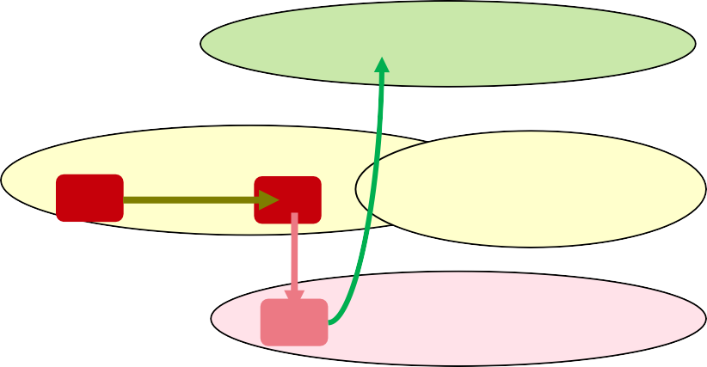
5G Baseline Parameter : MCG Carrier Management
Flexible Anchoring with more chances for SgNB Addition
MML Object | Parameter ID | Default Value | G Baseline | Remarks
NsaDcMgmtConfig | PERIODIC_PCC_ANCHORING_SW | Off | On | ON=Enable Periodic NSA DC PCC anchoring
NsaDcMgmtConfig | NSA_DC_STATE_PCC_ANCHORING_SW | On | On | ON =NSA DC PCC anchoring can be triggered for UEs in the NSA DC state
NsaDcMgmtConfig | ScgAdditionInterval | 60s | 10s | 10s=Shorten the Interval Time for scenarios : Anchor Cell attempting to add NR SCG Trigger PCC Anchoring for an NSA UE If NR SCG addition failed, eNodeB will retry again after this period **Drawback: Smaller Value, will have more measurements
With the Periodic PCC Anchoring Switch, ScgAdditionInterval configured,
After NSA UE moves from Point 1 to 2 (Anchor Area), NSA UE will be able to handover to Point 3 and proceed SgNB Addition
Before that, without Periodic Switch, After NSA UE moves from Point 1 to 2 (Anchor Area) , NSA UE will not trigger handover to Anchor Cell.
5G
F1 Non Anchor
2
F1 Non Anchor
1
3
F2 NSA Anchor

Slide 125
5G Baseline Parameter : MCG Carrier Management
Anchoring Handover Policy with consider if there is any NR Coverage
During initial 5G rollout, the NR Coverage might not be continuous , therefore there will have scenario that after NSA UE has handover to the Anchor Cell , UE might unable to perform SgNB Addition,
MML Object | Parameter ID | Default Value | G Baseline | Remarks
NsaDcMgmtConfig | NsaDcPccAnchoringPolicy | DEFAULT | BASED_ON_NR_COVERAGE | BASED_ON_NR_COVERAGE= During Anchoring Cell Selection, would also need to consider NR Coverage Condition To fulfil A5 (Anchor Cell)+ B1 (NR Cell), then only will handover to Anchor Cell • DEFAULT=To fulfil A1 (Current Serving Cell)+A5 (Anchor Cell), then only will handover to Anchor Cell
5G
If NSA UE is at the location with NR Coverage, then NSA PCC Anchoring handover will be triggered from Point 1 to 2
Otherwise, If NSA UE is at the location without NR Coverage, then NSA UE will
based on LTE CA PCC Priority to perform Anchoring Selection
This Policy will involves in Initial Access, Coverage Handover, Re establish, PCC Periodic Anchoring , SCG Release
F1 with 20M
Non Anchor Cell
NSA Priority 0
PCC Priority 7
1
F2 with 5M
Anchor Cell
NSA Priority 5
PCC Priority 5
2

Slide 126
5G Baseline Parameter : MCG Carrier Management
MLB Options for NSA UE
NSA UE will only MLB within NSA PCC Anchoring Layer , will not MLB to Non Anchoring Layer
MML Object | Parameter ID | Default Value | Remarks
CellMlbUeSel | NsaDcUeSelectionStrategy | LTE_NSA_DC_FAIR | Random Select either NSA UE or LTE Only UE to MLB
 |  | LTE_UE_PREFERRED | 1.LTE Only UE --> 2. UE has NSA Capability but yet to add SgNB --> 3.NSA UE
 |  | NSA_DC_UE_PREFERRED | 1. UE has NSA Capability --> LTE Only UE
L26 F1/F2/F3
P0
P0
P7 P7 P6
L23 F1/F2
L21 F1
Anchor Cell
LTE UE
MLB Area
L18 F1
Anchor Cell
NSA UE
MLB Area
L7 F1
Anchor Cell
Page 9
SPID 4 SPID 256 SPID 1/2/3
SPID 256

Slide 127
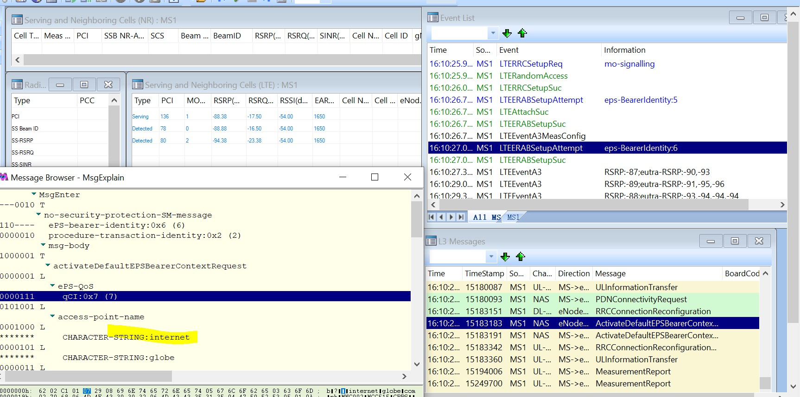
5G Baseline Parameter :
5G Project NSA Default QCI Bearer is 7
Parameter related to NSA Default Bearer would need to align at both LTE and NR Side, otherwise will unable to setup Data on NR.
LTE Side
MOD CELLQCIPARA: LocalCellId=1, Qci=7, NsaDcDefaultBearerMode=SCG_SPLIT_BEARER; MOD QCIPARA: Qci=7, NsaDcRlcPdcpParamGroupId=221;
MOD RLCPDCPPARAGROUP: RlcPdcpParaGroupId=221, RlcMode=RlcMode_AM, AmPdcpSnSize=AmPdcpSnsize_18bits;
NR Side
MOD NRCELLQCIBEARER: NrCellId=351, Qci=7, RlcMode=AM;
MOD GNBRLCPARAMGROUP: RlcParamGroupId=3, RlcMode=AM;
MOD GNBPDCPPARAMGROUP: PdcpParamGroupId=5, DlDataPdcpSplitMode=SCG_ONLY, DlPdcpSnSize=BITS18, UlPdcpSnSize=BITS18, UlDataSplitPrimaryPath=SCG,
UlDataSplitThreshold=INFINITY;
^{Pa}
ge 10
** Alignment is done along with all the Data QCI that is currently use at G Project, which is 6,7,8,9 to prevent sudden QCI Bearer change on Core Side

Slide 128
5G Baseline Parameter :
NR Single User and Multiple User MIMO
Key Parameters related to MIMO and for Throughput improvement
MML Object | Parameter ID | Default Value | G Baseline
NRDUCELLALGOSWITCH | Dl256QamSwitch | OFF | ON
 | Ul256QamSwitch | UL_256QAM_OFF | UL_256QAM_FIXED *Version 19B is not recommended to ON
 | DL_SU_MULTI_LAYER_SW@SuMimoMultipleLayerSw | ON | ON
 | UL_SU_MULTI_LAYER_SW@SuMimoMultipleLayerSw | ON | ON
 | DL_MU_MIMO_SW@MuMimoSwitch | OFF | ON
 | UL_MU_MIMO_SW@MuMimoSwitch | OFF | ON
 | PDCCH_MU_SW@MuMimoSwitch | OFF | ON
NRDUCellPdsch | MaxMimoLayerNum | LAYER_DEFAULT | LAYER_16 (DL)
NRDUCELLPUSCH | MaxMimoLayerCnt | LAYER_2(2 Layers) | LAYER_8 (UL)
NRDUCELLPDCCH | MaxPairLayerNum | LAYER_2 | LAYER_2
** Ensure the related MIMO license are available
Page 11

Slide 129

NSA Baseline Parameter Checking
For NSA Parameter Checking, would require to check on Performance Baseline Parameter and Neighoring for both Anchoring and NR Sides
Type | Detail | Remarks | Parameter
 | LTE Anchor Performance Baseline Parameters | Checked the configuration parameters on the Anchor Side. | NsaDcAlgoSwitch @ NSA_DC_CAPABILITY_SWITCH-1&NSA_PCC_ANCHORING_SWITCH-1 PCCFREQCFG: PccDlEarfcn=1650, NsaPccAnchoringPriority=7; According to the strategy NSADCMGMTCONFIG: LocalCellId=111, NsaDcAlgoSwitch=NSA_DC_CAPABILITY_SWITCH- 1&NSA_PCC_ANCHORING_SWITCH-1&DlDataMcgSplitBearerMode=SCG_ONLY, NsaDcDefaultBearerMode=SCG_SPLIT_BEARER, UlDataSplitThreshold=INFINITY 4.CELLQCIPARA: LocalCellId=111, Qci=7, NsaDcDefaultBearerMode=SCG_SPLIT_BEARER; 5.RLCPDCPPARAGROUP: RlcPdcpParaGroupId=221, RlcMode=RlcMode_AM, AmPdcpSnSize=AmPdcpSnsize_18bits; 9.NRCELLQCIBEARER: NrCellId=351, Qci=6/7/8/9, RlcMode=AM;
Performance Baseline Parameters |  |  | NRDUCELLTRP: NrDuCellTrpId=401, TxRxMode=64T64R, MaxTransmitPower=295; NRDUCELL: NrDuCellId=401, DuplexMode=CELL_TDD, FrequencyBand=N78, SlotAssignment=8_2_DDDSUUDDDD, SlotStructure=SS818 GNODEBPARAM: FrameOffset=0 NRDUCELLALGOSWITCH: NrDuCellId=401, MuMimoSwitch=UL_MU_MIMO_SW-1&PDCCH_MU_SW- 1&DL_MU_MIMO_SW-1, Ul256QamSwitch=UL_256QAM_FIXED, (* UL 256 QAM for Version 19B is not recommended) SuMimoMultipleLayerSw=DL_SU_MULTI_LAYER_SW-1&UL_SU_MULTI_LAYER_SW-1, Dl256QamSwitch=ON; 5.NRCELLALGOSWITCH: NrCellId=401, NsaDcSwitch=ON, InterFreqHoSwitch=COVERAGE_BASED_HO-1; 6.NRDUCELLPDSCH: NrDuCellId=401, MaxMimoLayerNum=LAYER_16 7.NRDUCELLPUSCH: NrDuCellId=401, UlAdditionalDmrsPos=POS1, MaxMimoLayerCnt=LAYER_8 8.GNBPDCPPARAMGROUP: PdcpParamGroupId=5, DlDataPdcpSplitMode=SCG_ONLY, DlPdcpSnSize=BITS18, UlPdcpSnSize=BITS18, UlDataSplitPrimaryPath=SCG, UlDataSplitThreshold=INFINITY;
NR Performance Baseline Parameters |  | Checked the configuration parameters on the NR Side.
NSA 4G->5G Neighboring Cell & X2 |  | Check whether the NSA 4G->5G unidirectional neighboring cell is missing and whether the external cell consistency check is performed based on the topology. X2 interface configuration parameter check | PCC frequency configuration PCCFREQCFG: PccDlEarfcn=1650, NsaPccAnchoringPriority=7; According to the strategy NR neighboring frequency configuration NRNFREQ: LocalCellId=183, DlArfcn=638000; NR DC frequency configuration NRSCGFREQCONFIG: PccDlEarfcn=1650, ScgDlArfcn=638000; External cell configuration NREXTERNALCELL: Mcc="515", Mnc="02", GnodebId=834747, CellId=353, DlArfcn=638000, UlArfcnConfigInd=NOT_CFG, PhyCellId=290, Tac=50028; NR neighboring cell configuration NRNRELATIONSHIP: LOCALCELLID=183, Mcc="515", Mnc="02", GnodebId=834747, CellId=353; GLOBALPROCSWITCH: InterfaceSetupPolicySw=LTE_NR_X2_SON_SETUP_SW-1;
Neighboring Cell & X2
NSA 4G<->4G neighboring cell |  | Check the missing neighboring cell configuration, invalid neighboring cell check, and external parameter consistency of the NSA 4G<->4G neighboring cell. | ANR
NSA 5G<->5G neighboring cell |  | Check the missing neighboring cell configuration, invalid neighboring cell check, and external parameter consistency of the 5G<->5G neighboring cell. | NREXTERNALNCELL: Mcc="515", Mnc="02", gNBId=837551, CellId=352, PhysicalCellId=174, RanNotificationAreaId=65535, Tac=50010, SsbFreqPos=638000; _{Page 12} NRCELLRELATION: NrCellId=352, Mcc="515", Mnc="02", gNBId=837551, CellId=352;

Slide 130
NSA DC SgNB Evaluation for Service Integrity and Traffic
Category | KPI Name | KPI Formula
Availability | NR Cell Unavailable Duration (s) | N.Cell.Unavail.Dur.System + N.Cell.Unavail.Dur.Manual
Service Integrity | NR User DL Average Throughput (Mbps) | ((N.ThpVol.DL - N.ThpVol.DL.LastSlot)/N.ThpTime.DL.RmvLastSlot)*1000
Service Integrity | NR User UL Average Throughput (Mbps) | ((N.ThpVol.UL- N.ThpVol.UE.UL.SmallPkt)/N.ThpTime.UE.UL.RmvSmallPkt)*1000
Service Integrity | NR Cell DL Average Throughput (Mbps) | (N.ThpVol.DL.Cell/N.ThpTime.DL.Cell)*1000
Service Integrity | NR Cell UL Average Throughput (Mbps) | (N.ThpVol.UL.Cell/N.ThpTime.UL.Cell)*1000
Traffic | N.User.NsaDc.PSCell.Avg | N.User.NsaDc.PSCell.Avg
Traffic | N.User.RRCConn.Max | N.User.RRCConn.Max
Traffic | N.User.RRCConn.Avg | N.User.RRCConn.Avg
Traffic | NR DL Traffic Volume (GB) | (N.ThpVol.DL)/8/1024/1024
Traffic | NR UL Traffic Volume (GB) | (N.ThpVol.UL)/8/1024/1024
Traffic | NR Avg RRC DL Active User Number | N.User.RRCConn.Active.DL.Avg
Traffic | NR Max RRC DL Active User Number | N.User.RRCConn.Active.DL.Max
Traffic | NR Avg RRC UL Active User Number | N.User.RRCConn.Active.UL.Avg
Traffic | NR Max RRC UL Active User Number | N.User.RRCConn.Active.UL.Max
Traffic Volume for Data Split | NR Total DL Data Volume Split over X2 (Mbit) | N.PDCP.Vol.DL.X2U.TrfPDU.Tx /1000
Traffic Volume for Data Split | NR Total UL Data Volume Split Over X2 (Mbit) | N.PDCP.Vol.UL.X2U.TrfPDU.Rx/1000

Slide 131
NSA DC SgNB Evaluation for Capacity
Resource Type | Resource Monitoring Indicator | Resource Meaning | KPI Formula
Cell | PRB Usage | Physical channel bandwidth over the air interface | NR DL PRB Utilization (%) =(N.PRB.DL.Used.Avg/N.PRB.DL.Avail.Avg）× 100% NR UL PRB Utilization (%)=(N.PRB.UL.Used.Avg/N.PRB.UL.Avail.Avg）× 100%
 | User Capacity Usage | Number of users in RRC_CONNECTED mode | NSA N.User.NsaDc.PSCell.Avg
 | PDCCH Resource Usage | PDCCH resources | CCE usage = N.CCE.Used.Avg/N.CCE.Avail.Avg x 100%
gNodeB | Paging Resource Usage | Paging capability of a gNodeB | NSA Paging messages are delivered through the LTE network. Therefore, the paging resource usage of the LTE network is used.
 | Main Control Board CPU Usage | Processing capability of the main control board of a gNodeB | Average CPU usage: VS.BBUBoard.CPULoad.Mean
 | BBP CPU Usage | Processing capability of the BBP of a gNodeB | Control-plane CPU usage Average control-plane CPU usage: VS.BBUBoard.CPULoad.Mean Percentage of times the control-plane CPU usage exceeds a preconfigured threshold: VS.BBUBoard.CPULoad.Over User-plane CPU usage Average user-plane CPU usage: VS.NRBoard.UPlane.CPULoad.Avg

Slide 132
Module 4: Alarms and Troubleshooting

Slide 133
What 3GPP Does Standardize: The Alarm Model
KPI Category | Common 3GPP probableCause Values
Accessibility | resourceUnavailable, underlyingResourceUnavailable, lossOfSignal, softwareError, configurationOrCustomizationError
Retainability | lossOfSignal (Radio Link Failure), linkFailure (Transport), qoSUnattainable, thresholdCrossed (e.g., high interference)
Mobility | linkFailure (for Xn interface), handoverFailure, configurationOrCustomizationError (Missing neighbor)
Throughput | thresholdCrossed (High Interference, High PRB usage), qoSUnattainable, degradedSignal, transmitFailure

Slide 134
Alarms Affecting 5G NR Accessibility KPI
Alarm Group / Type | Specific Alarms from Your List (Examples) | Key MO Class(es) | Impact Explanation
Cell/Carrier Unavailability | Service Unavailable,MO Configuration Exceeds Resources...,Resource Configuration Failure,Configuration Requires Feature Activation,ESS Service Unavailable | NRCellDU | Direct Impact: The cell is not operational and cannot broadcast system information or respond to access requests. This is the most severe cause of accessibility failure.
Transport & Interface Failure | F1C Link to GNBCUCP Failure,GNBCUCP Service Unavailable,Default AMF PLMN Service Unavailable,XnC Link to GNodeB Failure (Impacts NSA setup) | GNBDUFunction,GNBCUCPFunction | Direct Impact: The gNB-DU cannot communicate with the gNB-CU, or the gNB-CU cannot communicate with the AMF in the core network. No new user sessions can be authenticated or set up.
Synchronization Failure | Synchronization Lost,Sync PTP Time Availability Fault,Radio Clock Service in Time Holdover Mode,Calendar Clock Misaligned | FieldReplaceableUnit,RadioEquipmentClock...,NRSynchronization | Direct Impact: A cell without a stable timing reference cannot transmit correctly or at all. It is effectively offline, leading to total accessibility failure for that cell.
Admission Control / Licensing | Licensed Capacity Exceeded,License Key Not Available,MO Configuration Exceeds Resources Enabled by the Key | FeatureState,NRCellDU | Direct Impact: The gNB is operational but actively rejects new users because a software or hardware capacity license limit has been reached.
Hardware Fault | No Connection,HW Fault,Missing SXU | FieldReplaceableUnit,PlugInModule | Direct Impact: The physical hardware (baseband or radio unit) required to operate the cell has failed. The cell cannot be brought into service.

Slide 135
Alarms Affecting 5G NR Retainability KPI
Alarm Group / Type | Specific Alarms from Your List (Examples) | Key MO Class(es) | Impact Explanation
RF Quality & Interference | VSWR Over Threshold,RF Reflected Power High,PIM Desense Over Threshold | RfPort | Direct Impact: High VSWR indicates a problem with the antenna line (cable, connector, antenna). PIM is a form of self-interference. Both degrade the SINR, leading to radio link failures and dropped calls.
Hardware & RF Path Failures | HW Fault,HW Partial Fault<brLinearization Disturbance Performance Degraded,Link Failure / Link Degraded | FieldReplaceableUnit,RiLink (CPRI/eCPRI) | Direct Impact: A fault in the radio unit, baseband, or the optical link (RiLink) connecting them will cause instability or failure, immediately dropping all active sessions on that hardware.
Cell Restart / "Sleeping Cell" | Suspected Sleeping Cell,SW Error,System Restart Alert,Radio Restart Alert | EUtranCellFDD/TDD,NRCellDU,ManagedElement | Direct Impact: A "sleeping cell" transmits a signal but doesn't process user traffic, causing drops. A software error forcing a cell or node restart will drop all active connections.
Unstable Transport | Ethernet Link Failure (if flapping),Aggregated Ethernet Link Failure,IKE Peer Not Reachable (for IPsec) | EthernetPort,LagPort,Ikev2Session | Indirect Impact: An unstable or "flapping" backhaul connection causes high packet loss and latency. This makes the gNB lose contact with the UPF, causing timers to expire and sessions to be dropped.

Slide 136
Alarms Affecting 5G NR Mobility KPI
Alarm Group / Type | Specific Alarms from Your List (Examples) | Key MO Class(es) | Impact Explanation
Inter-gNB Link (Xn) Failure | XnC Link to GNodeB Failure | GNBCUCPFunction | Direct Impact: This is the most critical alarm for inter-gNB mobility. The Xn control plane link between two gNBs is down, making handovers between them impossible.
Target Cell Unavailability | Service Unavailable,Resource Allocation Failure,Licensed Capacity Exceeded | NRCellDU (on the target cell) | Direct Impact: The source gNB commands a UE to hand over to a target cell that is down, locked, or has no free resources. The handover preparation or execution will fail.
Feature Incompatibility | Inter Node Feature Incompatibility,Inconsistent Configuration | ExternalENodeBFunction,NRCellDU | Indirect Impact: The source and target cells have conflicting feature sets or parameters, preventing a successful handover.
Inter-Node CA/DC Failure | Inter Node Carrier Aggregation Service Unavailable | ExtGNBDUPartnerFunction | Direct Impact: This specifically affects Dual Connectivity (EN-DC, NE-DC) or Inter-Node Carrier Aggregation setup, which is a form of mobility procedure. Failure to add the secondary cell impacts this KPI.

Slide 137
Alarms Affecting 5G NR Throughput KPI
Alarm Group / Type | Specific Alarms from Your List (Examples) | Key MO Class(es) | Impact Explanation
RF Quality & Performance | VSWR Over Threshold,PIM Desense Over Threshold,Antenna Calibration DL/UL Failure,ESS Service Degraded | RfPort,NRSectorCarrier | Direct Impact: Poor RF quality (high reflections, interference) lowers the SINR. The gNB is forced to use a more robust but less efficient Modulation and Coding Scheme (MCS), which directly reduces data throughput. Failed calibration leads to suboptimal beamforming.
Resource & Feature Limitations | Carrier Control All Resources Allocated to Other RAT,Power Saving Capacity Limit Exceeded,Resource Allocation Failure Service Degraded | NRSectorCarrier,SectorCarrier | Direct Impact: Fewer resources (PRBs) are available for 5G users, either because they are shared with LTE or limited by power-saving features. This reduces the total cell throughput and the average user throughput.
Hardware Degradation | HW Partial Fault,Linearization Disturbance Performance Degraded,RX Diversity Lost | FieldReplaceableUnit,AntennaUnitGroup | Direct Impact: The hardware is not fully failed but is operating in a degraded state (e.g., reduced power, one of two RX paths failed). This shrinks the high-SINR, high-throughput coverage area of the cell. Loss of diversity is particularly harmful to UL throughput.
Transport Bottleneck | Ethernet Link Failure,Aggregated Ethernet Link Failure | EthernetPort,LagPort | Indirect Impact: If a gNB with multiple backhaul links loses one, the remaining link may become a bottleneck. The radio link may be capable of 2 Gbps, but if the backhaul is congested at 500 Mbps, user throughput will be capped.

Slide 138
Thanks

